Slide 1
CSC 555
Mining Big Data
Lecture 8
Alexander Rasin
College of CDM, DePaul University
February 27th, 2019

Slide 2
Tonight
Page Rank
Clustering and Mahout
Streaming databases/Storm

Slide 3
HBase Example
Create/populate a table:
    create 'test', 'cfam'
    list 'test'
    put 'test', 'row1', 'cfam:a', 'value1'
    put 'test', 'row2', 'cfam:b', 'value2'
    put 'test', 'row3', 'cfam:c', 'value3'
    put 'test', 'row5', 'cfam:a', 'value4'
    put 'test', 'row3', 'cfam:b', 'value5'
    scan 'test'
Notes:
http://rasinsrv07.cstcis.cti.depaul.edu/CSC555/hbase-0.90.3.tar.gz
bin/start-hbase.sh

Slide 4
Uses of HBase
    put 'test', 'row1', 'cfam:z', 'value6'
    put 'test', 'row5', 'cfam:z', 'value7'
    put 'test', 'row6', 'cfam:z', 'value8'
    scan 'test', {COLUMNS => 'cfam:c'}
    scan 'test', {STARTROW => 'row3'}
    put 'test', 'row3', 'cfam:b', 'newValue5'
    scan 'test', {COLUMNS => 'cfam:b'}
    scan 'test', {TIMERANGE=>[a, b]}

Slide 5
Hadoop streaming/Hive Transform
Source vs Target columns
Delimiter for data
  Hive vs Hadoop streaming
-file option/jar file

Slide 6
Link Analysis
Web search
Link spamming
  Search engine optimization (SEO)

Slide 7
Early Web Searches
Crawl the web
Find the search terms
  Scan collected web-page snapshots
  Inverted index
Weight the terms accordingly
  Header = more important
  Frequently used = more important

Slide 8
Inverted Index
Search term location
For popular term record
  Locations where it was found
  One-time pre-computation (needs updating)
Intersect these locations for several terms
Rank the selected results

Slide 9

Gaming the System
Term spamming
  Add Hadoop to header
  Add Hadoop 1000 times
  Hide words in background
Add related terms
  Search for Hadoop
  Copy the pages that come up first

Slide 10
The Google Solution
Find the “important” pages
  Random walk the web
    Start anywhere
    Follow random links
    See where you end up
  Cannot count the # of links instead…
Do not trust the (destination) page
  Rely on terms in the linking page
  Source page outside of destination control

Slide 11
Page Rank
Ignore the terms on the page
Only trust others to define your page
Ignore link farms
  Link farms are a closed system
Web traffic indicative of page popularity
Links indicative of page relevance

Slide 12
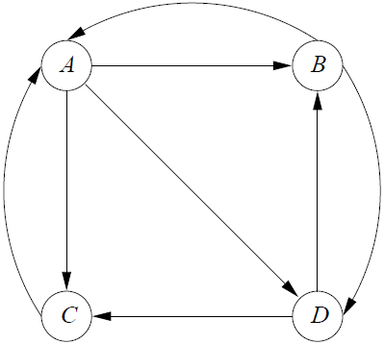
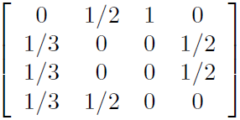
Definiton of PageRank
Imagine this is the web
  Assume random walk
  From A -> 3 places
  From B -> 2 places
  …
Define a transition matrix
A
B
C
D
A B C D

Slide 13
Surfer Probability Distribution
Randomly placed surfer [1/n, 1/n, … 1/n]
  [¼, ¼, ¼, ¼] for our example
To compute probability distribution
  Multiply the transition matrix by vector
1/41/4
1/4
1/4
3/8
5/24
5/24
5/24

Slide 14
Probability Distribution
Probability distribution after 2 steps
  M * M * v = M² * v
Eventually converge
  Strongly connected graph
  No dead ends
In practice – 50 to 75 iterations
In reality starting probability not equal

Slide 15
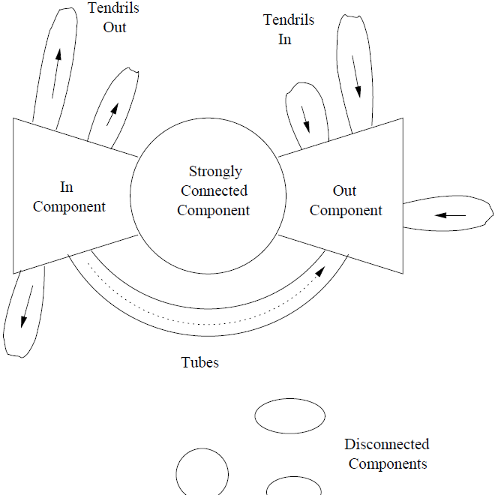

Structure of the Web
InC => SCC/OutC
SCC => OutC
Dead ends
  0% to leave
Spider traps

Slide 16
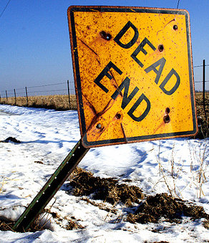
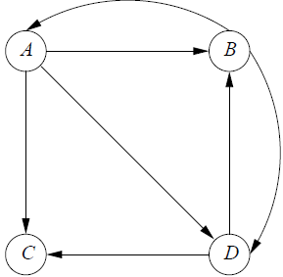
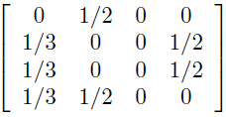
Avoiding Dead Ends
Node C = dead end
Matrix multiplication
  Converges to [0, 0, 0, 0]
  C linked to itself? (spider trap)
Solution?
  Drop dead end nodes

Slide 17
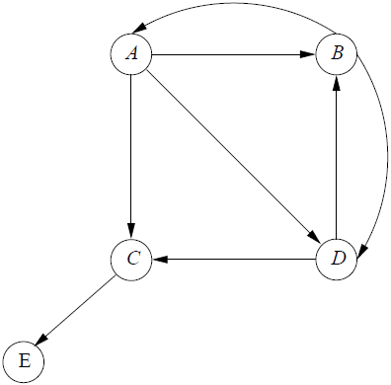


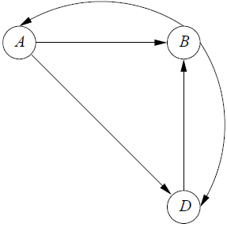


Dropping Dead Ends
A
B
D
C
PageRank C = 1/3 * 2/9 + 0 * 4/9 + 1/2 * 3/9

Slide 18
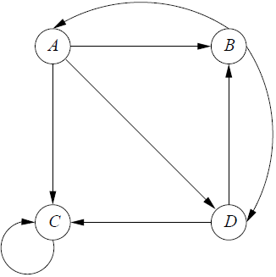
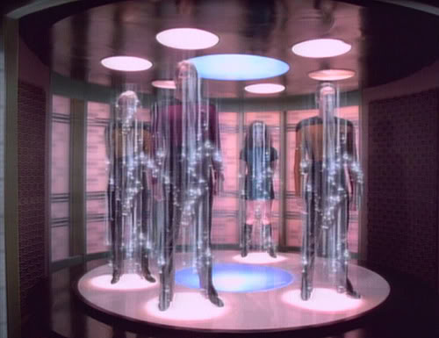
Spider Traps
PageRank converges to
Solution?
0
0
10
Random jump from any node to any node
  Small probability
With dead ends, total PageRank < 1

Slide 19
PageRank Computation
Google’s secret formula
Select pages with search terms
Apply PageRank
  Filter out unrelated/spam results
  Apply your preferences (Google+, gmail)
  Weight by topic?
PageRank is just one of the components

Slide 20

A Break

Slide 21
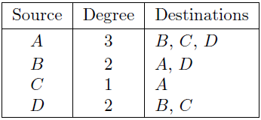
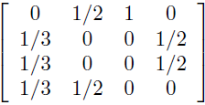
PageRank and MapReduce
Matrix multiplication
Transition matrix is (usually) sparse
  Average page has ~10 out links
  Operate on non-zero elements
Graph representation

Slide 22
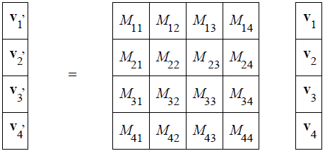
PageRank and MapReduce
Stripe the vector v (to fit in memory)
Partition the matrix into blocks
  k² map tasks
  Vector stripes sent across the network

Slide 23
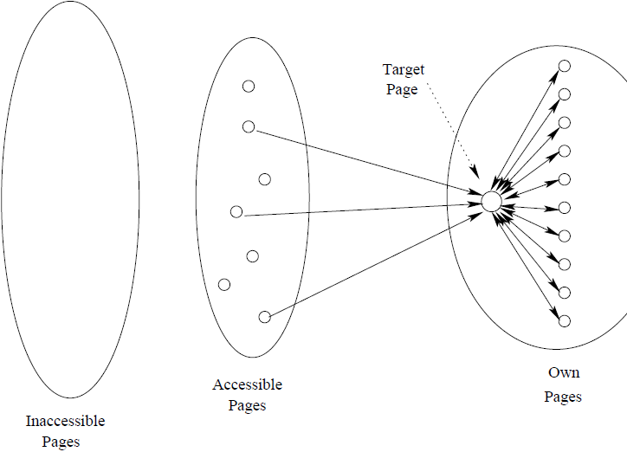
LinkSpam
Inaccessible pages
Accessible pages
Owned pages

Slide 24
Dealing with LinkFarms
TrustRank
  Topic-sensitive set of pages that is “trustworthy”
  Cannot be spam-able (blogs, etc.)
  Human selected
    Pages
    Domains
Spam Mass
  (PageRank – TrustRank)/PageRank
  Negative/small values => likely ok

Slide 25
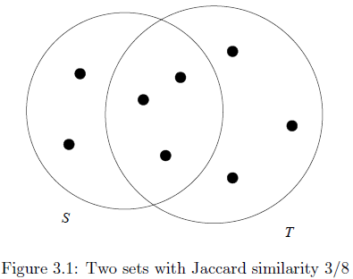
Jaccard Similarity
Ratio between
  Intersection of two sets and
  Union of two sets
Intuitive tests
  Similarity S <> S is 1
  Similarity S <> T with zero overlap is 0
  Otherwise similarity is between 0 and 1

Slide 26

Distance Properties
Dist(x, y) >= 0
Dist(x, y) = 0 iff x=y
Dist(x,y) = Dist(y, x)
Dist(x,y) <= Dist(x,z) + Dist(z, y)
Euclidean Distance

Slide 27
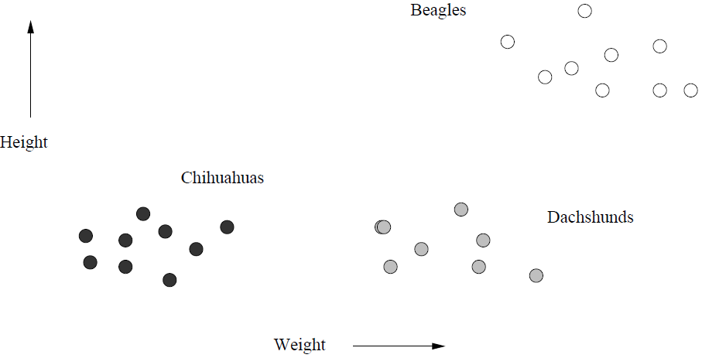
Clustering
Set of elements in space
Group in clusters or categories
Distance
Notes:
2:07:15

Slide 28
Hierarchical Clustering
Start from 1 point => 1 cluster
Apply pairwise merging
  Simpler distance measure requirements
Stop condition
  k # of clusters, cluster too large, etc.
No back-tracking

Slide 29

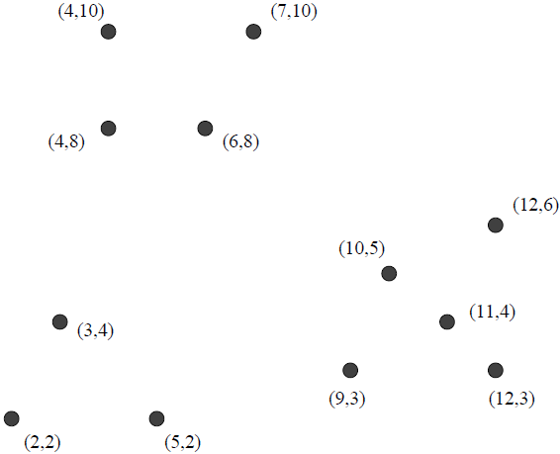
Hierarchical Clustering

Slide 30
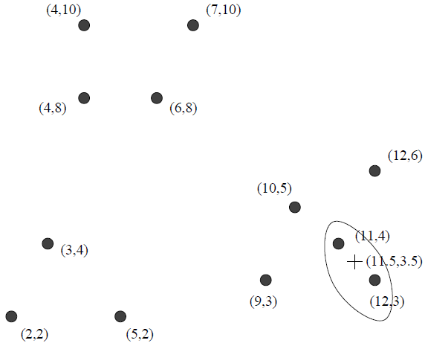
Hierarchical Clustering

Slide 31
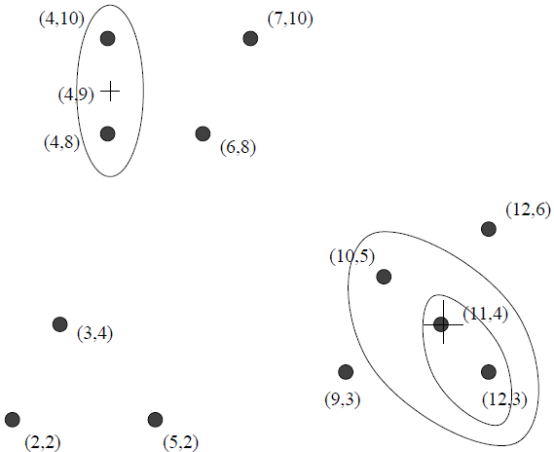
Hierarchical Clustering

Slide 32
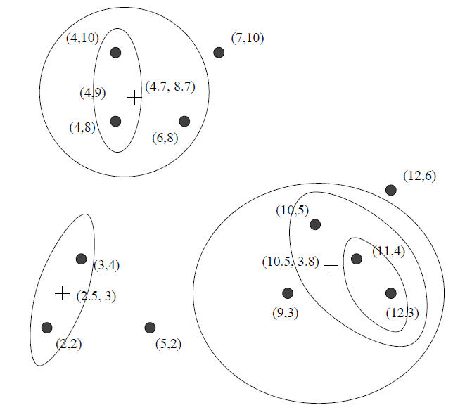
Hierarchical Clustering

Slide 33
Merging Materialized Views:
Hierarchical Query Clustering
MV_{1,2,3,4}
Q₁, Q₂ , Q₃,, Q₄
Q₁, Q₂ , Q₄
MV_{1,2,4}
Use a
distance function
based on
predicate
selectivity
Q₁, Q₂
MV_{1,2}
Q₁
Q₂
Q₃
Q₄

Slide 34
Selectivity Vector for a SQL Query
SELECT SUM(revenue)
FROM lineorder, dwdate, part, supplier
WHERE … category = ‘MFGR#12’
AND nation = ‘CANADA’ AND year = 1997;
(category : 0.27, nation : 0.20, year : 0.14)

Slide 35
K-Means Clustering
Choose an initial set of centers
  Well distributed (likely in different clusters)
  Converges*
Assign every point to the closest centroid
Find the new centroids
Repeat
  N steps
  Or until converges

Slide 36
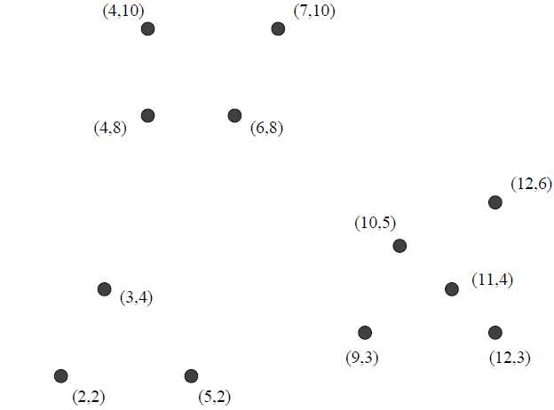
K-Means Clustering
What is the best value for k?

Slide 37

Mahout
Machine learning library
Community contribution
Provides a number of algorithms
  Clustering
    K-Means, Fuzzy K-Means, …
  Recommenders
    User and item based recommenders
  Classifiers
Runs on top of Hadoop/Spark/etc.

Slide 38
K-Means Clustering
http://his.anthropomatik.kit.edu/users/loesch/LaborWissRepr-DHBW-KA-2010SS/Clustering_K-means_demo.html

Slide 39
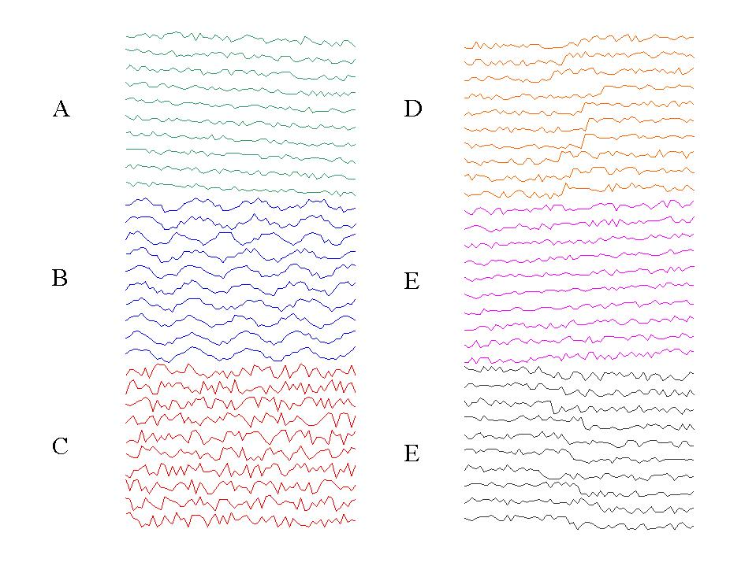
Mahout Example
600 items
6 categories
Notes:
Image courtesy of Eamonn Keogh.
wget http://rasinsrv07.cstcis.cti.depaul.edu/CSC555/apache-mahout-distribution-0.11.2.zip
export MAHOUT_HOME=/home/ec2-user/apache-mahout-distribution-0.11.2
export PATH=/home/ec2-user/apache-mahout-distribution-0.11.2/bin:$PATH

Slide 40
Example KMeans Run
$MAHOUT_HOME/bin/mahout org.apache.mahout.clustering.syntheticcontrol.kmeans.Job
Defaults – testdata, Euclidian vector dist, 10 iterations
KMeans Mapper
  Assign the point to nearest cluster
KMeansCombiner
  Partially aggregate the points towards the new centroid
KMeansReducer
  Receive all keys and compute the new cluster centroid
KMeansDriver – iterate n times (or converge)
Notes:
$MAHOUT_HOME/bin/mahout clusterdump --input output/clusters-10-final --pointsDir output/clusteredPoints --output clust_result.txt
export MAHOUT_HOME=/home/ec2-user/mahout/
time mahout org.apache.mahout.clustering.syntheticcontrol.kmeans.Job

Slide 41
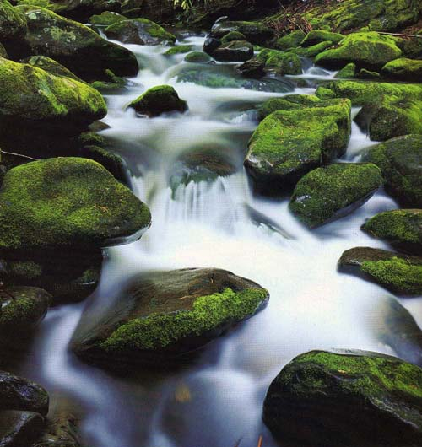
Streaming Database Engines

Slide 42
Data-Stream Management
Traditional DBMS
  Data stored in finite, persistent data sets
Data streams
  Distributed, continuous, unbounded, time-varying
Data-Stream Management
  Network monitoring
  Data security
  Sensor network
  Financial applications

Slide 43
Streaming Data
Types of data (infinite)
  Sensor data
  Stock market quotes
  Network monitoring data
Types of queries
  One pass (cannot rewind or store)
  Report last day average
  Report changes in sensor data
  Collect information about single user

Slide 44
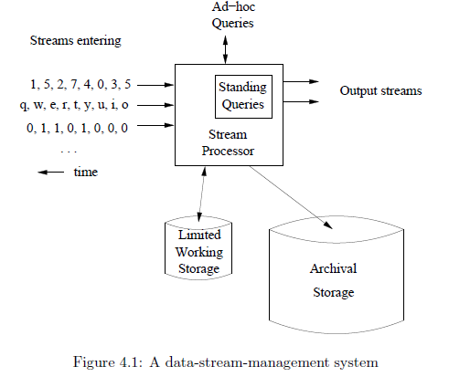
Data-stream-management System

Slide 45
Stream Processing
U
Σ
μ
Data
Sources
Client
Apps
U
μ
Σ
Data sources push tuples continuously
Operators process windows of tuples

Slide 46
Examples
Ocean temperature sensors
  GPS+temperature every 1/10 second (3.5MB)
  More sensors (x1000, or x1000000)
Image data
  London has millions cameras
Internet monitoring
  Intruder alert
  Any activity spike, traffic

Slide 47
Operations
Filter the stream
  E.g., select (temperature > 100)
Aggregate the stream
  # of cars entered the garage
    Window (per-hour? Over last hour?)
Join two streams
  Match “buy” and “sell” offers

Slide 48
Distributed Stream Processing
Node 1
Node 2
U
Σ
μ
Data
Sources
Client
Apps
Node 3
Node 4
U
μ
Σ
Data sources push tuples continuously
Operators process windows of tuples

Slide 49
Fault-Tolerance through Replication
Goal: Tolerate node and network failures
Node 3
U
μ
s₃
Node 1
Node 2
U
Σ
μ
s₁
s₂
s₄
Node 1’
Node 2’
U
Σ
μ
Node 3’
U
μ
s₃’

Slide 50
Load Shedding
Goal:
Minimize
total loss
Node A
Node B
r₁
4C
r₂’
C
25%
r₂
App₁
r₁
C
r₂
3C
58%
App₂
CPU Load = 5Cr₁, Cap = 4Cr₁
CPU Load = 4Cr₂, Cap = 2Cr₂
No overload
CPU Load = 3.75Cr₂, Cap = 2Cr₂
No overload
A must shed 20%
B must shed 50%
A must shed 20%
A must shed 20%
B must shed 47%
Plan | Loss
Local | App₁: 25% App₂: 58%

Slide 51
Running Storm
Submit "topologies"
  WordCountTopology.java
Spouts / Bolts
Can use any language
Notes:
http://www.haroldnguyen.com/blog/2015/01/setting-up-storm-and-running-your-first-topology/
/home/ec2-user/apache-storm-0.9.2-incubating/examples/storm-starter
~/apache-maven-3.2.3/bin/mvn compile exec:java -Dstorm.topology=storm.starter.WordCountTopology
RandomSentenceSpout
WordCountTopology
Splitsentence

