Slide 1
Project: Kaggle Competition and XGBoost
Dennis J. Zhang
Washington University in St. Louis

Slide 2
Influence in Social Networks
Data Science London and the UK Windows Azure Users Group in partnership with Microsoft and Peerindex, announce the Influencers in Social Networks competition as part of The Big Data Hackathon. This competition asks you to predict human judgements about who is more influential on social media.
The dataset, provided by Peerindex, comprises a standard, pair-wise preference learning task. Each datapoint describes two individuals, A and B. For each person, 11 pre-computed, non-negative numeric features based on twitter activity (such as volume of interactions, number of followers, etc) are provided.
The binary label represents a human judgement about which one of the two individuals is more influential. A label '1' means A is more influential than B. 0 means B is more influential than A. The goal of the challenge is to train a machine learning model which, for pairs of individuals, predicts the human judgement on who is more influential with high accuracy.

Slide 3
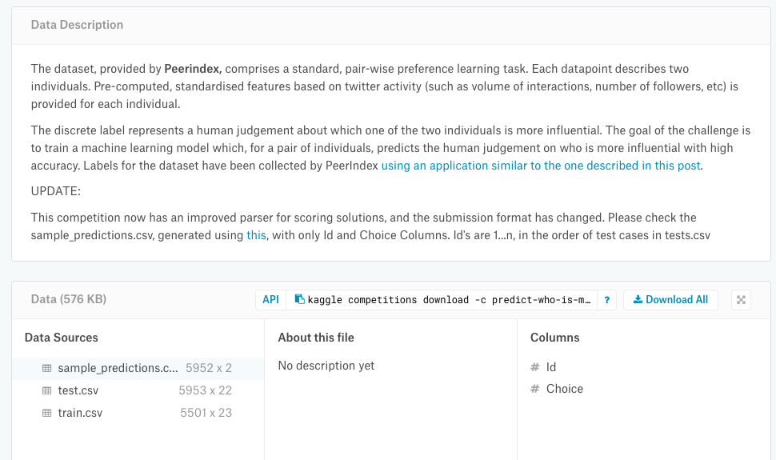
Influence in Social Networks
Website: https://www.kaggle.com/c/predict-who-is-more-influential-in-a-social-network
You need to register on Kaggle to compete.

Slide 4
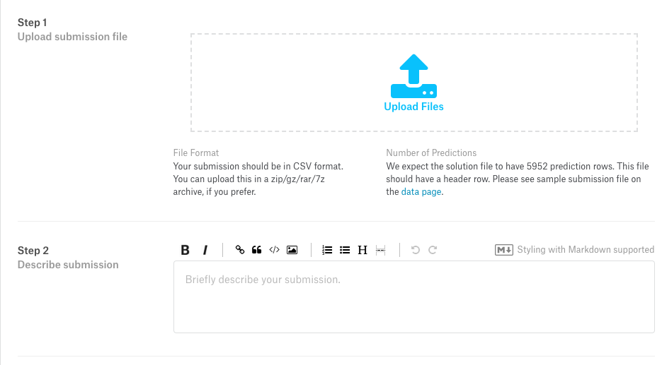
Influence in Social Networks
You also need to submit your solution to Kaggle to see your ranking in the match.

