Slide 1

Module 1.3: Intro to Python/Jupyter -- Python Functions
Dennis J. Zhang
Washington University in St. Louis

Slide 2
Functions
Why functions?
Maximize code reuse and minimize redundancy
Procedural decomposition
Break bit task into smaller tasks
Makes code less buggy – can test each function individually

Slide 3
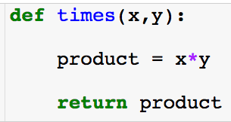
Functions
Create function (required)
Function inputs: here there are two and order matters. (required)
Inside the function (local scope)
Object that function gives back. (optional)
The code inside the function is never executed unless you call the function!

Slide 4
Scope
Python scopes are the places where variables are defined and looked up.
Local Scope
Variables created with a function, i.e., inside of a def.
Variables inside of a def will not clash with variables outside even if they have the same name.
Global Scope
Variable created outside of a function.
When inside of a function, python first searches the local scope and then searches the global.

Slide 5
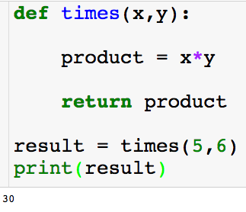
Scope
Local scope:
Global scope:

Slide 6
Scope
Local scope:
Global scope:

Slide 7
Scope
Local scope:
Global scope:

Slide 8
Scope
Local scope:
Global scope:

Slide 9
Scope
Local scope:
Global scope:

Slide 10
Scope
Local scope:
Global scope:

Slide 11
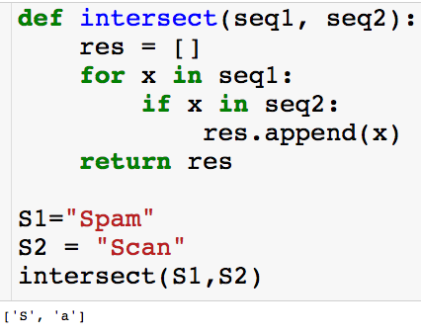
Scope
Local scope:
Global scope:

Slide 12
Scope
Local scope:
Global scope:

Slide 13
Scope
Local scope:
Global scope:

Slide 14
Scope
Local scope:
Global scope:

Slide 15
Scope
Local scope:
Global scope:

Slide 16
Scope
Local scope:
Global scope:

Slide 17
Scope
Local scope:
Global scope:

Slide 18
Scope
Local scope:
Global scope:

Slide 19
Scope
Local scope:
Global scope:

Slide 20
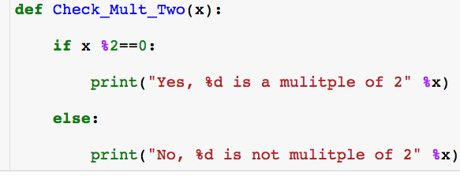

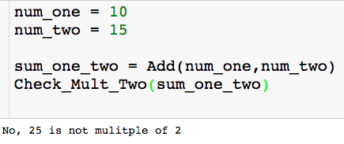
Stringing Functions Together

Slide 21
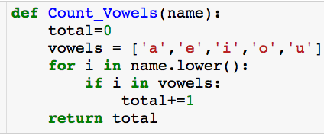
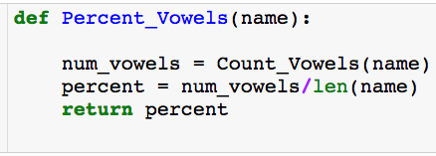

Nested Functions
Count number of vowels in name
Computes percentage of vowels in name

Slide 22
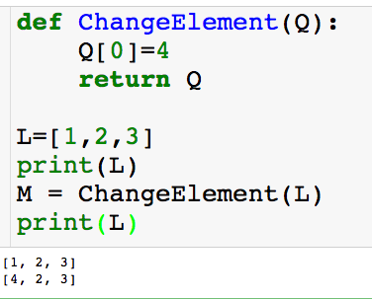
Back to Scope
Local scope:
Global scope:

Slide 23
Back to Scope
Local scope:
Global scope:

Slide 24
Back to Scope
Local scope:
Global scope:

Slide 25
Back to Scope
Local scope:
Global scope:

Slide 26
Back to Scope
Local scope:
Global scope:
Also will change L…huh???

Slide 27
Back to Scope
Local scope:
Global scope:

Slide 28
Back to Scope
Local scope:
Global scope:

Slide 29
Back to Scope
Local scope:
Global scope:

Slide 30

Variable Assignment
a “points” to 3

Slide 31
Variable Assignment

Slide 32

Variable Assignment

Slide 33
Variable Assignment
Anytime you set a variable equal to a new object, its pointer will now point to the new object.

Slide 34
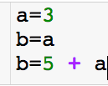
Variable Assignment

Slide 35
Variable Assignment

Slide 36
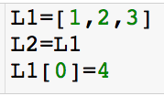
Variable Assignment

Slide 37
Variable Assignment

Slide 38
Variable Assignment

Slide 39
Variable Assignment
Both L1 and L2 are changed! Next, we’ll see how to correctly copy L1.

Slide 40
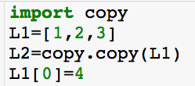
Variable Assignment

Slide 41
Variable Assignment

Slide 42
Variable Assignment

Slide 43
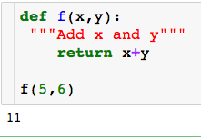
Lambda Functions
Lambda function allows us to create simple function in one line without a def.

Slide 44
Lambda Functions
Lambda function allows us to create simple function in one line without a def.
Let’s see how we can use a lambda function to do the same thing

Slide 45
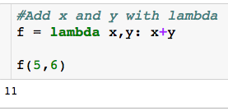
Lambda Functions
Lambda function allows us to create simple function in one line without a def.
Let’s see how we can use a lambda function to do the same thing

Slide 46

Lambda Functions
Dissecting the lambda function:
All lambda function begin by typing lambda

Slide 47
Lambda Functions
Dissecting the lambda function:
All lambda function begin by typing lambda
Function inputs, there can arbitrarily many

Slide 48
Lambda Functions
Dissecting the lambda function:
All lambda function begin by typing lambda
What to return
Function inputs, there can arbitrarily many

Slide 49
Lambda Functions
Dissecting the lambda function:
All lambda function begin by typing lambda
Give function a name so we can use it
What to return
Function inputs, there can arbitrarily many

Slide 50
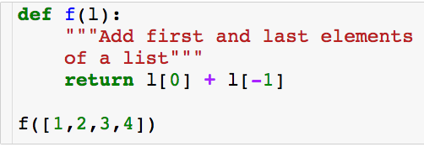
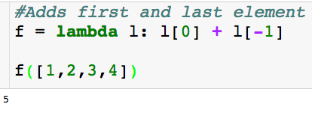
Lambda Functions
Another example:
Lambda function:

Slide 51
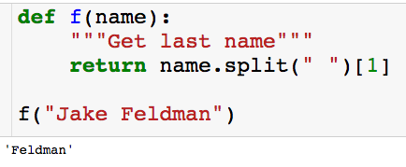
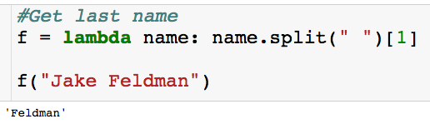
Lambda Functions
Another example:
Lambda function:

Slide 52
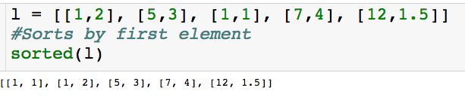
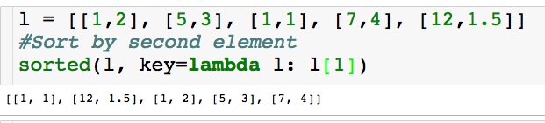
Uses of Lambda Functions
Can uses lamba functions as input to key in sorted function:
Lambda function takes list and returns the second element
With the key parameter you can specify a function to be called on each list element prior to making comparisons. The value of the key parameter should be a function that takes a single argument and returns a key to use for sorting purposes.

Slide 53
Uses of Lambda Functions
Can uses lamba functions as input to key in sorted function:
Lambda function takes list and returns the second element
With the key parameter you can specify a function to be called on each list element prior to making comparisons. The value of the key parameter should be a function that takes a single argument and returns a key to use for sorting purposes.

