Slide 1

Module 1.1: Intro to Python/Jupyter -- Python Objects and Methods
Dennis J. Zhang
Washington University in St. Louis

Slide 2
Python Objects
Variables are simply names that are used to keep track of information.
Variables are created when they are first assigned a value.
Variables must be assigned before they can be used.
Variables will take the form of Python objects. We will use 3 different objects:
Numbers: integers, real number, etc …
Strings: ordered sequences of characters
Lists: ordered collection of objects
Dictionary: paired objects
Tuples: Immutable lists
All of the data we look at will take the form of numbers and strings.

Slide 3
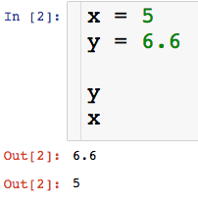
Creating Variables
Let’s create our first variables
Code cell
Order in which cells have been run
Output, we get this by typing variable names
A couple of things about Jupyter

Slide 4
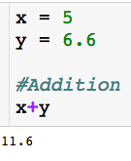
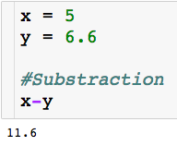
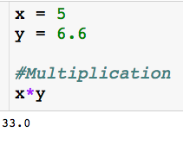
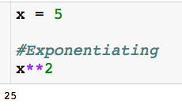
Arithmetic Operations

Slide 5
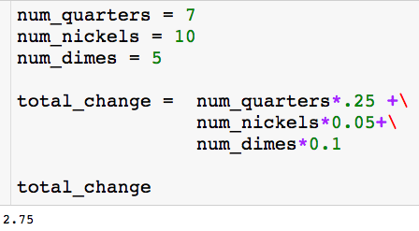
Using Variables
Use description variable name
I can create variables that are a function of other variables
The backslash lets you continue your block of code on the next line.

Slide 6
Booleans
The Boolean type can be viewed as numeric in nature because its values (True and False) are just customized versions of the integers 1 and 0.
The True and False behave in the same way as 1 and 0, they just make the code more readable.
Let us check if specified conditions are true

Slide 7
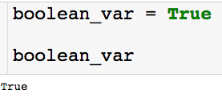

Booleans
Creating boolean variable:
Note that the boolean does behave exactly like a 1:

Slide 8



Conditional Tests
Sets the variables x equal to 5.
Asks if x is equal to 5. Returns boolean.
Asks if x is less than or equal to 4. Returns boolean.

Slide 9
Strings
Python strings are an ordered collection of characters (usually these characters will be letters and numbers) used to represent text.
String are created by placing single or double quotation marks around a sequence of characters.
Strings support the following operations
concatenation (combining strings)
slicing (extracting sections)
Indexing (fetching by offset)
the list goes on ….

Slide 10

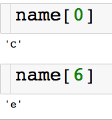
Indexing Strings
We can access the characters of the string through their index
Slicing single characters through e index:
(pretend there aren’t spaces between the letters)

Slide 11

Slicing Strings
We can access the characters of the string through their index
Slicing contiguous characters:
(pretend there aren’t spaces between the letters)
start
finish (non-inclusive)

Slide 12
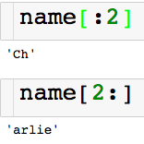
Slicing Strings
We can access the characters of the string through their index
Slicing contiguous characters:
(pretend there aren’t spaces between the letters)
If start index is left blank defaults to 0
If end index is left blank defaults to end of the string

Slide 13
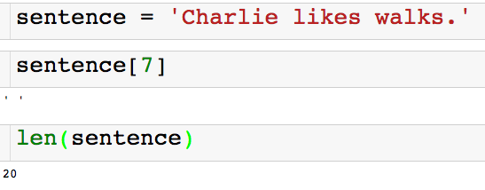
Slicing Strings
We can access the characters of the string through their index
Spaces and punctuation count in the indexing of a string!

Slide 14
Slicing Strings
We can access the characters of the string through their index
Returns the number of characters in the string

Slide 15
String Concatenation
I can combine strings using the + operator.
So the + operator between two numbers add them and the + operator between two strings concatenates them! This is called polymorphism.

Slide 16
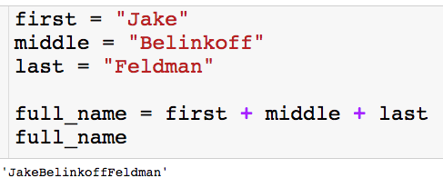
String Concatenation
I can combine strings using the + operator.
So the + operator between two numbers add them and the + operator between two strings concatenates them! This is called polymorphism.
If we want a space, we have to say so.

Slide 17
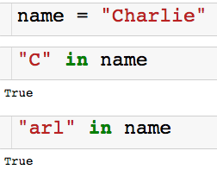

Using In
We can use the keyword in to check if a string is contained in another string.
There is also a not in:

Slide 18
Lists
Ordered collection of arbitrary objects.
There is a left to right ordering (just like string).
Can contain numbers, string, or even other lists.
Elements accessed by offset.
You can fetch elements by index (just like string).
You can also do slicing and concatenation.
Variable in length and arbitrarily nestable.
Lists can grow and shrink in-place.
You can have lists of lists of lists…

Slide 19
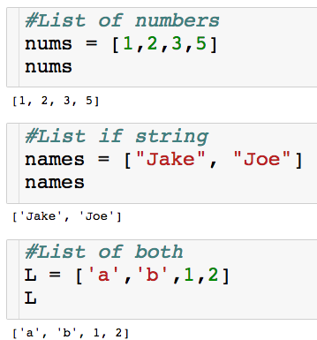
Lists
Lets create our first lists
Elements enclosed in square brackets.
Elements separated by commas.

Slide 20

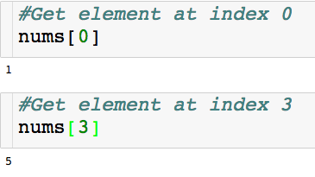
Indexing Lists
Indexing for lists is very similar to strings

Slide 21
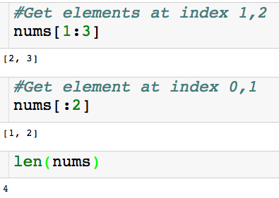
Slicing Lists
Slicing for lists I also very similar to strings
Returns lists
Returns # of elements in list

Slide 22

Nested Lists
Creating a nested list:
There are two elements in the list nested_L.
There is a list of numbers in index 0.
There is a list of string of index 1.

Slide 23
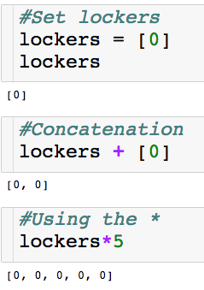
Polymorphism with Lists
The + and * operator work on lists as well!

Slide 24
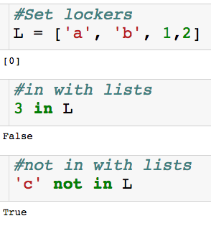
Using in with Lists
Keywords in and not in work with lists as well.

Slide 25
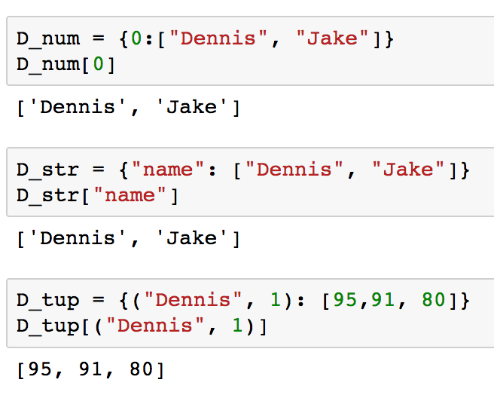
Dictionaries
The key in a dictionary must me an immutable object
number, string, tuple, dictionary (we can have nested dictionaries)
The value can be any object

Slide 26
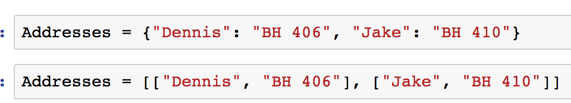
Dictionaries
Why Dictionaries?
Let’s us store and access info through something other than a number (index) for list.
Let’s say I wanted to store people’s address somewhere in my code
With a dictionary:
With a list:

Slide 27
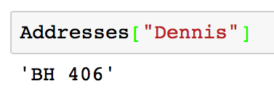
Dictionaries
With a dictionary:
Take get Dennis’ address:

Slide 28
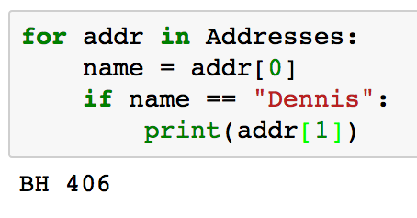
Dictionaries
With a list:
Take get Joe’s address (imagine there were hundreds of addresses):
A lot more tedious!

Slide 29
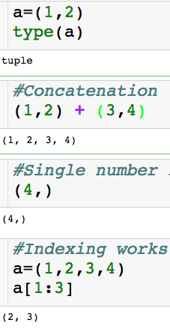
Tuples
Tuples are essentially immutable lists.
They can be slice and index and used in for loops, but you can’t sort them.
Since they are immutable, they can be keys in a dictionary, as we already saw.
Notice parentheses instead of bracket!

Slide 30
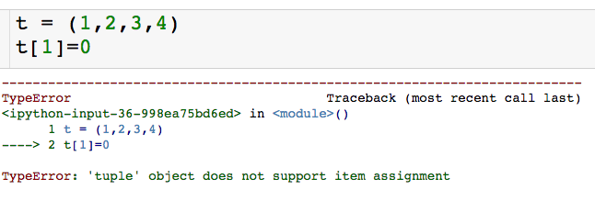
Tuples
Tuples are essentially immutable lists.
They can be slice and index and used in for loops, but you can’t sort them.
Since they are immutable, they can be keys in a dictionary, as we already saw.
Can’t change an element of tuple because of immutability

Slide 31
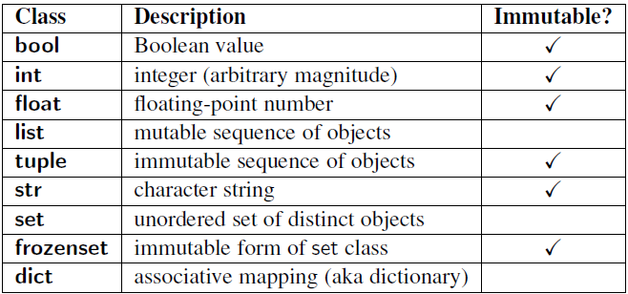
Immutability

Slide 32
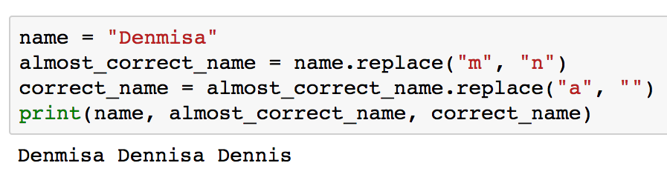
String Methods
Replace method : global search and replace.
name of string
method

Slide 33
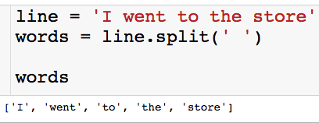
String Methods
Split method : splits string into list, delimited by input.
“split string by space”

Slide 34
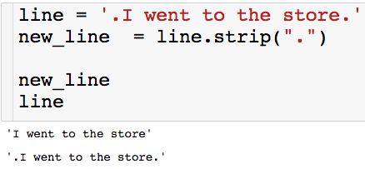
String Methods
Strip method : Deletes input from both sides of string.
“Get rid of periods on the left and right of the string”

Slide 35
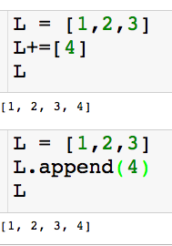
List Methods
Append method : Add element to end of the list.

Slide 36
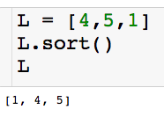
List Methods
Sort method : Sorts the elements in the list

Slide 37
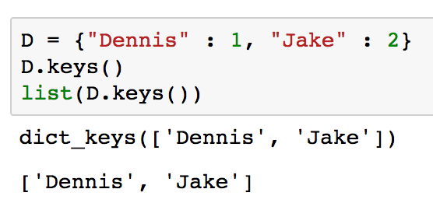
Dictionary Methods
keys method : returns the keys as an interable.
You can wrap in a list to a get indexable object

Slide 38
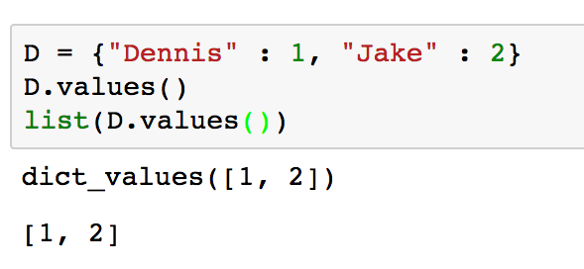
Dictionary Methods
values method : returns the values as an interable.
You can wrap in a list to a get indexable object

