Slide 1

Module 1.2: Intro to Python/Jupyter -- Python If-statement and For-loop
Dennis J. Zhang
Washington University in St. Louis

Slide 2
If-statement and For-loop
In Python, code runs line by line unless specified otherwise.
If-statement
For-loop
List-comprehension: An easy (and faster) way of writing for-loop

Slide 3
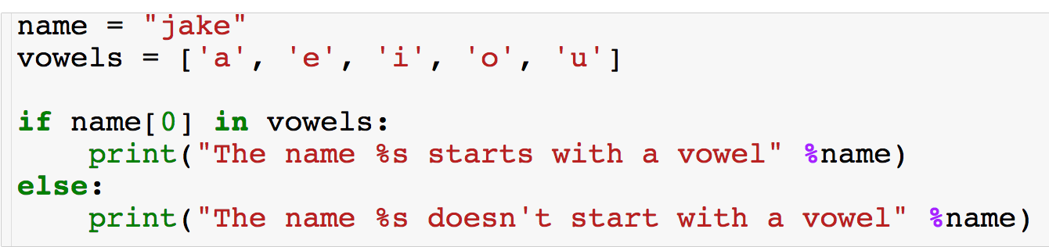
If + Else Statement
Output: “The name jake doesn’t start with a vowels”

Slide 4
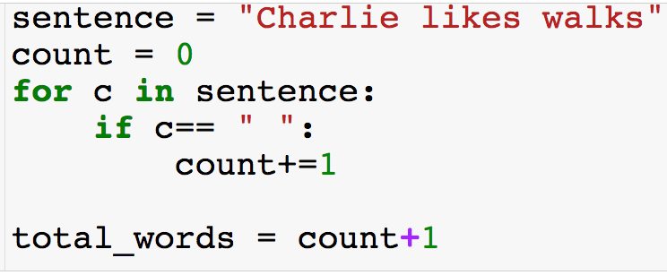
For Loops w/ Strings

Slide 5
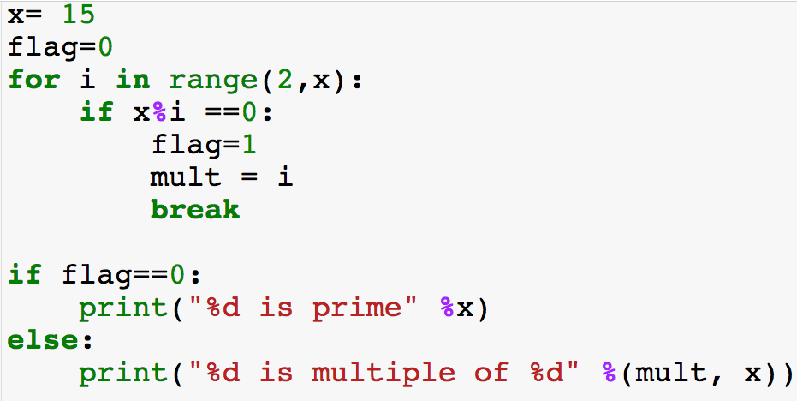
Break Statement

Slide 6
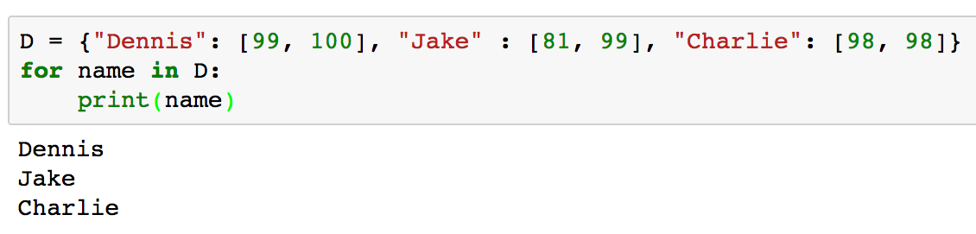
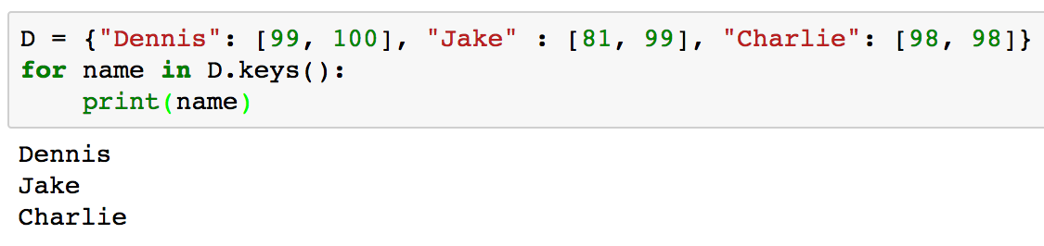
Dictionaries with for Loops
Iterate over keys of dictionary:
REMEMBER: Dictionaries are not ordered!
Equivalent way to iterate over keys of dictionary:

Slide 7
List Comprehension
List comprehension is useful for efficient and concise list creation
Faster than a for loop due to C implementation.
Sometimes they are less readable than for loops.
Very useful for reading files.
There is also dictionary comprehension.
We will begin with somewhat arbitrary uses and then move to more application that can make certain tasks way easier!

Slide 8
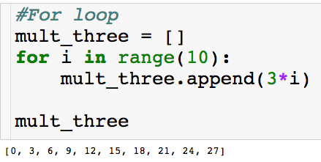
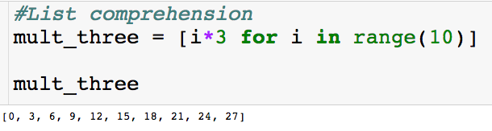
List Comprehension
Basic use - let’s create a list of the first 10 multiples of 3:
Before:
Now:

Slide 9

Closer Look
Let’s take a closer look at the list comprehension
“Place i*3 in the list for each i from 0 to 9”

Slide 10
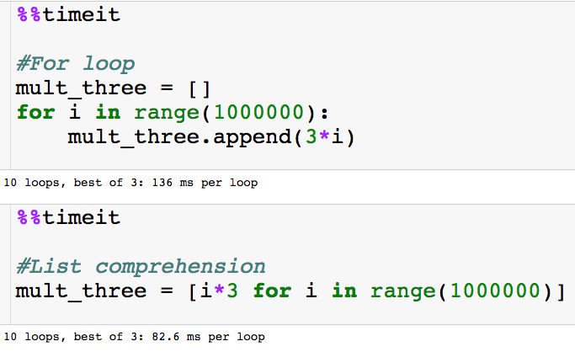
Speed-Up
Let’s look at the time to generate the first one million multiple of 3:
List comprehension is almost twice as fast just for this simple task!
Jupyter magic

Slide 11
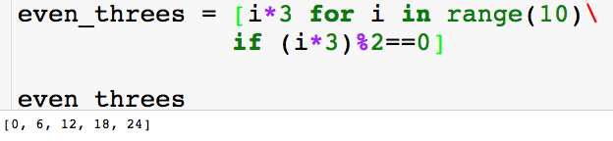
Adding an if Statement
We can throw in an if statement in the list comprehension. Let’s say we only want even multiples of 3:

