Slide 1

Module 1.4: Intro to Python/Jupyter -- Python Packages and Numpy
Dennis J. Zhang
Washington University in St. Louis

Slide 2
Python Packages
Python has many built in packages that makes things a lot easier.
Here are the main ones we will consider
os: operator system interface
numpy: matrix algebra, random number generation
scipy: random number generation, optimization
pandas: reading csv/xls files, data analytics, plotting

Slide 3
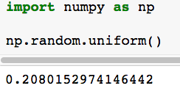
Numpy + Scipy
The Numpy and Scipy packages are used for scientific computation in Python
For example, you want to use it to generate uniform variable:

Slide 4
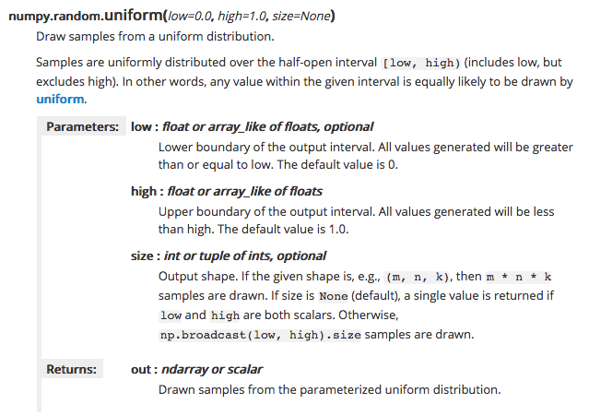
Numpy + Scipy
How to generate 100 random variables which are uniform between 100 and 150?
If you are not sure what a function does, Google it.
Documentation for numpy.random.uniform(): https://docs.scipy.org/doc/numpy/reference/generated/numpy.random.uniform.html

Slide 5
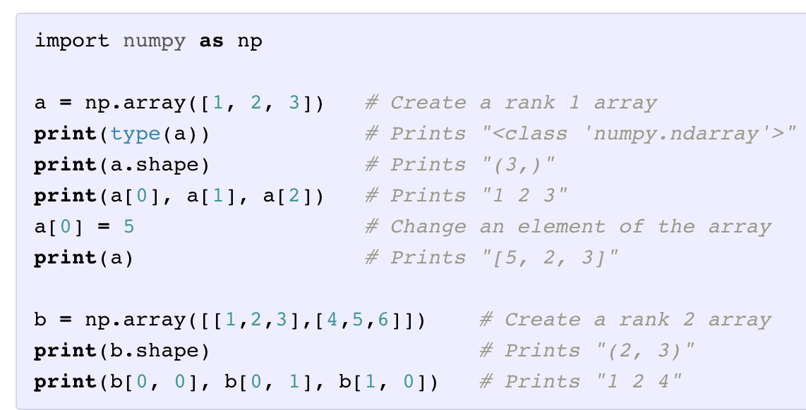
Numpy Arrays
A numpy array is a grid of values, all of the same type, and is indexed by a tuple of nonnegative integers. The number of dimensions is the rank of the array; the shape of an array is a tuple of integers giving the size of the array along each dimension.

Slide 6
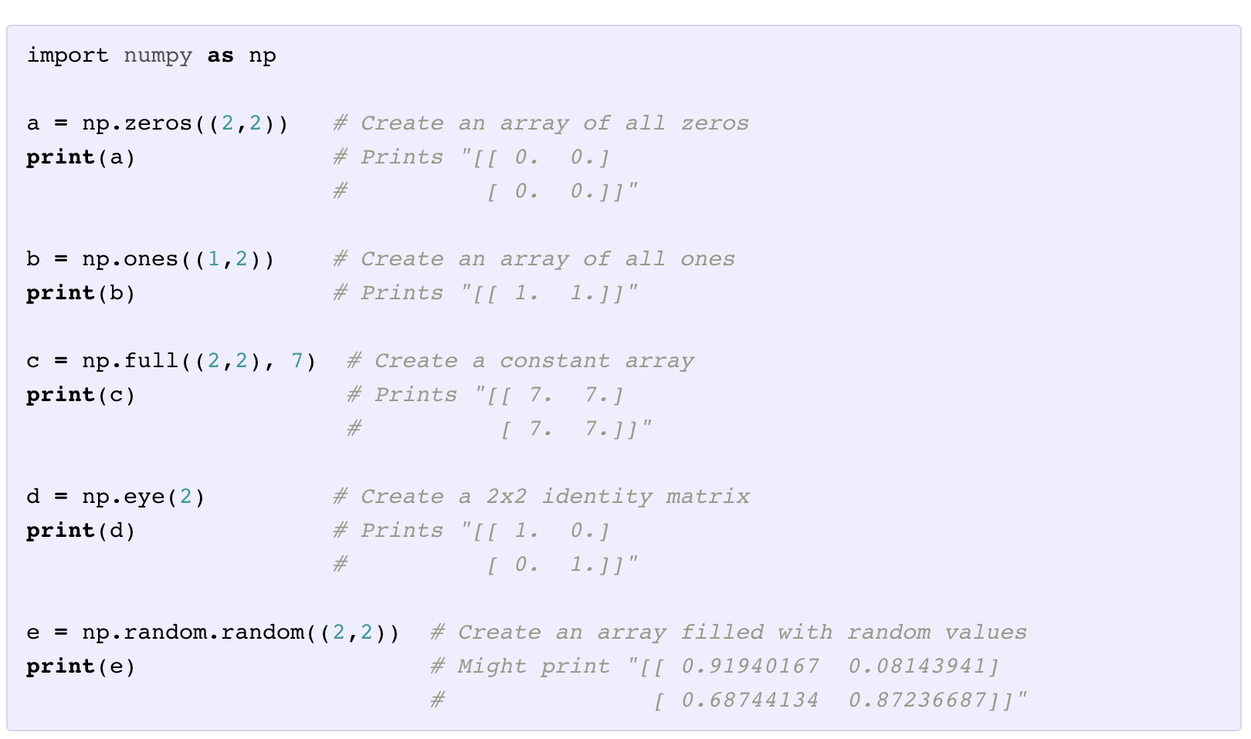
Numpy Arrays
Numpy also provides many functions to create arrays:

Slide 7
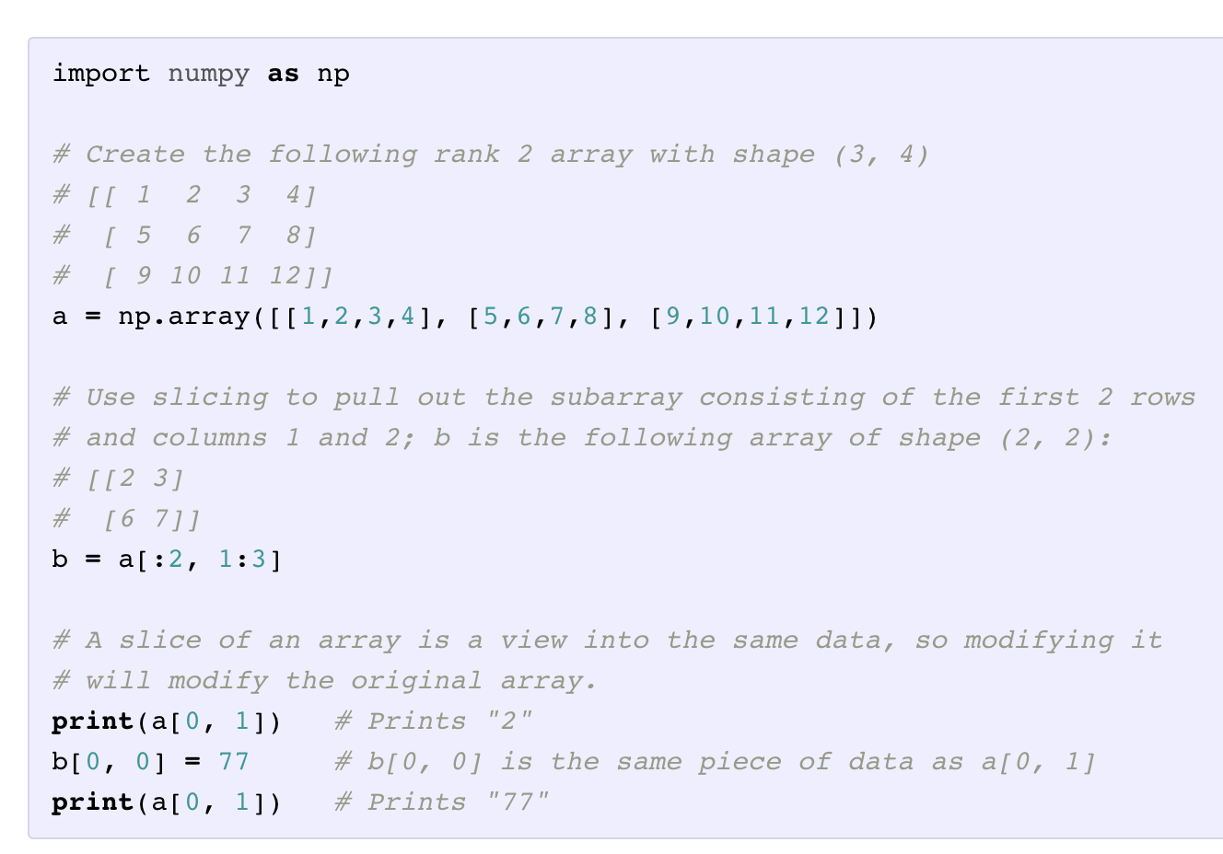
Numpy Array Indexing
Numpy offers several ways to index into arrays.
Slicing: Similar to Python lists, numpy arrays can be sliced. Since arrays may be multidimensional, you must specify a slice for each dimension of the array

Slide 8
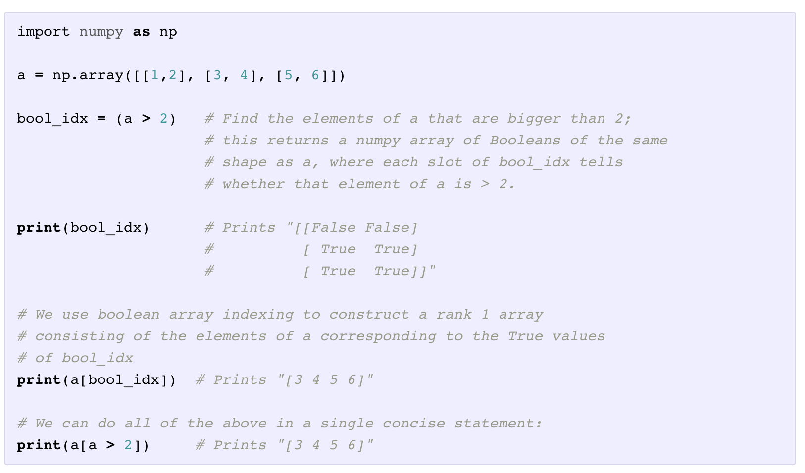
Numpy Array Indexing
Boolean array indexing: Boolean array indexing lets you pick out arbitrary elements of an array. Frequently this type of indexing is used to select the elements of an array that satisfy some condition. Here is an example:

Slide 9
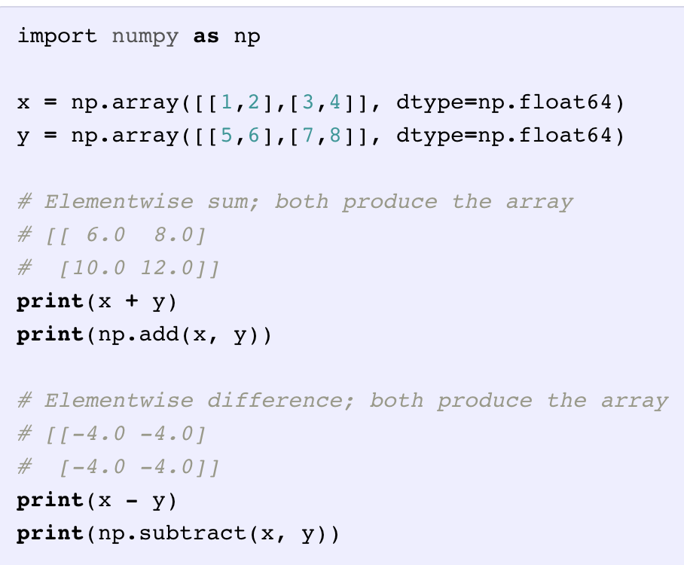
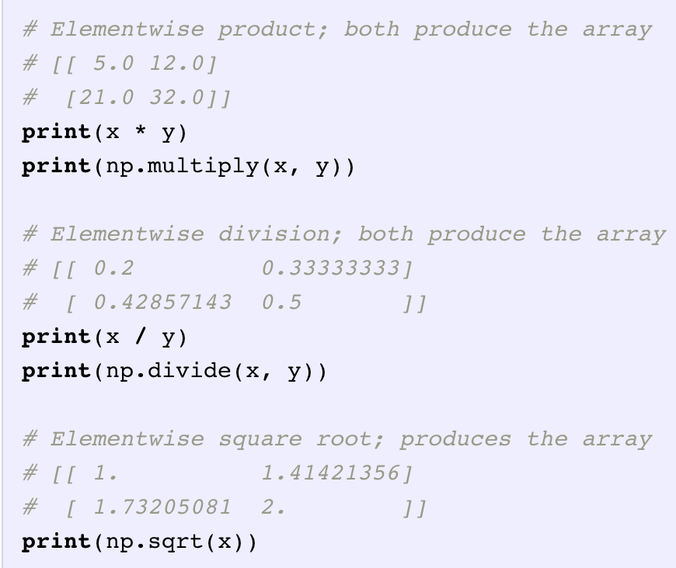
Numpy Array Math
Basic mathematical functions operate elementwise on arrays, and are available both as operator overloads and as functions in the numpy module:

Slide 10
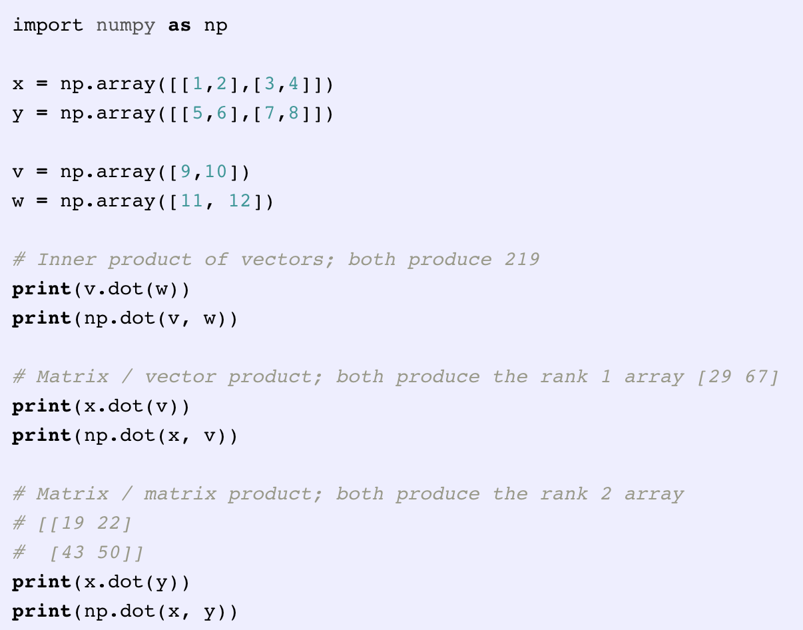
Numpy Array Math
Note that unlike MATLAB, * is elementwise multiplication, not matrix multiplication. We instead use the dotfunction to compute inner products of vectors, to multiply a vector by a matrix, and to multiply matrices. dot is available both as a function in the numpy module and as an instance method of array objects:

Slide 11
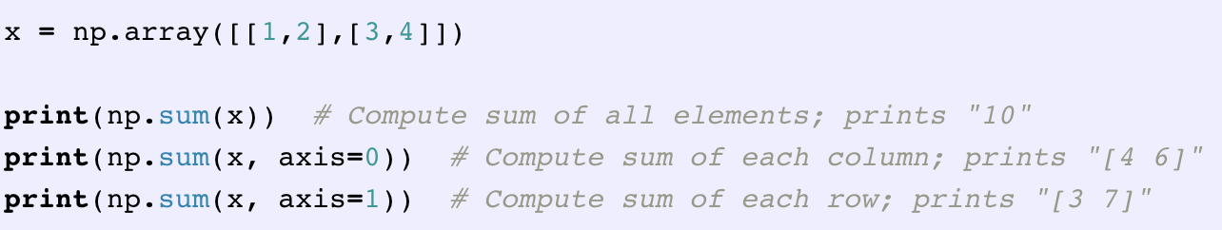
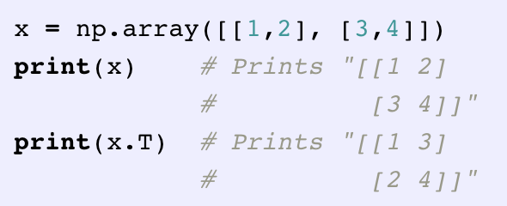
Numpy Array Math
Numpy provides many useful functions for performing computations on arrays; one of the most useful is sum:
Apart from computing mathematical functions using arrays, we frequently need to reshape or otherwise manipulate data in arrays. The simplest example of this type of operation is transposing a matrix; to transpose a matrix, simply use the T attribute of an array object:

Slide 12
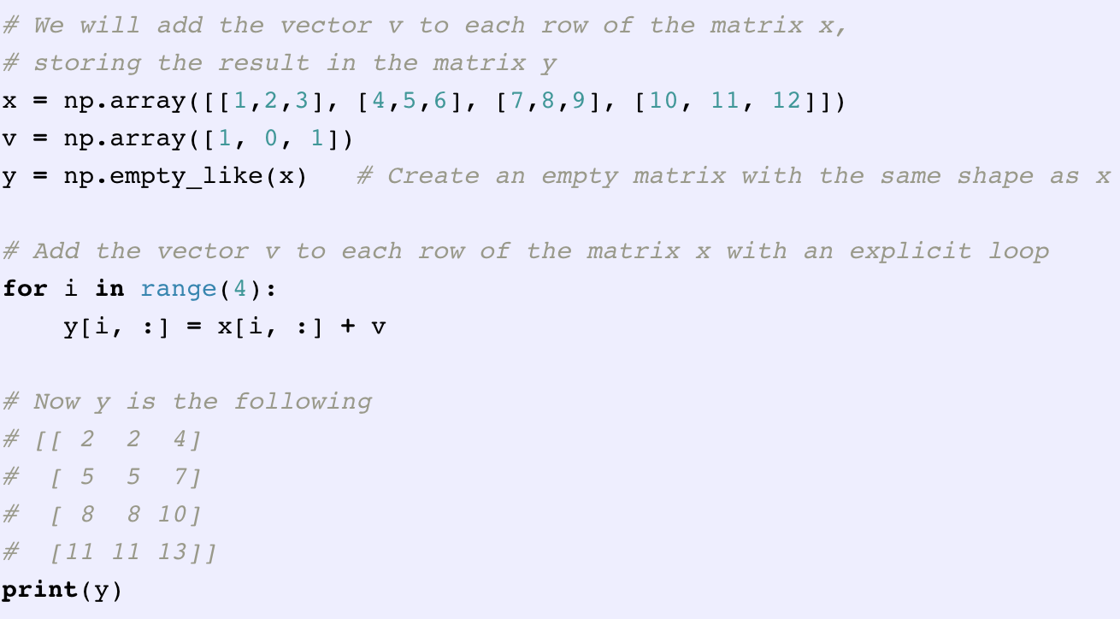
Numpy Array Broadcasting
Broadcasting is a powerful mechanism that allows numpy to work with arrays of different shapes when performing arithmetic operations. Frequently we have a smaller array and a larger array, and we want to use the smaller array multiple times to perform some operation on the larger array.
For example, suppose that we want to add a constant vector to each row of a matrix. We could do it like this:

Slide 13
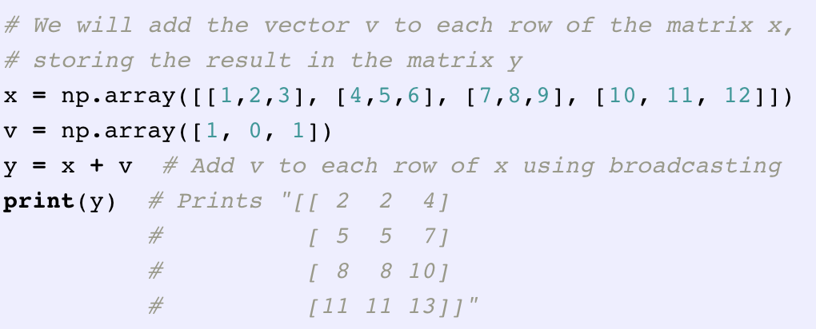
Numpy Array Broadcasting
Numpy broadcasting allows us to perform this computation without actually creating multiple copies of v. Consider this version, using broadcasting:
The line y = x + v works even though x has shape (4, 3) and v has shape (3,) due to broadcasting; this line works as if v actually had shape (4, 3), where each row was a copy of v, and the sum was performed elementwise.
Broadcasting two arrays together follows these rules:
If the arrays do not have the same rank, prepend the shape of the lower rank array with 1s until both shapes have the same length.
The two arrays are said to be compatible in a dimension if they have the same size in the dimension, or if one of the arrays has size 1 in that dimension.
The arrays can be broadcast together if they are compatible in all dimensions.

