Slide 1

Module 2.1: Basic Pandas
Dennis J. Zhang
Washington University in St. Louis

Slide 2
Pandas
We will use pandas to:
Read in data from Excel.
Manipulate data in spreadsheet.
Visualize data (we will also use another Python package called ggplot to do this).
Filter and aggregate data from spreadsheet using SQL

Slide 3
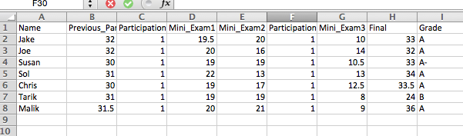
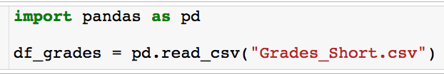
Reading in Data From Excel
I have the following data saved in the file “Grades_Short.csv”:
Reading the data into a variable called df_grades.
Let’s see how we read this data into pandas:
Built in read_csv method
Path to file

Slide 4
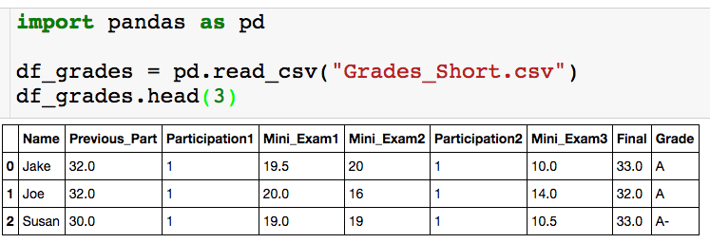
The head() Method
Using the head() method
If the data is really large you don’t want to print out the entire dataframe to your output.
The head(n) method outputs the first n rows of the data frame. If n is not supplied, the default is the first 5 rows.
I like to run the head() method after I read in the dataframe to check that everything got read in correctly.
There is also a tail(n) method that returns the last n rows of the dataframe

Slide 5
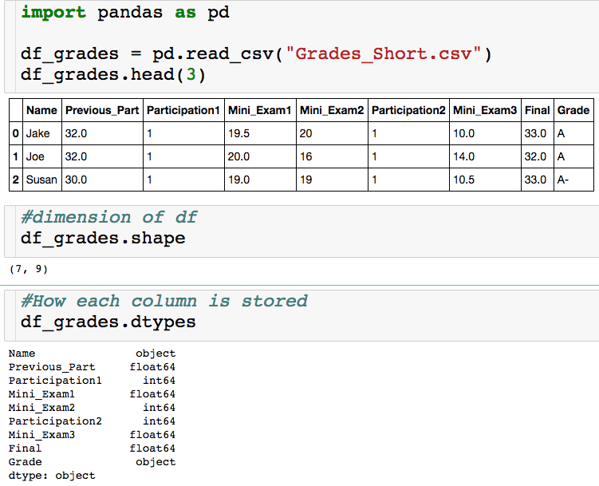
Basic Features
Think of this as a list
object = string
float64 = decimal
int64 = integer

Slide 6
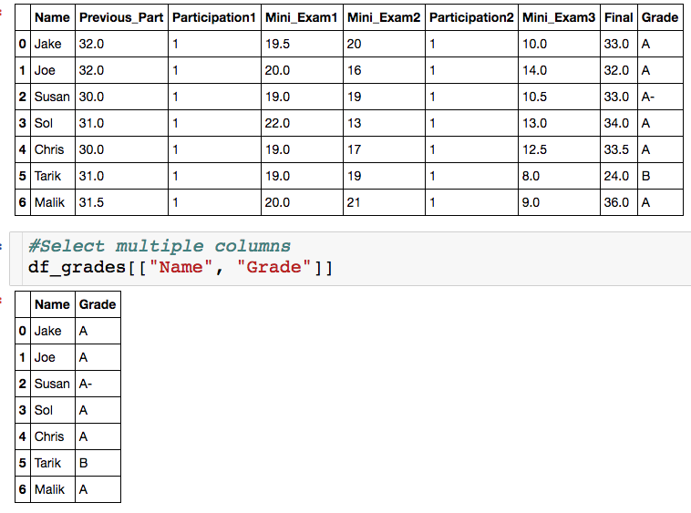
Selecting Multiple Columns
List of strings, which correspond to column names.
You can select as many column as you want.
Column don’t have to be contiguous.

Slide 7
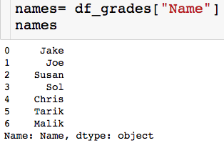

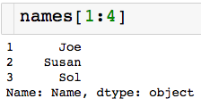
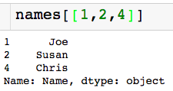
Slicing a Series
Slice/index through the index, which is usually numbers
Picking out single element
Contiguous slice
Arbitrary slice

Slide 8
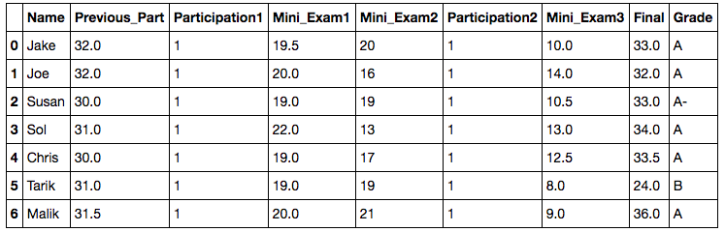

Slicing a Data Frame
Pick a single value out.
Column name (string)
Index label (number)

Slide 9
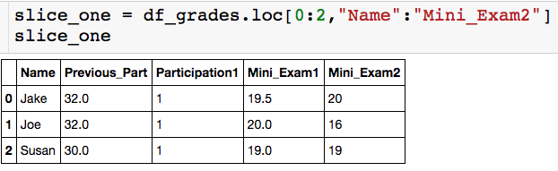
Slicing a Data Frame
Pick out contiguous chunk:
Endpoints are inclusive!

Slide 10
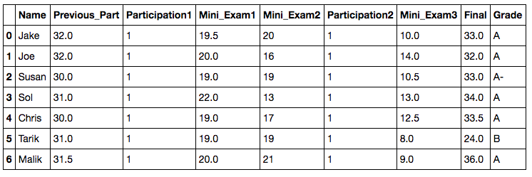
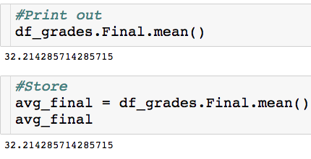
Built in Functions
How do I compute the average score on the final?
Built in mean() method

Slide 11
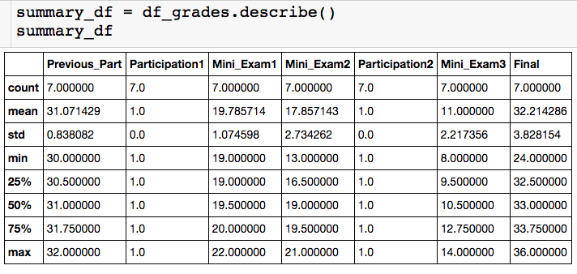
Built in Functions
I can actually get all key stats for numeric columns at once with the describe() method:
summary_df is a dataframe!

Slide 12
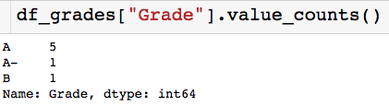
Built in Functions
Other useful built in methods:
value_count(): Gives a count of the number of times each unique value apears in the column. Returns a series where indices are the unique column values.

Slide 13
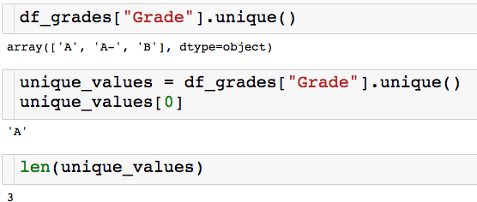
Built in Functions
Other useful built in methods:
unique(): Returns an array of all of the unique values.

Slide 14
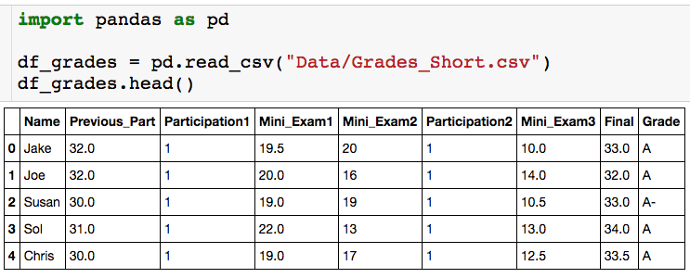
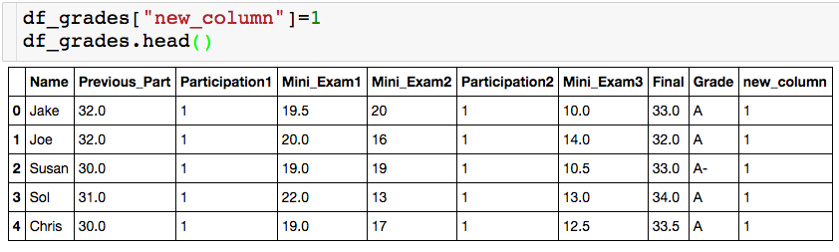
Creating New Columns
Let’s create a useless new column of all 1s:

Slide 15
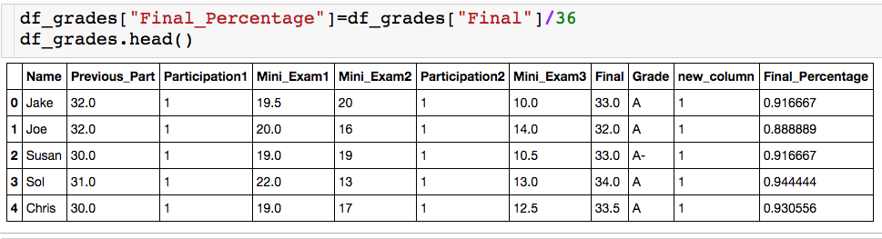
Creating New Columns
We can also create column as function of other column. The Final was worth 36 points, let’s create a column for each student’s percentage.

Slide 16
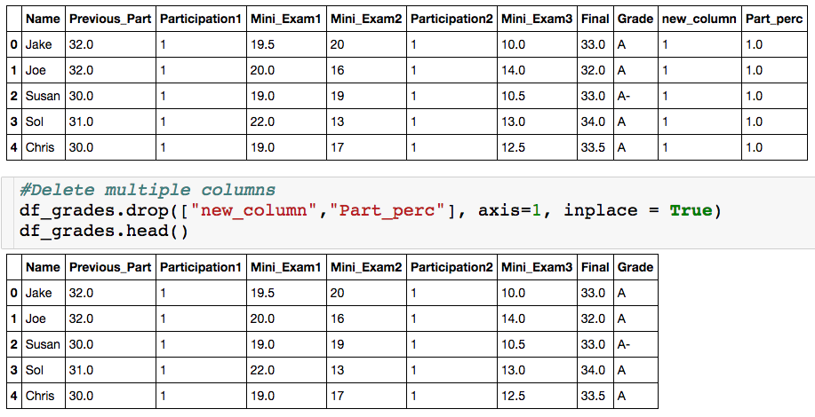
Deleting Columns

Slide 17
The Drop Method
inplace = True– change df_grades
inplace = False – return dataframe with specified columns deleted, do not change df_grades
List of column of index label
axis = 1 – delete specified columns
axis = 0 – delete specified rows

Slide 18
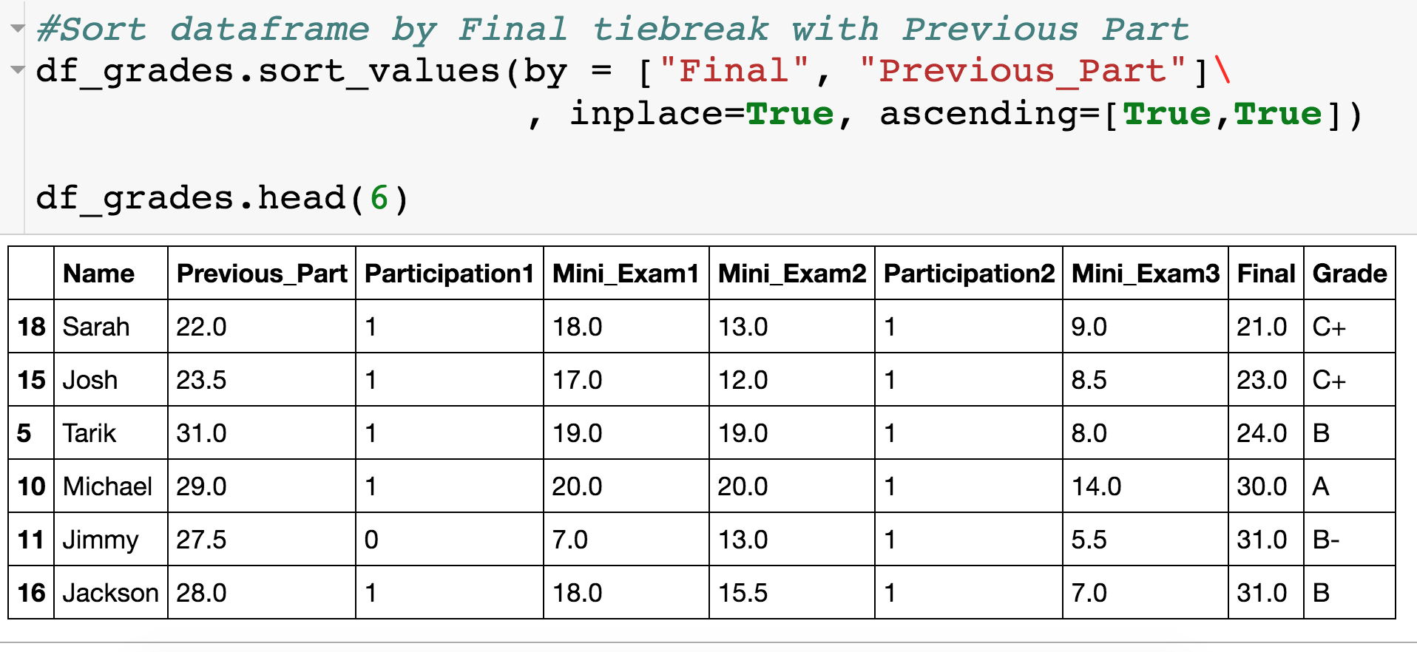
Sorting Dataframes

Slide 19
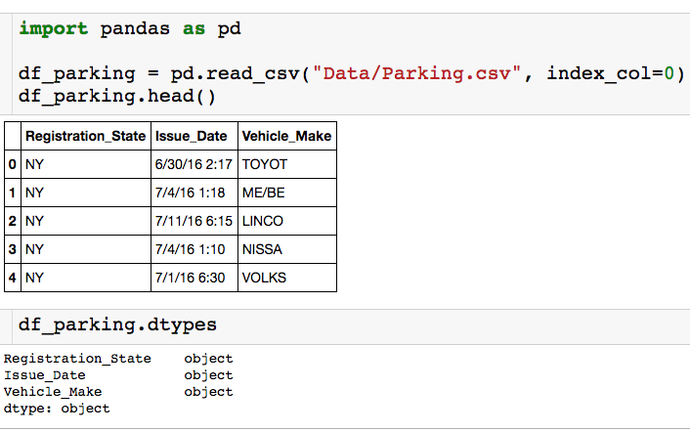
Parking Ticket Data
All columns are stored as strings!

Slide 20
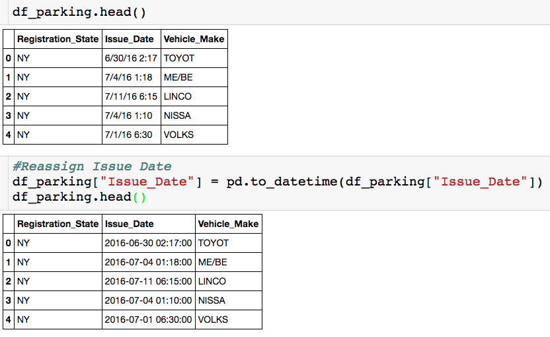
Converting to Datetime
Option 2:
Wrap column in to_datetime() built in function

Slide 21
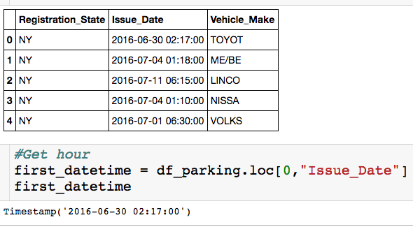
Timestamp Attributes

