Slide 1
Module 2.3: Advanced Pandas
Dennis J. Zhang
Washington University in St. Louis

Slide 2
Filtering Dataframes
New dataframe methods
Nunique()
Duplicated(), drop_duplicates()
New inputs to string methods
Faster way to use apply
Defining functions using lambda
How do I only select row rows that satisfy a certain condition? Multiple conditions?
What is going on under the hood?

Slide 3
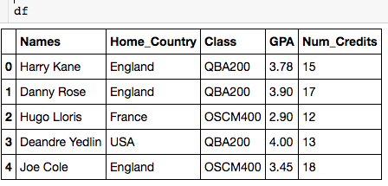

Using nunique()
Can only be applied to single columns

Slide 4
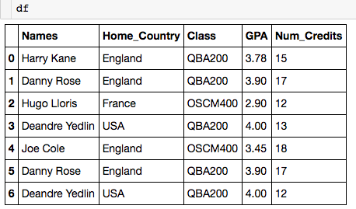
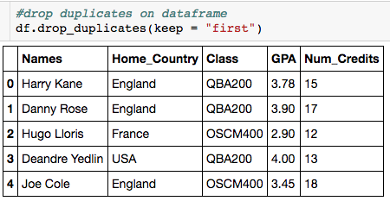
Using drop_duplicates()
Let’s look at how to deal with duplicate columns:
“Drop all duplicate rows except for the first.”

Slide 5
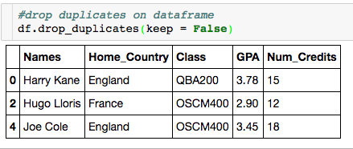
Using drop_duplicates()
Let’s look at how to deal with duplicate columns:
“Drop all duplicate rows.”

Slide 6
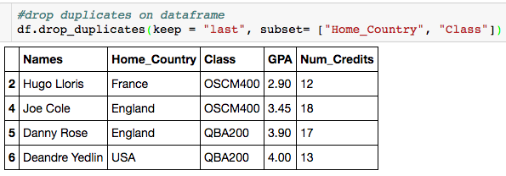
Using drop_duplicates()
Let’s look at how to deal with duplicate columns:
“Drop all duplicate rows based on Home_Country and Class except for the last.”

Slide 7
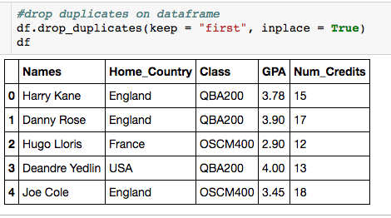
Using drop_duplicates()
Let’s look at how to deal with duplicate columns:
Change dataframe in place

Slide 8
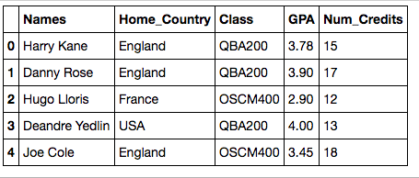
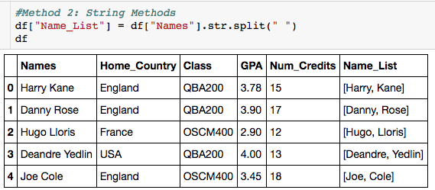
New String Method Techniques
How do I add a column for each person’s last name?
How do I get the last name?

Slide 9
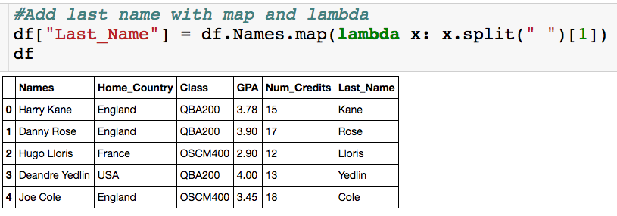
Use of Lambda Functions
How do I add a column for each person’s last name?

Slide 10

Filtering
Always name_df.loc
only rows where GPA>=3
All columns

Slide 11
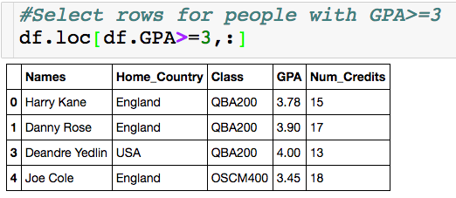
Filtering
Index is messed up
Returns a dataframe

Slide 12
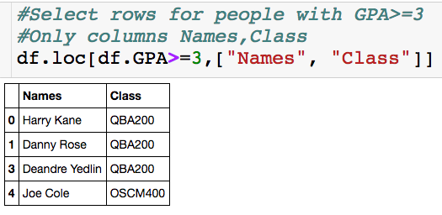
Filtering
We don’t have to select the column we filter on.

Slide 13
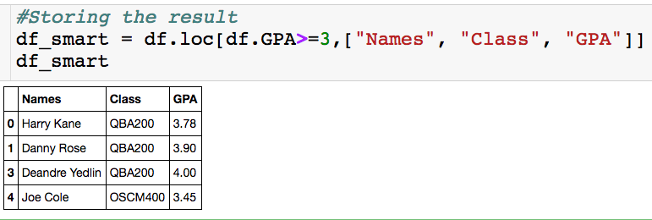
Filtering

Slide 14
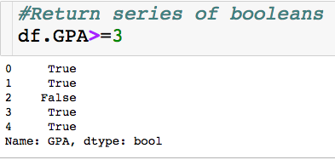
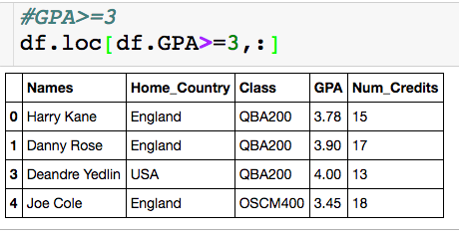
Under Hood
Only keep rows where there is a True

Slide 15

Filtering – Multiple Conditions
“and”
Make sure you put each condition in parentheses

Slide 16
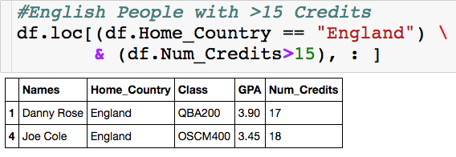
Filtering – Multiple Conditions

Slide 17

Filtering – Multiple Conditions
Returns True if string contains a “D”
“or”

Slide 18
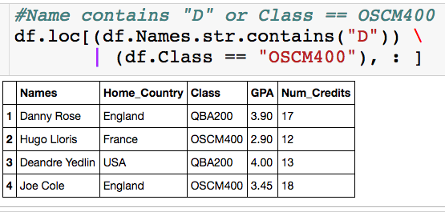
Filtering – Multiple Conditions

Slide 19
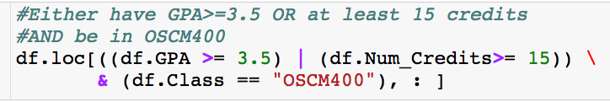
Filtering – Multiple Conditions
What will this give me?

Slide 20
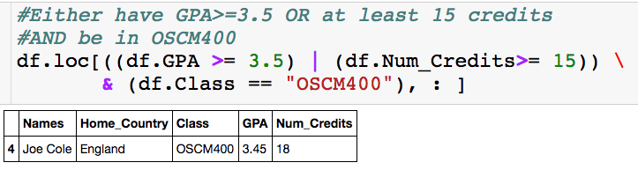
Filtering – Multiple Conditions

Slide 21
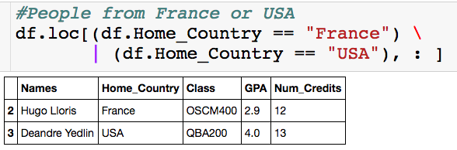
Filtering – Multiple Conditions

Slide 22
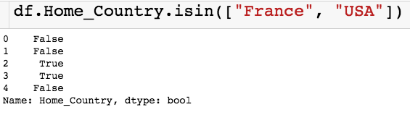
Filtering – Multiple Conditions
Input is a list

Slide 23
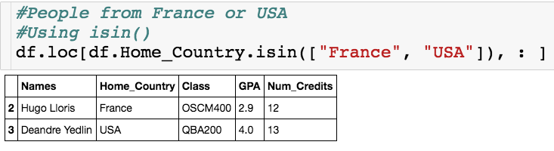
Filtering – Multiple Conditions

