Slide 1

Technical Communication: A History
How a Profession was Established

Slide 2
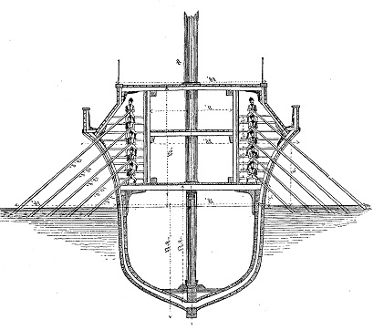
War and Technical Communication The Rise of the Roman Empire
Assembly instructions inscribed into planks of boats, quinqueremes
After capture of 1 boat, Romans produced 100 boats in less than 3 months
Romans defeated the Carthaginians using their own naval technology (Naylor, n.d.)
Baumeister: Denkmaler des klassischen Altertums, 1888, Volume III, page 1611

Slide 3
War and Technical Communication World War II
WWII was the first technological war.
Each new weapon, vehicle, and machine used for war required a manual (Connors, 1982).

Slide 4
War and Technical Communication World War II
Not only did technical writing grow as a result of WWII; it was also put to great use during the war.
“Under a period of great upheaval and stress, the Allies were able to train ordinary men and women, often in stressful or dangerous circumstances, to use some of the most cutting-edge technology of the time” (Naylor, n.d.).

Slide 5


Peaceful Applications of War Technology
“After the end of the war, technical writing finally became a genuine profession as wartime technologies were translated into peacetime uses” (Connors, 1982).
Life Magazine, August 14, 1944
Kare11.com September 22, 2023

Slide 6
Continued Focus of Technical Communication
The profession has and will continue to be user focused (Redish, 2019).
Technical communicators value communication as the most important aspect of their jobs (Pringles & Williams, 2005).

Slide 7
Technological Advances and Technical Communication
New technology has not made the profession obsolete (Connors, 1982).
Technical communicators need to learn new technologies to evolve along with the profession (O’Hara, 2001).

Slide 8
Transferable Skills of Technical Communication
Analyze rhetorical situations
Learn and use conventions in context
Effectively communicate to diverse audiences
Use communication to solve problems (Kimball, 2017)

Slide 9

Transferable Skills of Technical Communication
“Technical communication is both a thing that can be made and exchanged, and an activity that people the world over engage in everyday” (Kimball, 2017).

Slide 10
References
Connors, R. J. (1982/2004). The rise of technical writing instruction in America. In J. Johnson-
Eilola, & S.A. Selber (2004) Central works in technical communication. Oxford: Oxford University Press. (pp. 3-19). (Reprinted from the Journal of Technical Writing and Communication 12.4 (1982): 329-352.) https://na01.alma.exlibrisgroup.com/leganto/readinglist/citation/2289595235780001701/file/viewer
Kimball, M. A. (2017). The Golden Age of Technical Communication. Journal of Technical
Writing and Communication, 47(3), 330-358. https://journals-sagepub-com.ezp3.lib.umn.edu/doi/epub/10.1177/0047281616641927
Naylor, D. (n.d.). Empires, wars, and revolutions: a brief history of technical writing. 3di.
https://3di-info.com/empires-wars-and-revolutions-a-brief-history-of-technical-writing/
O'Hara, F. M. (2001). A brief history of technical communication. In STC's 48th annual conference: May 13-16, 2001, Chicago, Illinois: 2001, a global communication Odyssey: Proceedings (pp. 500-504). Society for Technical Communication.
Pringle, K., & Williams, S. (2005). The future is the past: has technical communication arrived as a profession? Technical communication, 52(3), 361-370.
Reddish, G. (2019). Technical communicators: Where we’ve been, where we’re going. In Technical Communication Summit. Society for Technical Communication.

Slide 11
Handout
Technical Communication: A History
How a Profession was Established
Technical History Handout

