Slide 1

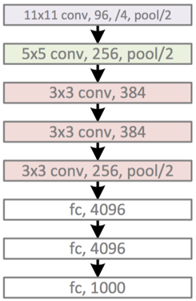
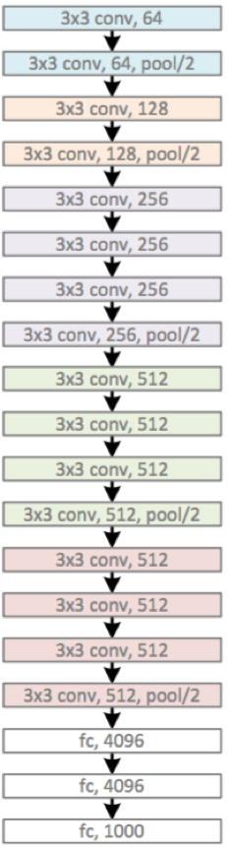


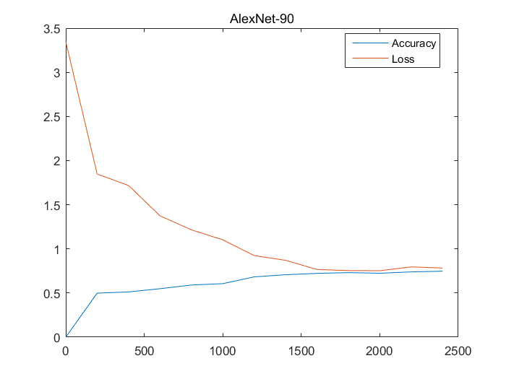
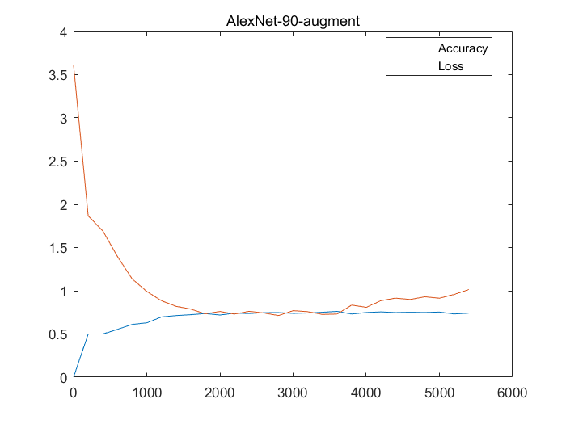
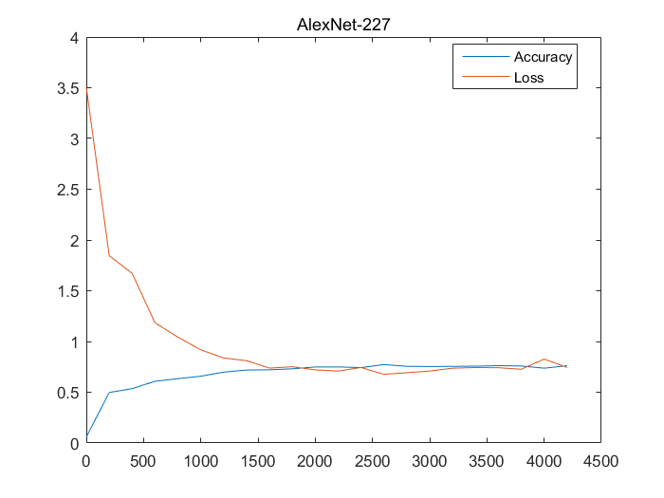
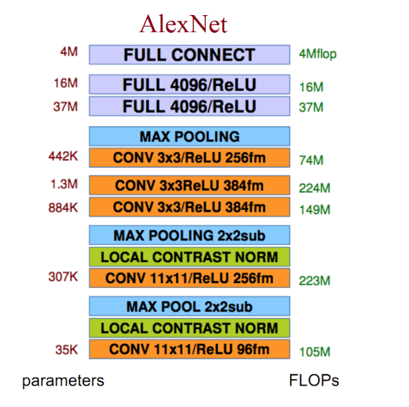
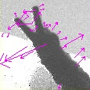
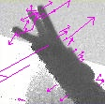
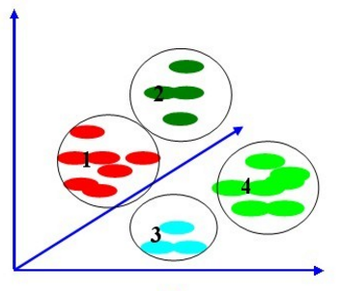
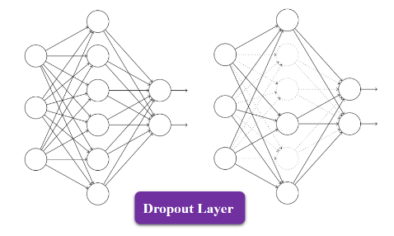
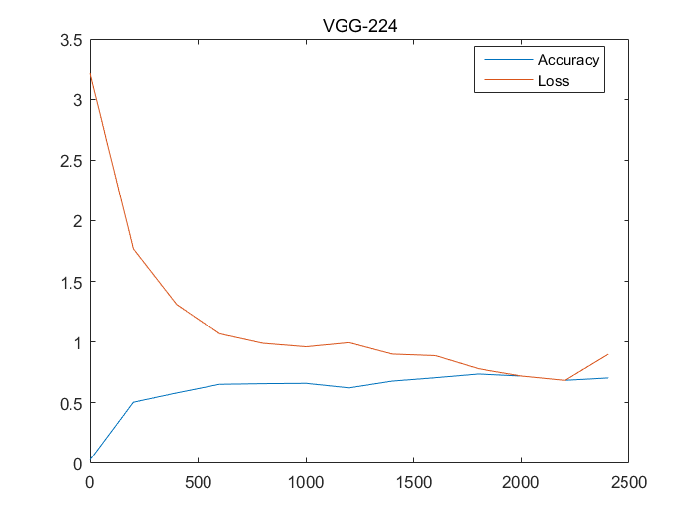
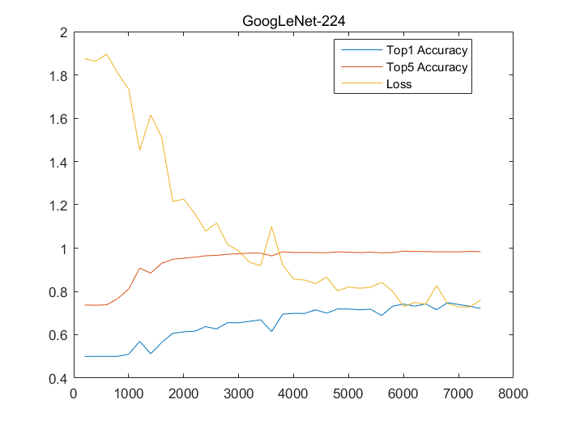
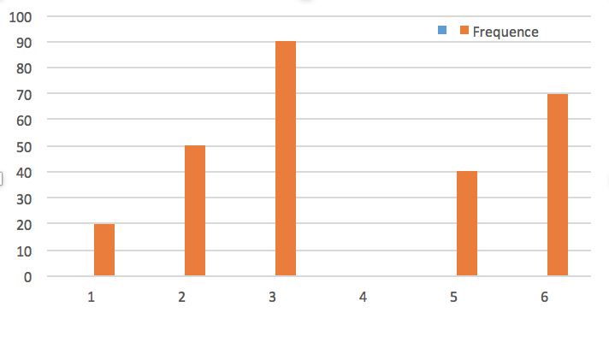
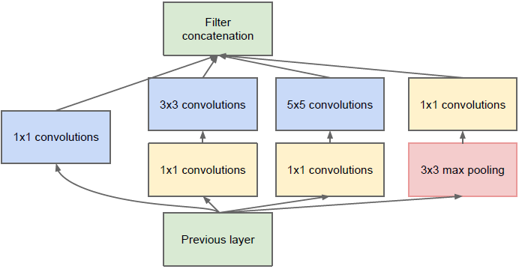

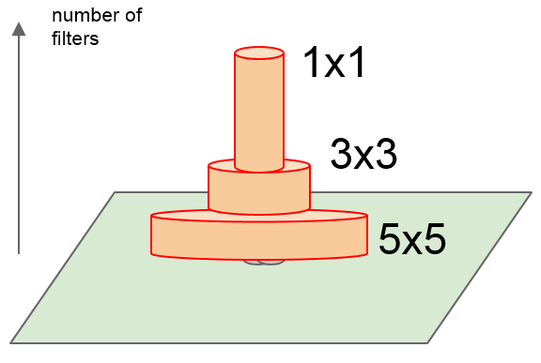

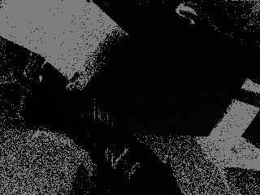
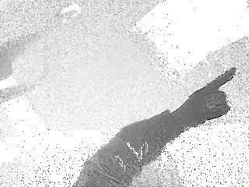
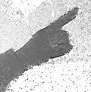
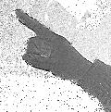
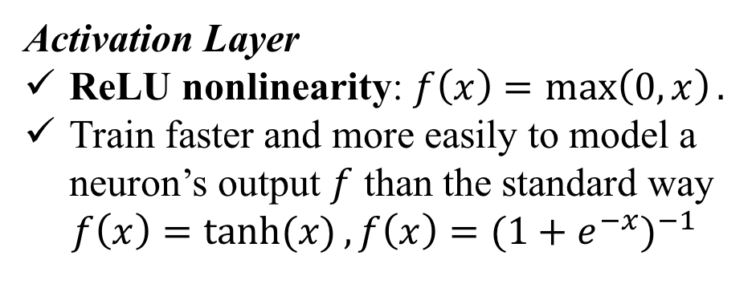
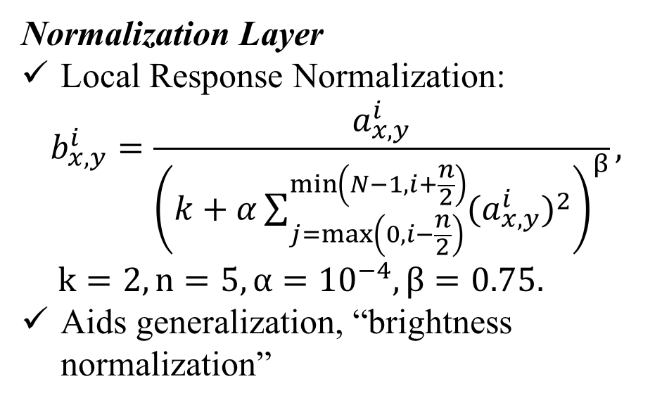
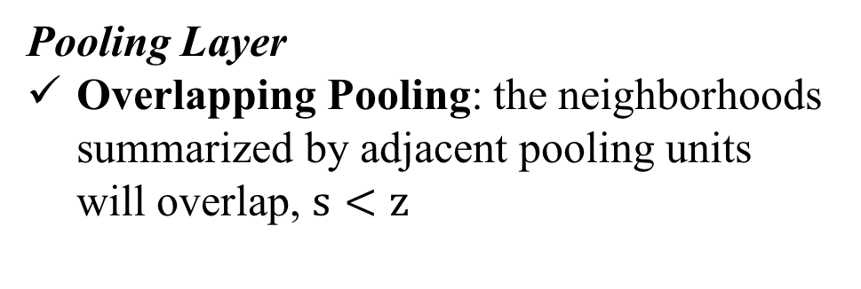
CS5340
Hand Gesture Recognition
Qi Miao, Longwei Zhu, Yifan Lu
Introduction
Models
Results & Analysis
AlexNet
VGG
AlexNet
Task: Classify hand images into pre-defined categories
Categories: 28, Training Images: 23987, Test Images: 6,016 Total: 30,003
Famous in ILSVRC 2012 Competition
Alex Net
Our Solutions:
Data Augmentation
To reduce overfitting, artificially enlarge the datasets by generating image translations and horizontal reflections.
Cropped Image
Cropped Image
Data-Augmentation
227 * 227 Image
“Traditional Way”: SIFT +K-means+SVM
Depth: 8
Depth: 19
“Fashion Way”: Deep Learning
Convolutional Layer
11*11*96; 5*5*256; 3*3*384; 3*3*384; 3*3*256
SIFT + K-Means + SVM
Activation Layer
ReLU nonlinearity: $f\left(x\right)=\max\left(0,x\right).$
Train faster and more easily to model a neuron’s output $f$ than the standard way
$$f\left(x\right)=\tanh{(x)},f\left(x\right)={(1+e^{−x})}^{−1}$$
Highest Accuracy: 73.5%
Highest Accuracy: 77.0%
Highest Accuracy: 74.8%
SIFT descriptor
Normalization Layer
Local Response Normalization:
$$b_{x,y}^{i}=\frac{a_{x,y}^{i}}{{\left(k+α\sum_{j=\max\left(0,i−\frac{n}{2}\right)}^{\min\left(N−1,i+\frac{n}{2}\right)}{({a_{x,y}^{i})}^{2}}\right)}^{β}}, k=2,n=5,{α=10}^{−4},β=0.75.$$
Aids generalization, “brightness normalization”
Highest accuracy with AlexNet in our project is 77.0%
SIFT Descriptor
Data-Augmentation improves the result by 1.5%
K-Means
Complete image for training improves the performance compared to cropped-sized image
[5]
Image Re-Construct with SIFT Feature Histogram
(bag of word)
Different Models
K-Means: Generate Clusters
Pooling Layer
Overlapping Pooling: the neighborhoods summarized by adjacent pooling units will overlap, $s<z$
Alex Net
VGG-16 Net
GoogLeNet
1-All SVM Classification
Train & Test
Dropout Layer
Simulate the running state of brain.
Setting to zero the output of each hidden neuron with probability 0.5 in the first two fully-connected layers
The “dropped out” neurons do not participate in back propagation.
Avoid overfitting, Faster Calculation
Histogram with SIFT Features for Each Image
Disadvantages
Highest Accuracy: 77.0%
Highest Accuracy: 71.9%
Highest Accuracy: 72.1%
Bad accuracy: < 25%
Slow
Datasets: Hand depth datasets
SVM not good in muti-class classification
CaffeNet
AlexNet got the best result
In Comparison, exchange the order between norm1 and pool1, norm2 and pool2.
Possible reason: dataset not large enough, parameter setting & layer adjustment not well
VGG
Increase depth: very deep
Use very small 3×3 filters in all convolutional layers
Future Work
Deep Learning
GoogLeNet
About SIFT + K-Means + SVM
AlexNet
Presented in ILSVRC 2014 Competition
Go deeper: depth = 22 layers
Try other supervised classification methods
Use CUDA to accelerate training
Combine with convolutional neural networks
VGGNet
Innovated Architecture: Inception
Motivation & High Level Consideration:
1. Bigger size => more parameters => overfitting:
Replace the fully connected layers by the sparse ones, even inside the convolutions.
2. Inefficiency numerical calculation on non-uniform sparse data structures:
Cluster sparse matrices into relatively dense submatrices.
GoogLeNet
[7]
Image Pre-processing
About Dataset
More cleaned data
Merge confusing categories
Data augmentation
Map
from
0 – 32001
(100 - 1000)
Architectural Details: (increasing the depth & width without a significant performance penalty)
1. Find the optimal local construction and to repeat it spatially.
2. Units from an earlier layer are grouped into filter banks.
3. Clusters concentrated in a single region and covered by a layer of 1×1 convolutions in the next layer.
4. Current architecture are restricted to filter sizes 1×1, 3×3 and 5×5, to avoid patch-alignment issues.
5. 1×1 convolutions are used to reduce dimension before the expensive 3×3 and 5×5 convolutions.
About Model
to
0 - 255
Parameter Adjusting
Step-size
Momentum
Weight decay
Fine-Tuning with trained models
Change input channel
Adjust layers
320 * 240 * 1 Channel
320 * 240 * 3 Channel
100 * 100 * 3 Channel
Reflection

Slide 2
Use reflection to do data augmentation
Crop the image from 320 * 240 to 100 * 100

