Slide 1
Using Galaxy AI to Improve Customer Retention
Samsung Mobile eXperience Division — Individual Analytics Transformation Capstone
Mickhail Reeves | CS655: Managing with Analytics – From Data to AI | Professor Denise Brown

Slide 2

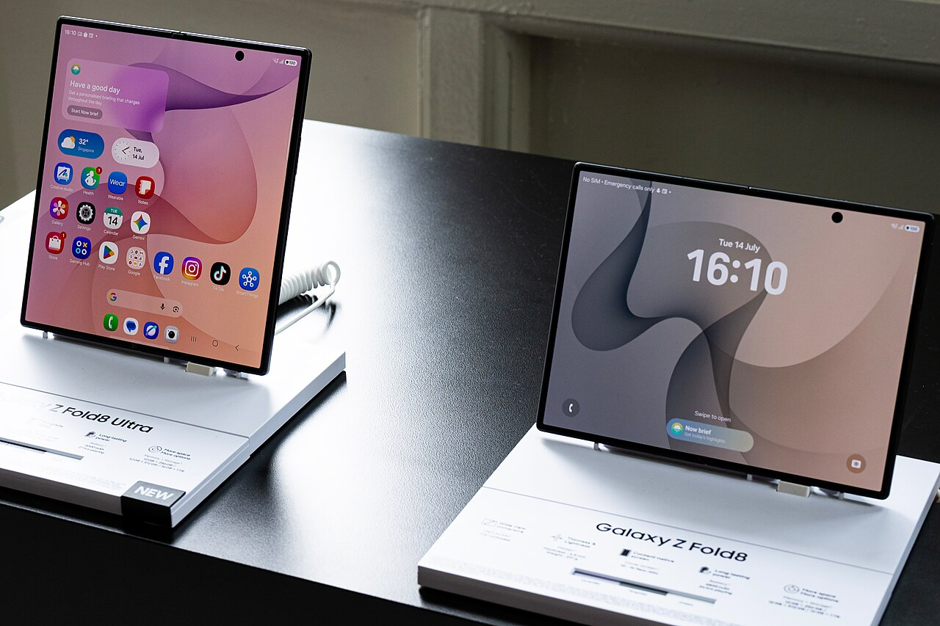

THE OPPORTUNITY
Samsung leads in shipments. It trails in loyalty.
#1 in Volume
Thin Margins
High Churn
Global smartphone shipments — Samsung continues to lead the market on sheer volume and distribution reach.
Hardware margins significantly trail Apple's ecosystem-driven pricing power and service revenue streams.
Premium buyers still switch to iPhone at upgrade. Now, Galaxy AI is moving past its free introductory period.

Slide 3
WHY NOW
Awareness surged. Retention hasn't caught up.
30% → 80%
The window to convert curiosity into a norm closes as soon as the free introductory period ends which is happening now.
Galaxy AI brand awareness, in a single year

Slide 4
THE ANALYTICS APPROACH
Treat Galaxy AI features like products, not marketing checkboxes.
Now Brief
Multi-Agent AI Orchestration
Samsung Health AI Coaching
Daily cross-app synthesis : the habit a customer would miss most on another phone.
Continuity across phone, watch, and tablet , the hardest experience for Apple to replicate.
Personalized health data compounding in value the longer a customer stays.

Slide 5

APPLYING THE FRAMEWORK
Not every decision moves at the same speed.
MOVE NOW
Explicit data · low cost of error
Feature-level engagement analytics: Correlating specific features with retention and upgrade behavior. A wrong read costs a misallocated roadmap decision , which is highly recoverable.
MOVE CAREFULLY
Tacit judgment · high cost of error
Data privacy & routing: What personal data feeds Samsung's AI stack, and governance of the Gemini dependency (on-device vs. cloud). Regulatory and reputational stakes are massive leadership owns this call.

Slide 6

THE LEADERSHIP CHALLENGE
Governance can't be an engineering afterthought.
✦
Samsung's Galaxy AI architecture depends heavily on Google's Gemini models for core generative functionality.
✦
Decisions about what personal and usage data leaves the device to carry real regulatory and reputational risk.
✦
That call belongs to leadership, not engineering , governance has to be a leadership responsibility from the start, not a review step at the end (Blackman, 2023).
Notes:
Galaxy AI leans on Google's Gemini; decisions about what data leaves the device carry regulatory and reputational risk, so governance must be a leadership responsibility from the start.

Slide 7
EXECUTIVE RECOMMENDATION
Fund the features that hold retention — not just the ones that get downloaded.
01
02
03
Instrument Features
Elevate Review
Assign Ownership
Instrument every Galaxy AI feature for retention correlation, looking beyond basic activation counts.
Route feature-level analytics through the same strict review cadence as the P&L quarterly, to leadership.
Assign explicit executive ownership of the on-device vs. cloud data governance decision before scaling further.

Slide 8
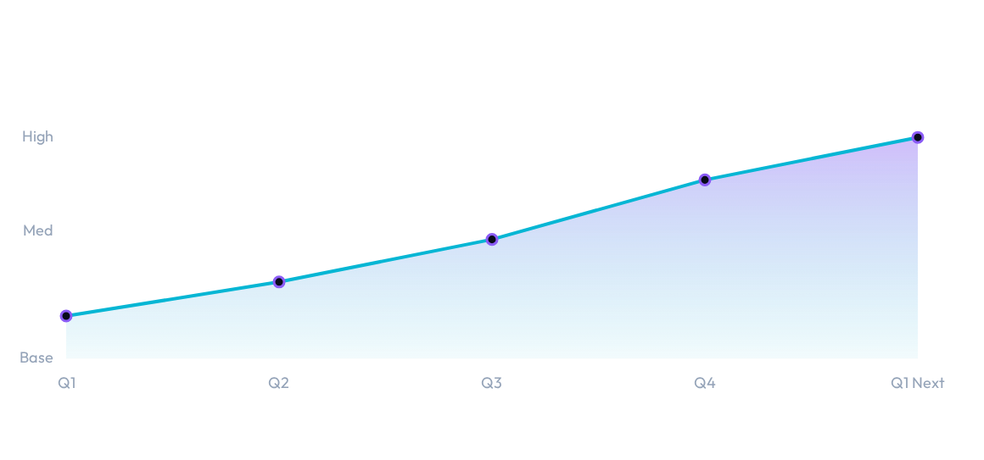
HOW WE'LL KNOW IT'S WORKING
Two numbers. Reported together, every quarter.
Premium Device Retention Rate
Measured at upgrade: Do premium buyers stay in the Galaxy ecosystem or switch to iPhone.
Active Galaxy AI Feature Engagement
Tied directly to churn analysis not downloads, not activations. Actual, continued use.

Slide 9
Retention isn't a feature. It's a discipline.
Thank you , questions welcome.

