Slide 1

Creating Autonomous, 3D Printed, Food Delivery Drones

Slide 2
The Why
?
Cheaper
No more tips!
Faster
Campus sidewalks and streetways are crowded, slowing down drivers and delivery rovers
More Food Storage
Drone can be as large as we need
More Reliable
Autonomy ensures a closed-loop system with zero human error

Slide 3
The What
1
Let’s look at the drone!

Slide 4
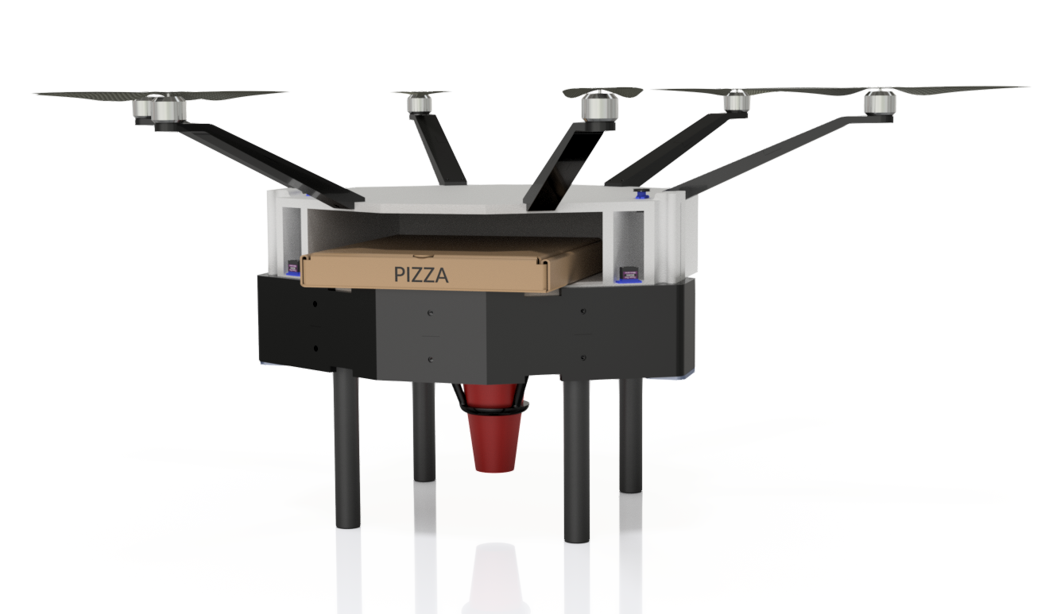

Slide 5
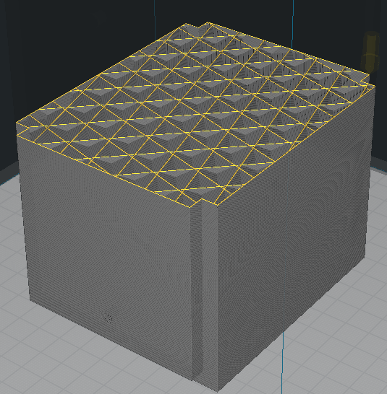
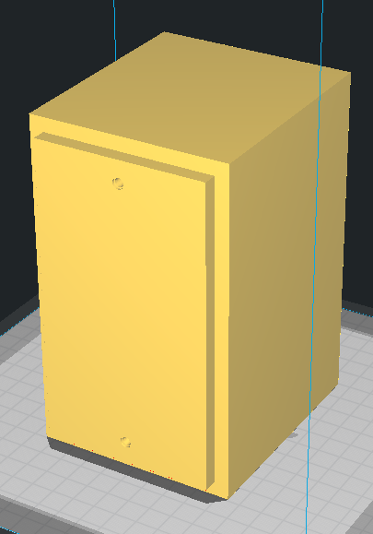
3D Printing
Low Density, High Strength

Slide 6
How to Print?
3D printers are small! How do we print such a large drone?

Slide 7
Split into pieces
1. Cut up Drone into Printable Portions
2. Ensure Pieces Fit Together

Slide 9
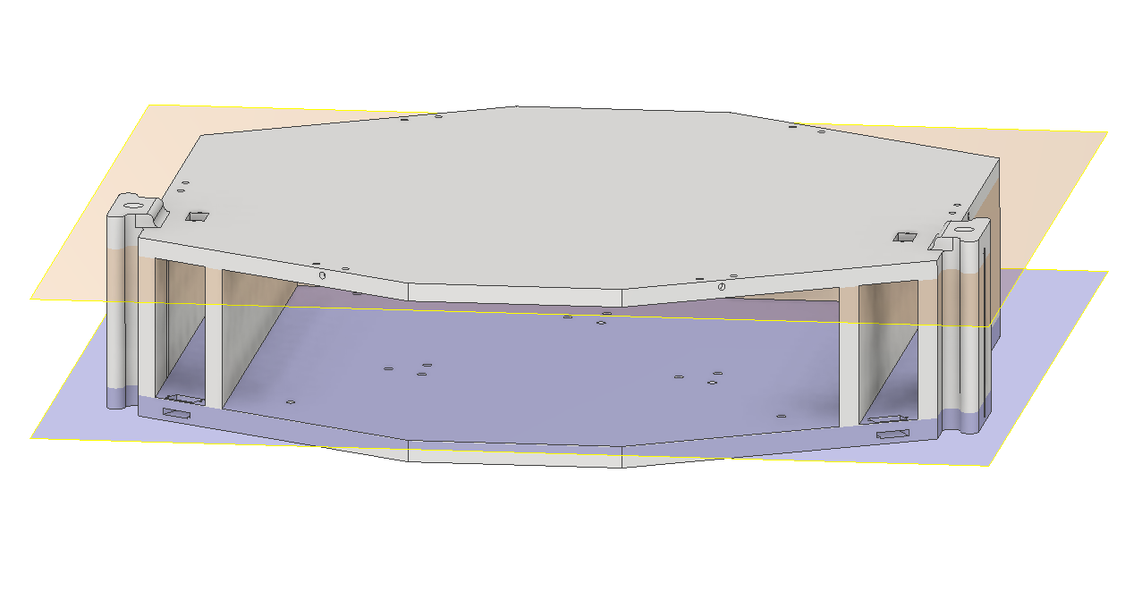
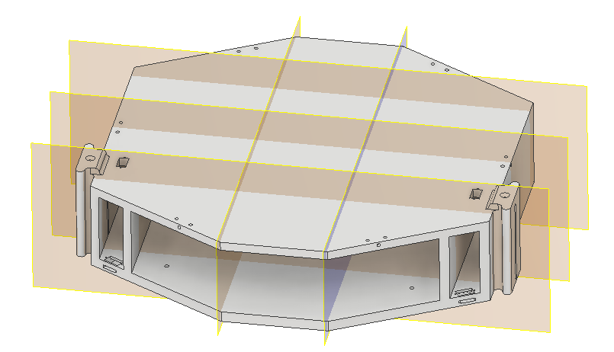
Cutting Drone Up

Slide 10
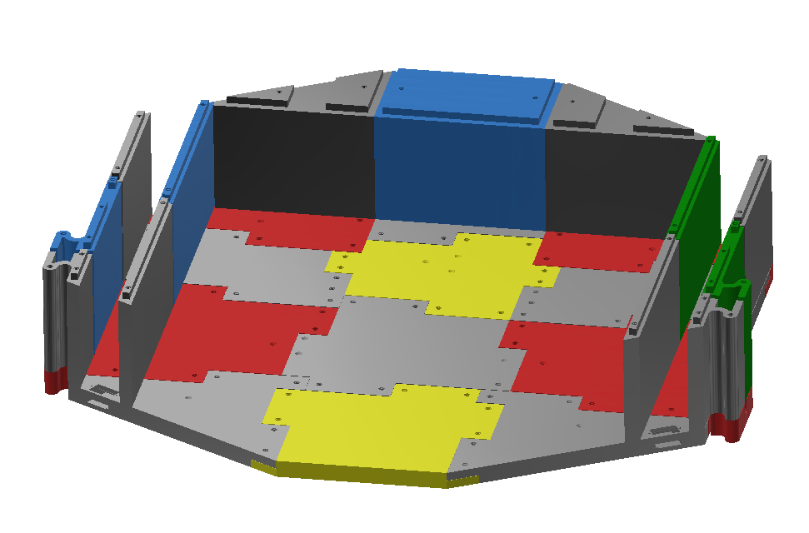
Ensuring Pieces Fit

Slide 11
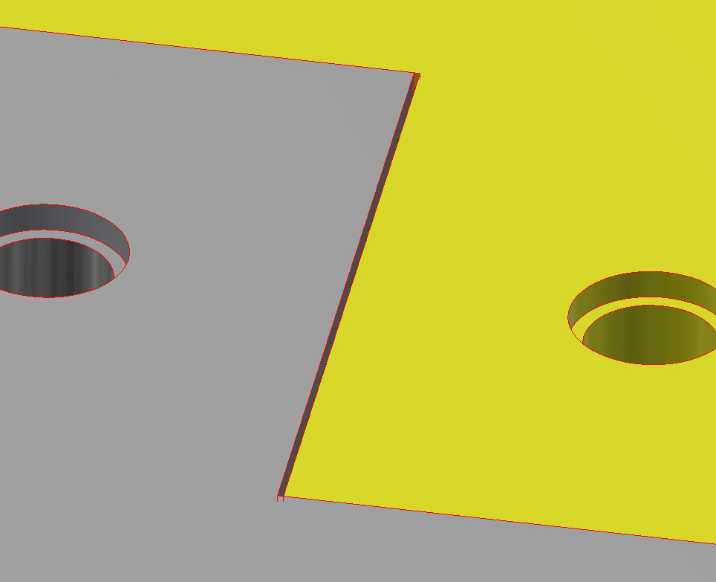
Ensuring Pieces Fit

Slide 12
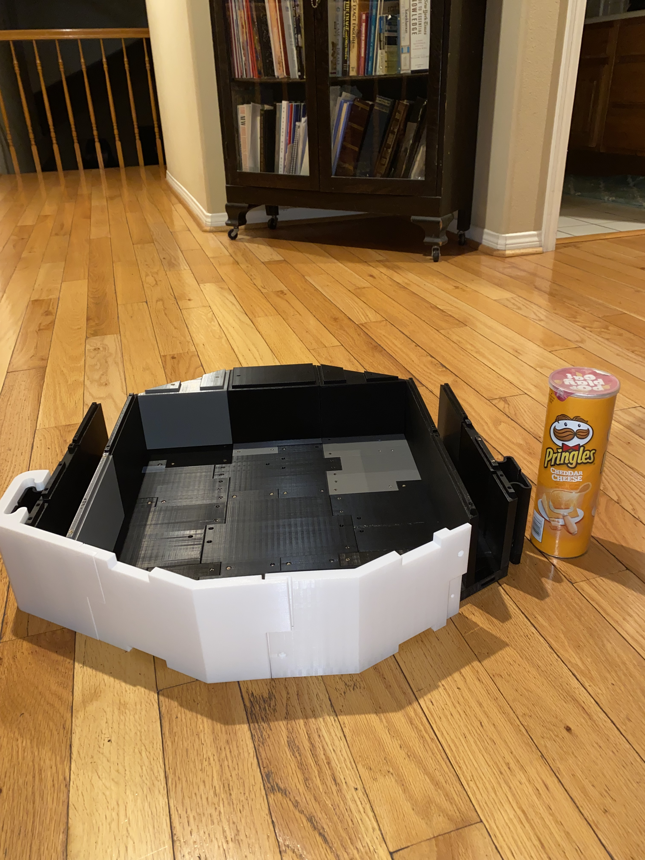
Current Progress

Slide 13
Thank You!

