Slide 1
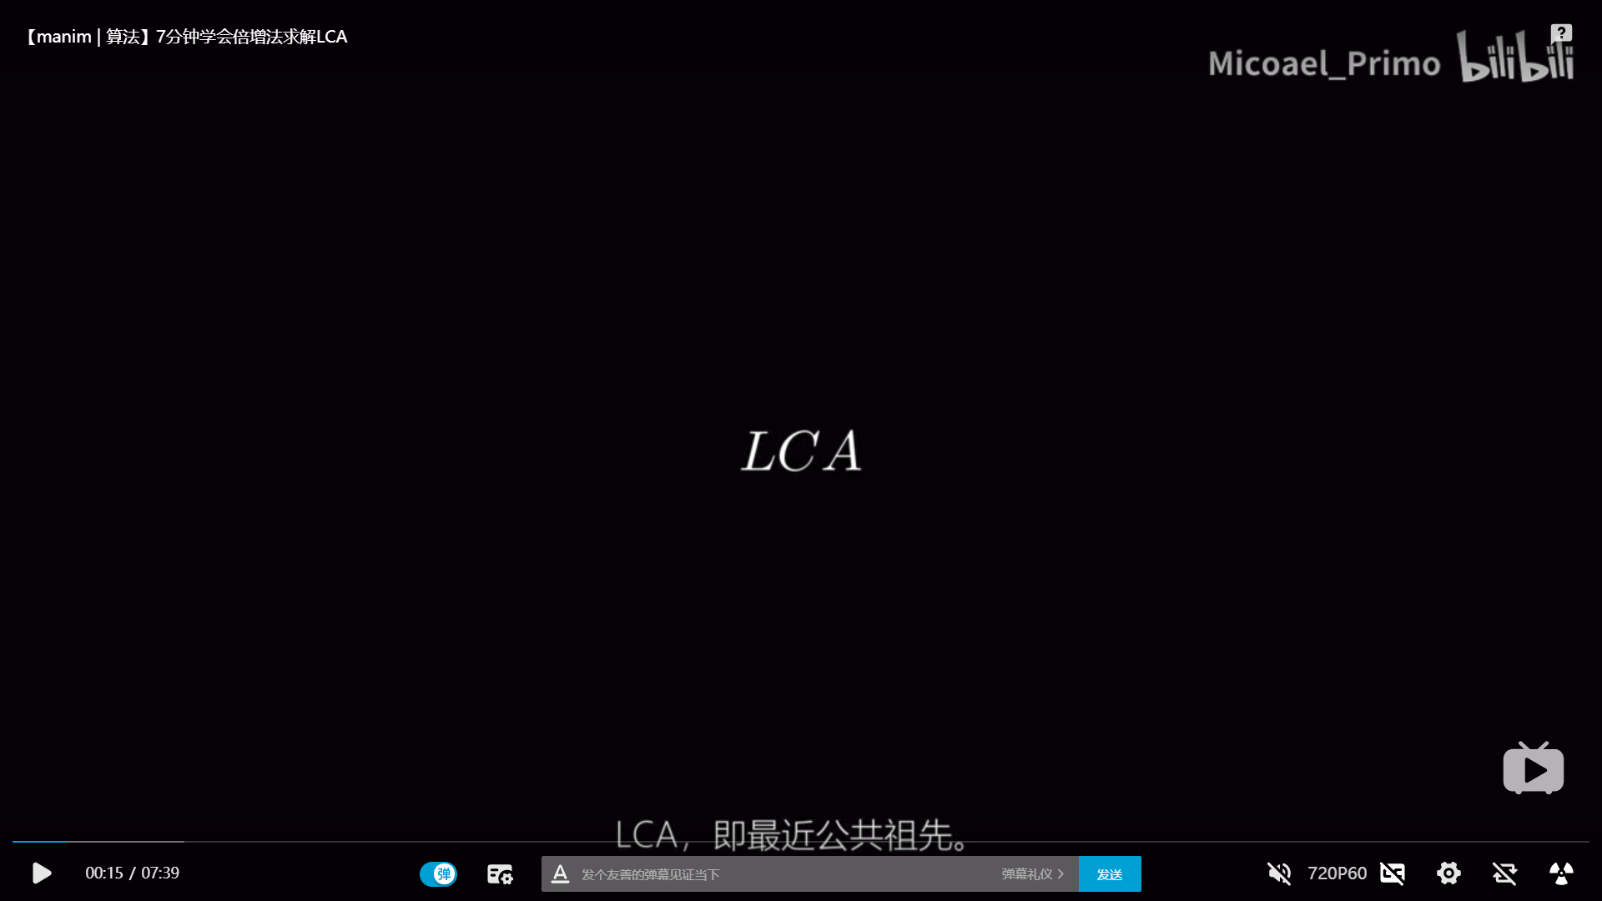
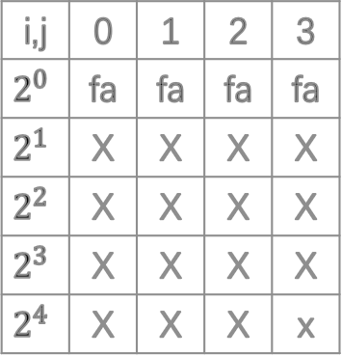










$$Thanks for watching!$$
$$east$$
$$ommon$$
$$ncestors$$
M_p
clf
wzh
7
6
5
3
2
a
c
x
r
y
c
e
f
v
n
y
k
l
x
c
v

Slide 2
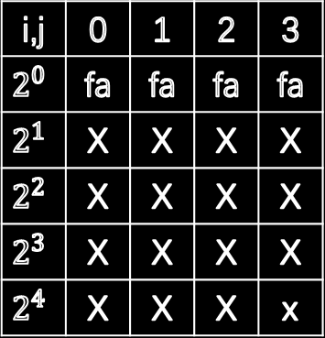
i,j | 0 | 1 | 2 | 3
$$2^{0}$$ | fa | fa | fa | fa
$$2^{1}$$ | X | X | X | X
$$2^{2}$$ | X | X | X | X
$$2^{3}$$ | X | X | X | X
$$2^{4}$$ | X | X | X | x

Slide 3



$$east$$
$$ommon$$
$$ncestors$$
M_p
clf
wzh
7
6
5
3
2
a
c
x
r
y
c
e
f
v
n
y
k
l
x
c
v

