Slide 1
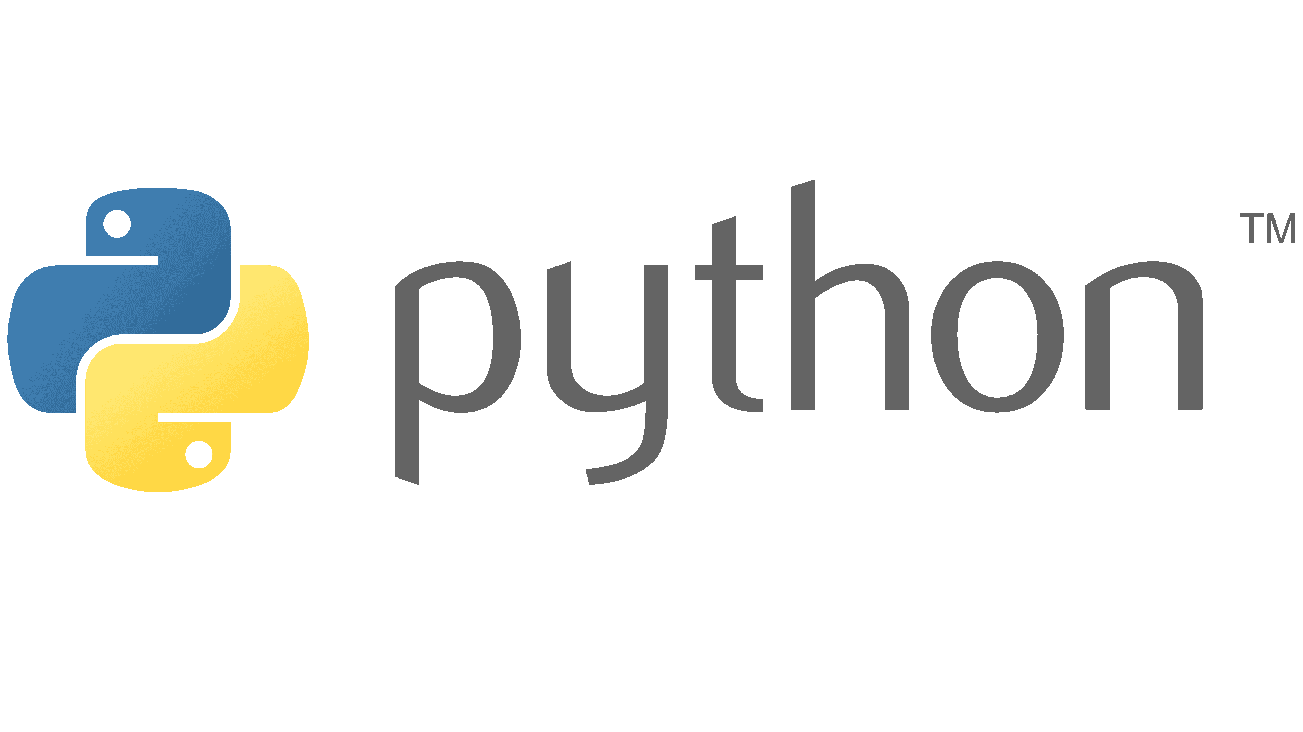
Brief introduction of python and it's interpreter

Slide 2
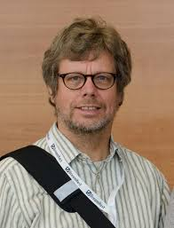
Brief introduction of python and it's interpreter
Python was created by Guido van Rossum. A Dutch programmer
Created in 1991

Slide 3
Brief introduction of python and it's interpreter
He got the experience to create a programming language from a previous company he worked on creating a language called ABC which was known for its simplicity and ease of learning. Which turned out
To be unsuccessful.
A B C

Slide 4
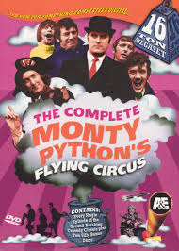
Brief introduction of python and it's interpreter
He didn’t give give the name python because of an actual python by the name was inspired from his favourite show.

Slide 5




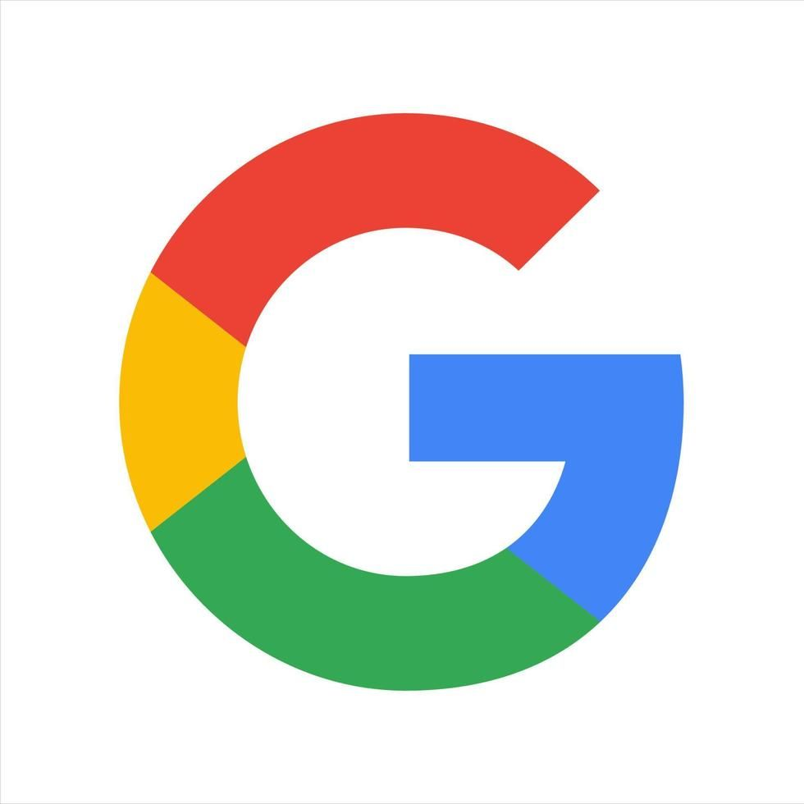
Popular Sites that uses python.
You tube.
Instagram
Spotify
Google

Slide 6
Brief introduction of python and it's interpreter
Python is a high-level, interpreted programming language known for its simplicity and readability.
It has a large standard library and supports multiple programming paradigms, including procedural, object-oriented, and functional programming.
Python code is executed by an interpreter, which translates high-level code into machine-readable bytecode.
Python’s interpreter: Python Virtual Machine(PVM)

Slide 7
Brief introduction of python and it's interpreter
Areas of application of Python programming language:
Web development (Django, Flask)
Data science and machine learning (NumPy, pandas, scikit-learn)
Scripting and automation
Game development (Pygame)
Desktop GUI applications (Tkinter)

Slide 8
Python no de use
semi colon for end
Of code oooh
It uses indentation

Slide 9
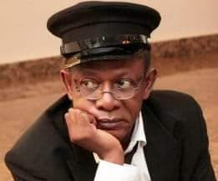
I hope don hear am !!!

