Slide 1
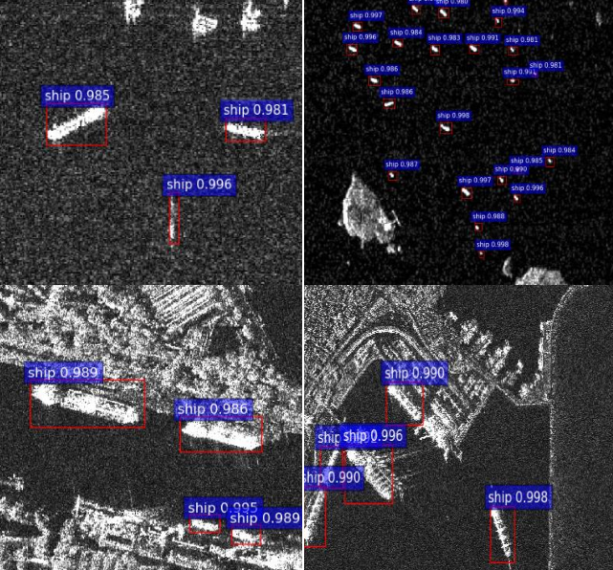


LOOKING FOR VESSELS DETECTION?
AI Solutions for Vessel Identification in SAR Images
Zazzarini Micol – Fiorani Andrea

Slide 2
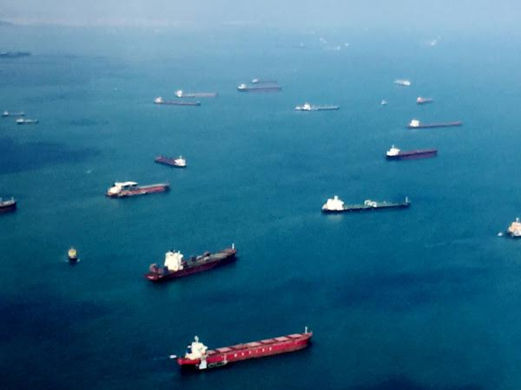
Contents
SAR Ship Detection
State of Art
Materials and Methods
Hyperparameter Tuning
Optimization
Conclusion

Slide 3
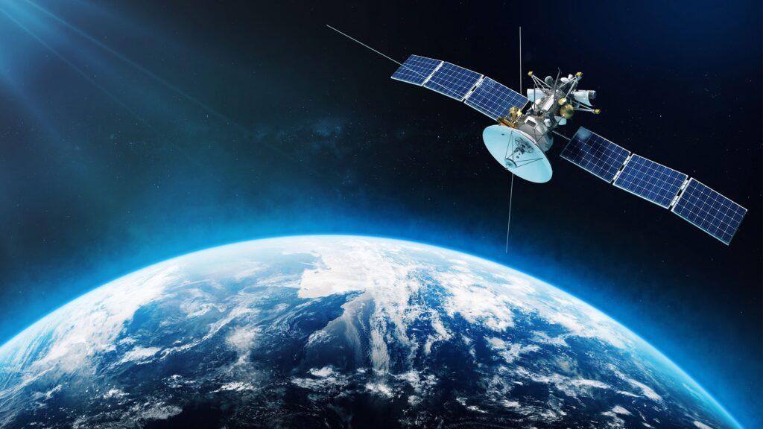
SAR Ship Detection
Problem: Identification of objects at sea using SAR for the monitoring and surveillance of vessels in absence of AIS signal.
Our Goal: improve the current state of the art in vessel identification using Synthetic Aperture Radar (SAR) imagery, in collaboration with National Research Council of Italy (CNR)

Slide 4



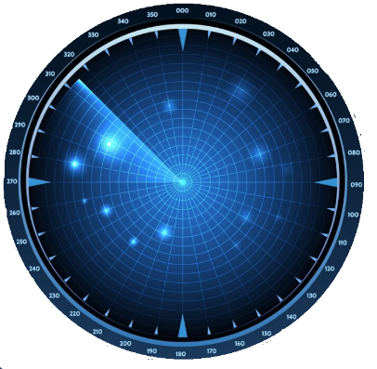
Understanding SAR Technology
Exploring the role of Synthetic Aperture Radar in Maritime Surveillance
Definition of SAR
Synthetic Aperture Radar
SAR is a remote sensing method used to create images of objects on the ground, including vessels at sea.
5) Applications in Surveillance
Crucial for detecting illegal fishing and other maritime activities, SAR enhances security in dense environments.
2) Vessel Detection
SAR technology effectively detects and monitors vessels, making it essential for maritime operations and surveillance.
3) High-Resolution Imagery
SAR provides detailed images regardless of weather conditions, ensuring reliable and accurate monitoring day and night.
4) Radar Reflection Analysis
Analysis of radar reflections from ship structures enables precise identification and tracking of various vessels.

Slide 5
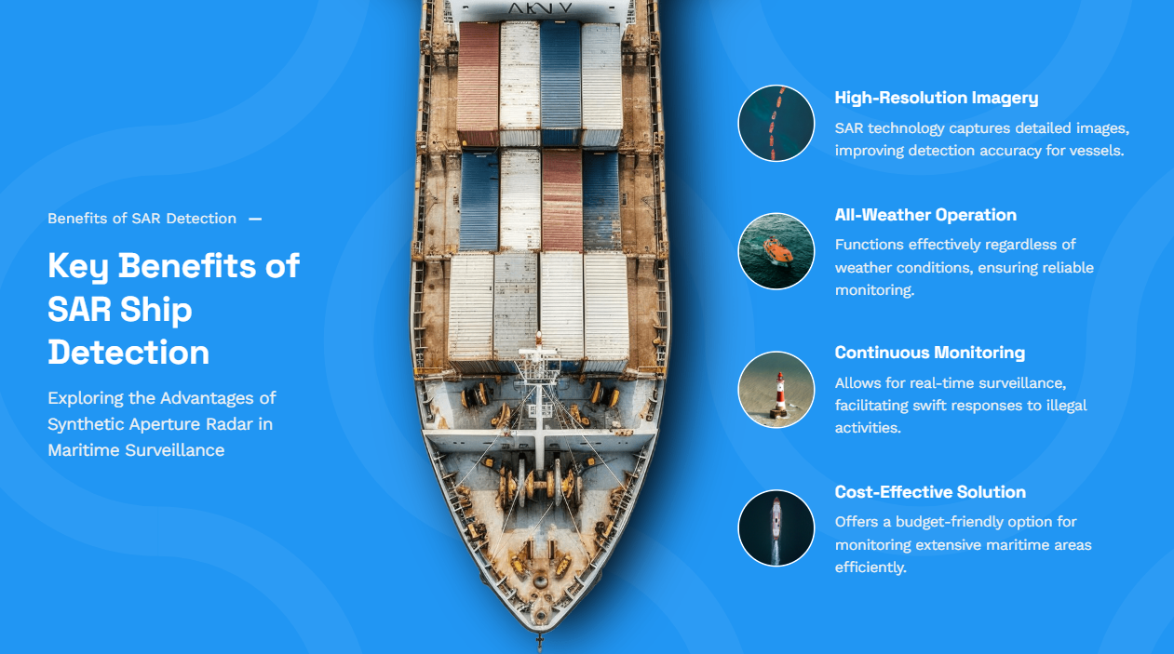
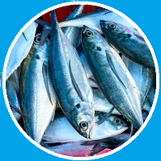
Understanding SAR Technology
Exploring the role of Synthetic Aperture Radar in Maritime Surveillance
Synthetic-aperture Radar
SAR technology captures detailed images, improving detection accuracy for vessels.
Key Benefits of SAR Ship Detection
Exploring the Advantages of Synthetic Aperture Radar in Maritime Surveillance
All-Weather Operation
Functions effectively regardless of weather conditions, ensuring reliable monitoring.
Continuous Monitoring
Allows for real-time surveillance, facilitating swift responses to illegal activities.
Monitoring IUU Fishing
SAR can detect vessels involved in illegal fishing 24/7, even in poor weather or darkness.
Cost-Effective Solution
Offers a budget-friendly option for monitoring extensive maritime areas efficiently.

Slide 6

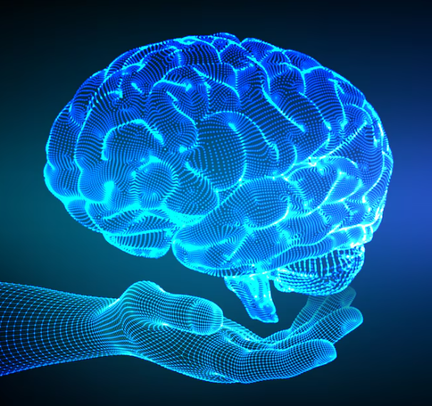
Understanding SAR Technology
State of Art
Traditional Algorithms
Deep Learning Algorithms
One stage detectors
(YOLO)
Two stage detectors
Affected by a series of limitations
(RCNN)

Slide 7
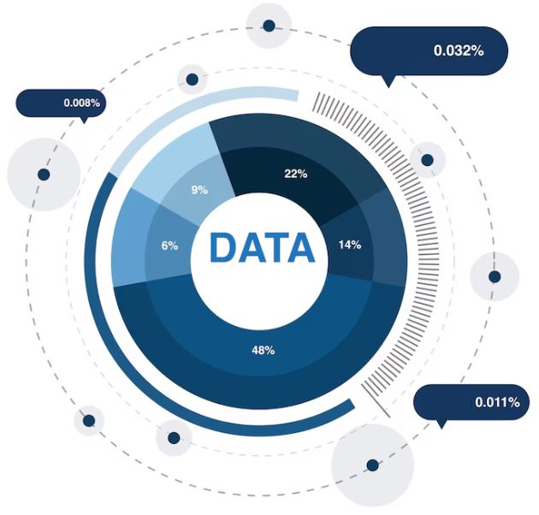
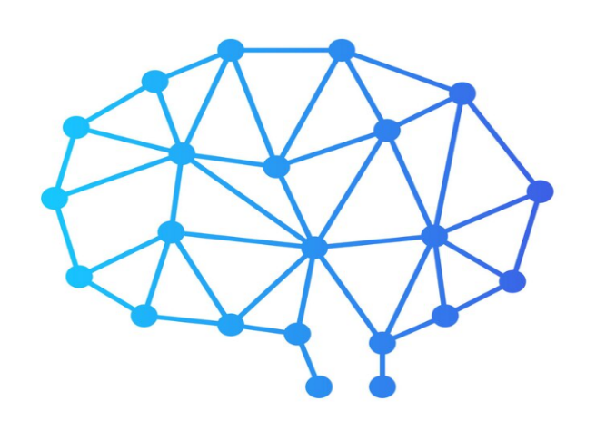
Materials and Methods
Dataset
Architectures

Slide 8
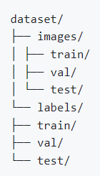
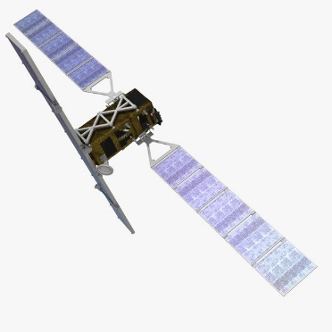
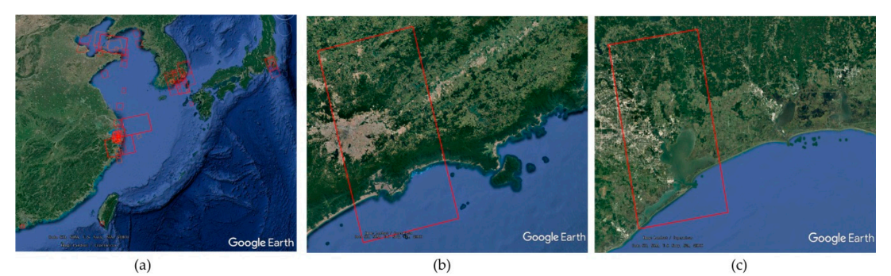
SAR Dataset of Ship Detection for Deep Learning under Complex Backgrounds
Object detectors archieve higher mean average precision on it and have higher generalization performance.
102 Chinese Gaofen-3 images and 108 Sentinel-1 images, 43.819 ship chips in total.
70%
15%
15%
Balance and consistency between images and labels

Slide 9
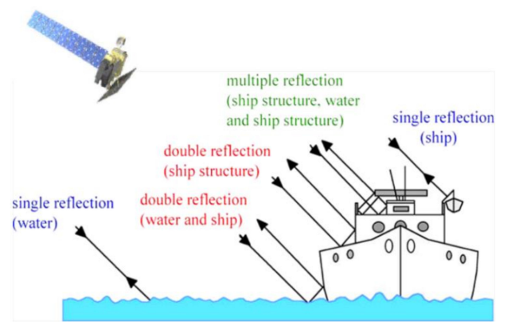
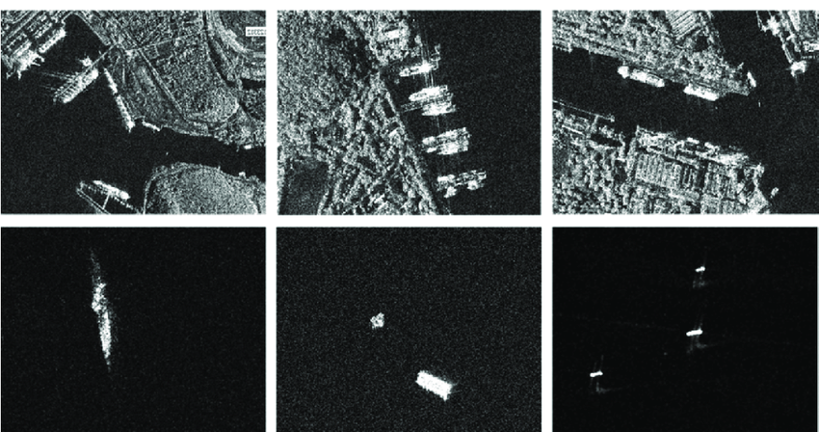
SAR Dataset of Ship Detection for Deep Learning under Complex Backgrounds
Challenges
These ships have distinct scales and backgrounds, and they vary in terms of polarization, resolution, incidence angle, imaging mode, and background.
Ships appear as bright pixels mainly due to the double reflection of pulses emitted by the sensor.
The incidence angle influences the geometry of the ships, producing foreshortening, layover, and shadowing.

Slide 10
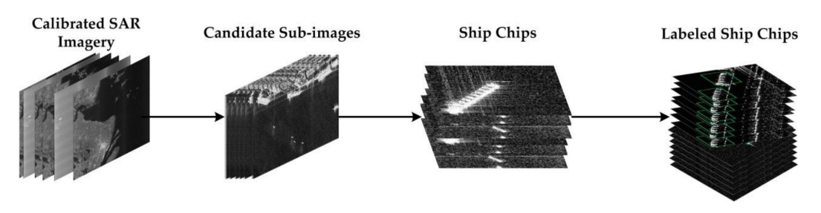
SAR Dataset of Ship Detection for Deep Learning under Complex Backgrounds
Labeling Procedure
3. Sliding windows from these candidate subimages are used to acquire ship images 256 x 256 pixels in size
2. Candidate subimages containing ships with sizes greater than 800 pixels are cropped
4. They are labeled by SAR experts with LabelImg
1. All SAR images are converted to sigma0 values

Slide 11


SAR Dataset of Ship Detection for Deep Learning under Complex Backgrounds
Multiscale Ships Size
PROBLEM
Compared with those objects in the optical dataset, the ship size is small, they miss the characteristics of ships on the feature map, making it difficult to distinguish ships leading to false alarms.
SOLUTION
Land-ocean segmentation
Complex backgrounds
Relative bounding box size

Slide 12
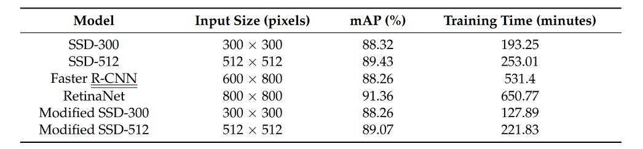
SAR Dataset of Ship Detection for Deep Learning under Complex Backgrounds
Experimental results from « A SAR Dataset of Ship Detection for Deep Learning under Complex Backgrounds » by Wang, Zhang, Wei
The models trained on these data can detect multiscale ships with low numbers of false positives under complex backgrounds.

Slide 13
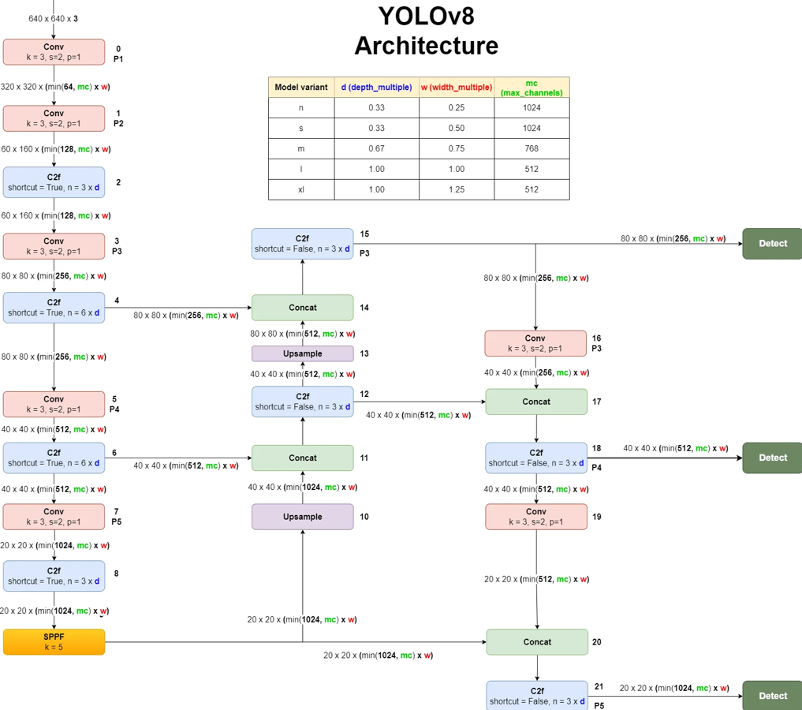

YOLOv8 architecture
Neck
Backbone
Head

Slide 14

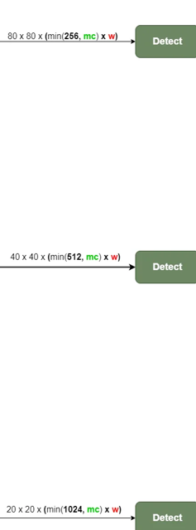
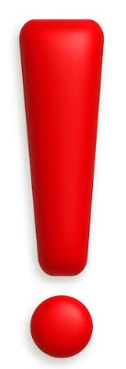
YOLOv8 architecture
Head
Small Objects
The Head manages the final object detection phase.
YOLOv8’s Key feature: division of the detect block into three distinct paths, each specialized in detecting objects of different sizes.
Each path consists of multiple convolutional layers and concat operations, which progressively reduce the resolution of feature maps, ensuring proper handling of objects at different scales.
Detect
Medium Objects
Detect
Big Objects
Detect

Slide 15
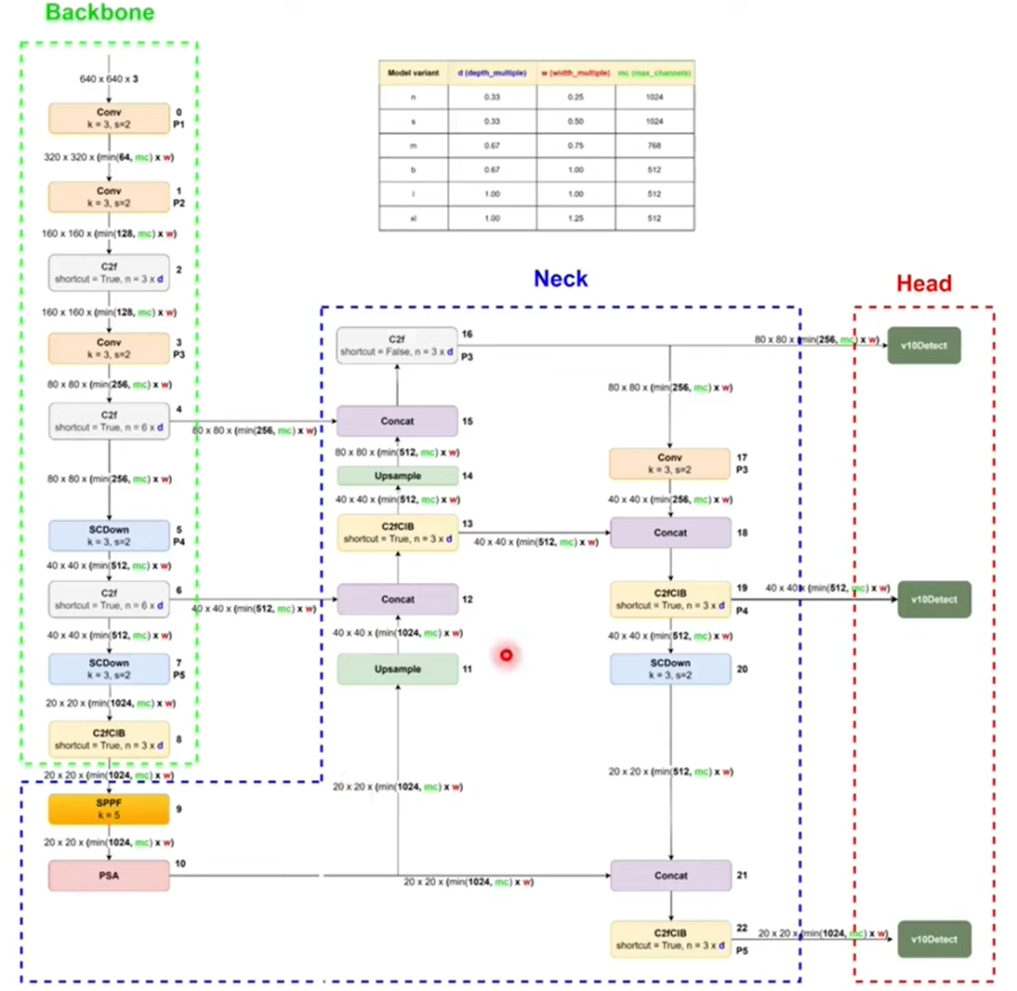
YOLOv10 Architecture
Elimination of the NMS (Non-Maximum Suppression) post-processing step during training.
Holistic approach to optimize every component of the model
Partial Self-Attention (PSA) module

Slide 16
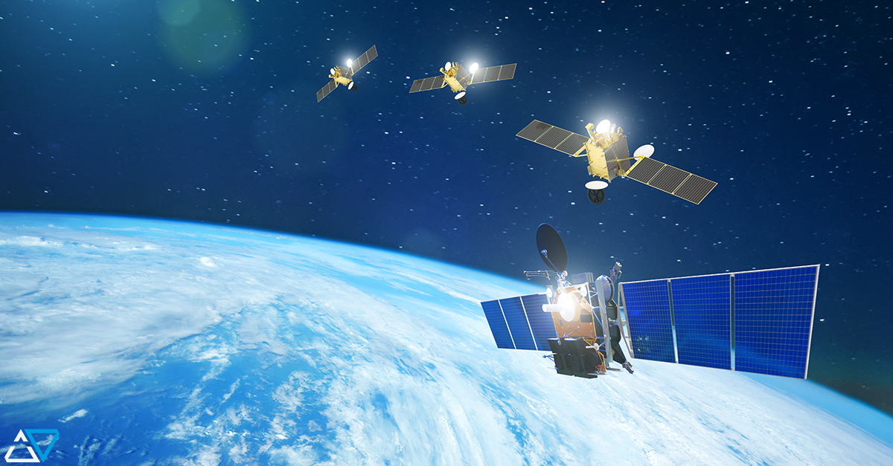
Experimental Setup and Analysis Conducted
Environment
Hyperparameter tuning
CO2 Emissions
Inference Evaluation
Optimization
Results and Discussion
Future Works

Slide 17


Environment
Robust experimental environment given by a Docker container, to provide a consistent and isolated platform for conducting our experiments.
Computational capabilities of an Intel(R) Xeon(R) Gold 6254 CPU @ 3.10GHz and GPU type NVIDIA RTX A6000 for our trainings.

Slide 18

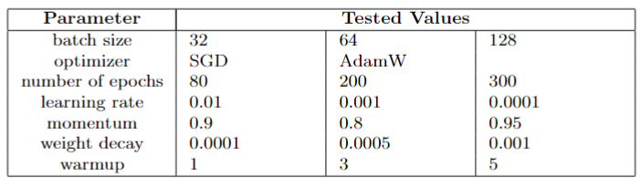
Hyperparameter tuning
Conducted tests
Hyperparameter tuning for YOLOv8s and YOLOv10s architectures.
This involved iteratively adjusting key parameters to maximize the models' detection accuracy and efficiency.
Tested Parameters:
Batch size
Optimizer
Number of Epochs
Learning Rate
Momentum
Weight Decay
Warmup

Slide 19
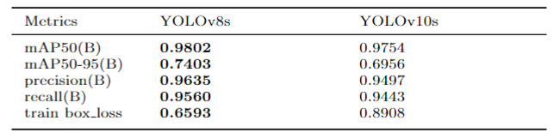
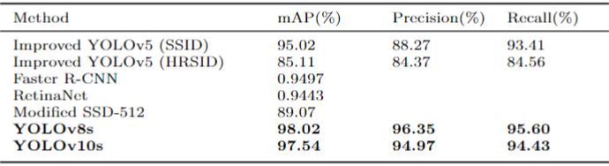

Hyperparameter tuning
Results
( epochs: 200, batch size: 64, optimizer: SGD, lr: 0.010, wd: 0.0005, wu: 3, mom: 0.9)
Time avg v8: 8h
Time avg v10: 10h

Slide 20

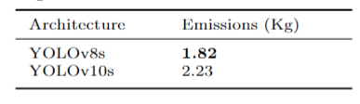
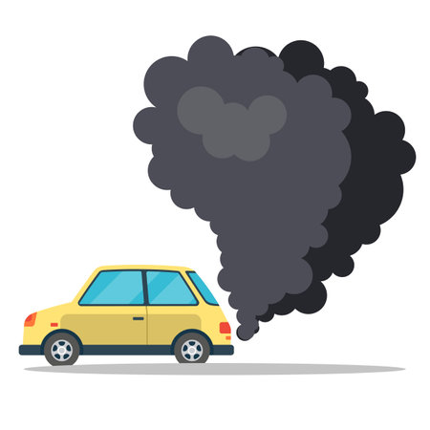
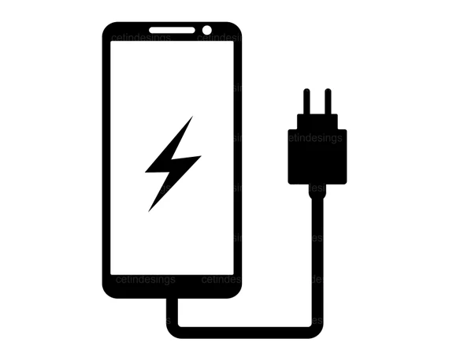
Hyperparameter tuning
CO2 Emissions
YOLOv8s with the best configuration emitted 1.82 Kg of CO2.
YOLOv10s with the best configuration emitted 2.23 Kg of CO2
driving 9 km with a car
Charging a smartphone 11 times

Slide 21
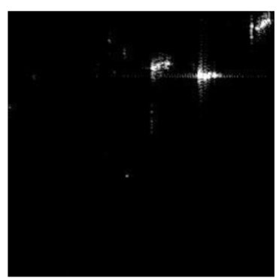
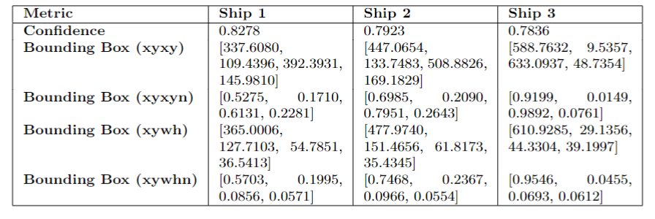
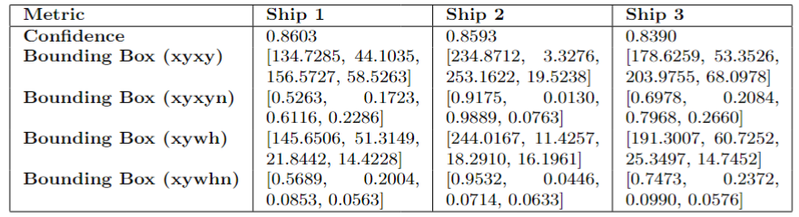
Inference
Results
We tested the inference on both YOLOv8 and YOLOv10 using 3 samples.
YOLOv8s
Input sample
YOLOv10s
Time avg: 2.5s

Slide 22
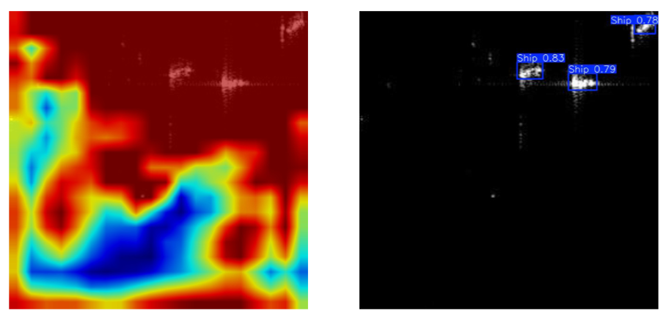
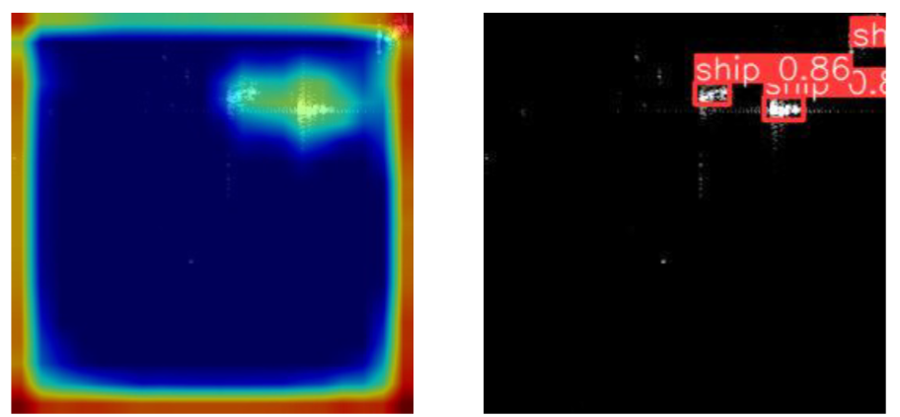
Inference
Explainability
Eigen CAM: technique applied in neural networks to generate an activation map that highlights the regions of an image that have most influenced the model's prediction.
YOLOv8s
YOLOv10s
RED for the areas that influenced the most
BLUE for the areas of less importance
Bounding box and relative Confidence Score

Slide 23
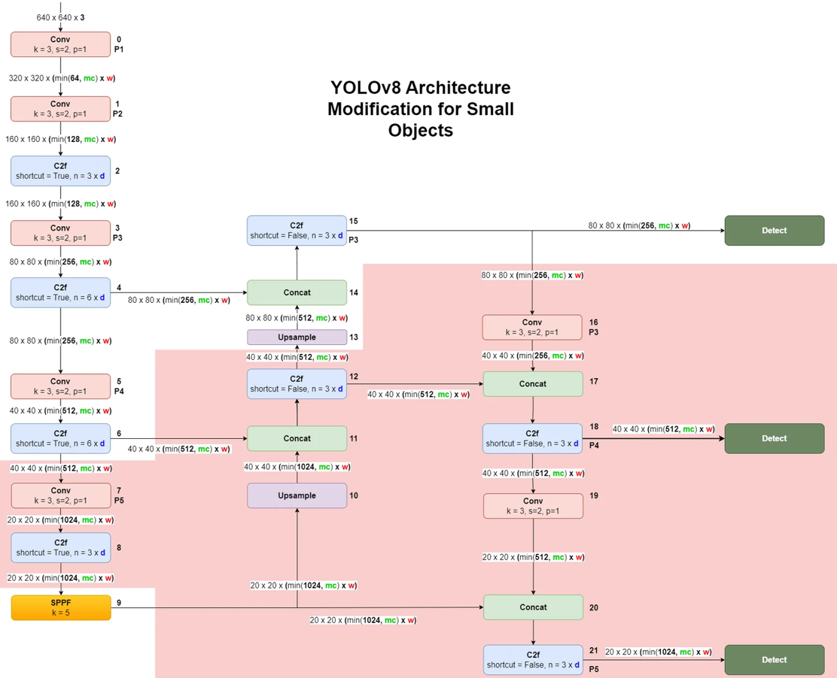
Optimization
YOLOv8s architecture’s modifications
Small Objects Detection block
Layer-based pruning approach
Deleted Layers

Slide 24

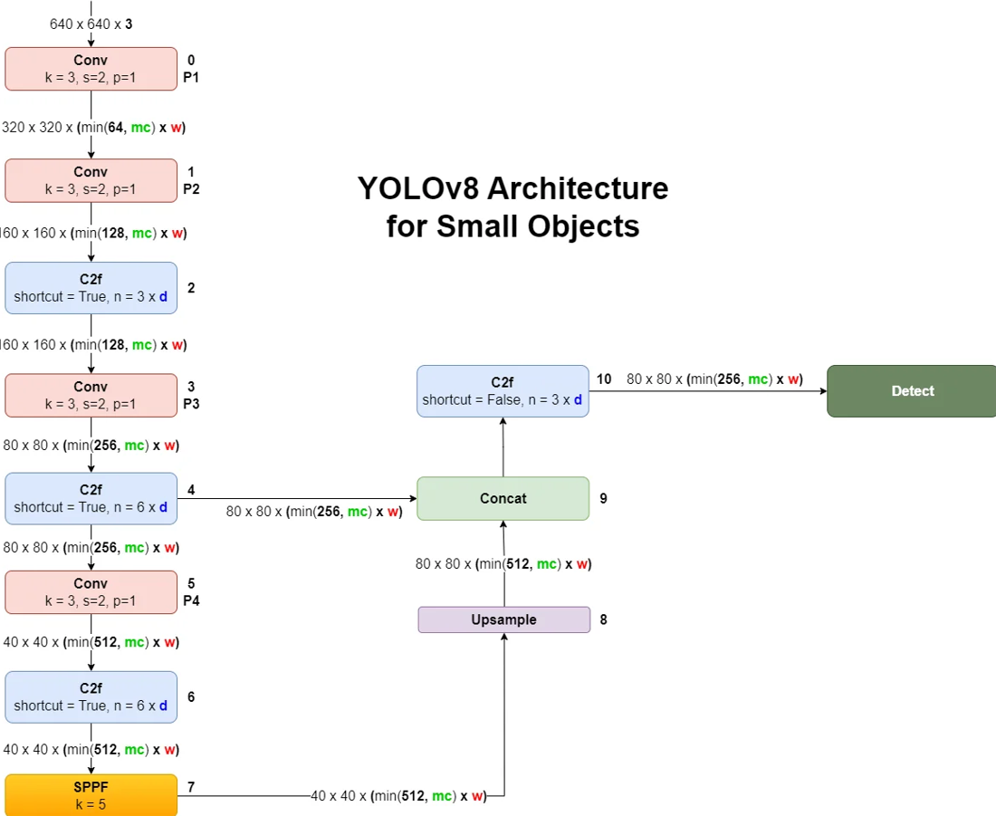
Optimization: YOLOv8s architecture for Small Objects

Slide 25
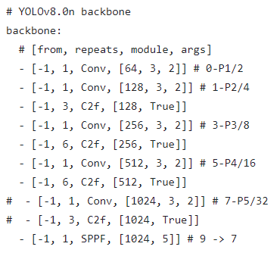
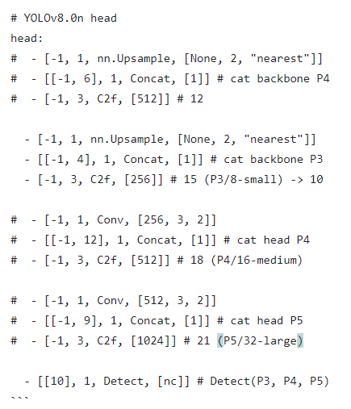

Optimization
YOLOv8 Architecture’s file modifications
We have commented out the file’s rows corrisponding to the layers we wanted to delete.

Slide 26

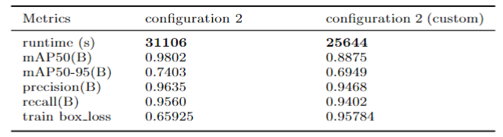
Optimization
YOLOv8s Results
Reduction of approximately 18%, 5462 seconds less!
The YOLOv8 Small Custom configuration offers a clear advantage in terms of time efficiency, with a significant reduction in execution times, at the cost of a minimal penalty in performance.
Tradeoff between Speed and Accuracy

Slide 27
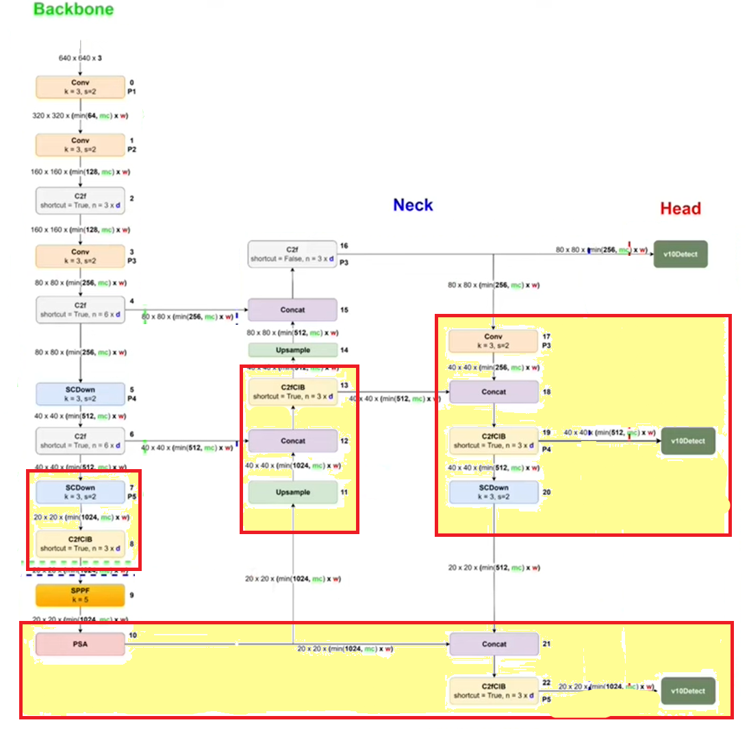
Optimization
YOLOv10s Modifications
Deleted Layers
The procedure for YOLOv10s is the same of YOLOv8s procedure, taking into account the slight architectural differences between the two models.

Slide 28
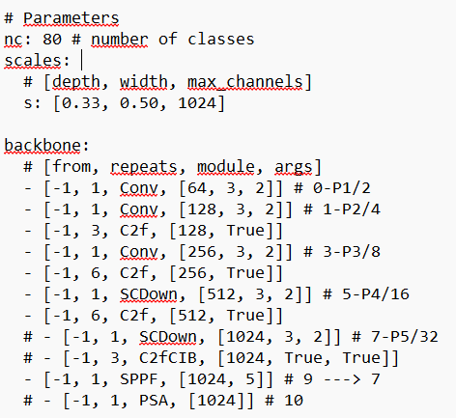
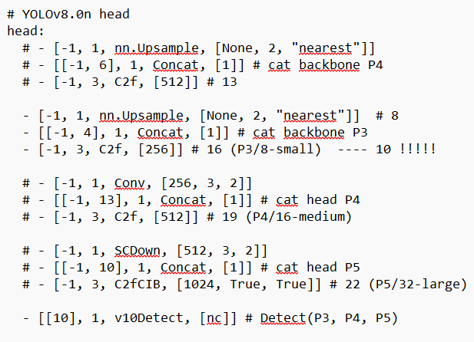
Optimization
YOLOv10 Architecture’s file modifications

Slide 29
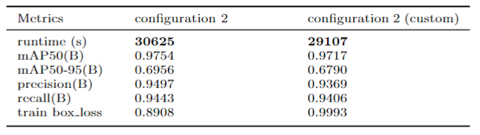
Optimization
YOLOv10s Results

Slide 30
Results and Discussion
The results obtained have shown significant improvements in terms of precision and efficiency compared to previous versions.
Our analysis of CO2 suggests that computational efficiency must be balanced with the need to reduce the carbon footprint.
We found a tradeoff between speed and accuracy through our customized architecture for small objects.

Slide 31
Future Works
Using a MobileNet as a convolutional backbone could significantly increase the computational efficiency
Approach the task not only as a detection task but also as a classification task
Focus on developing energy-efficient training protocols and optimizing the computational resources required for both training and inference.

Slide 32
Thank You for the Attention
Zazzarini Micol
Fiorani Andrea

Slide 33
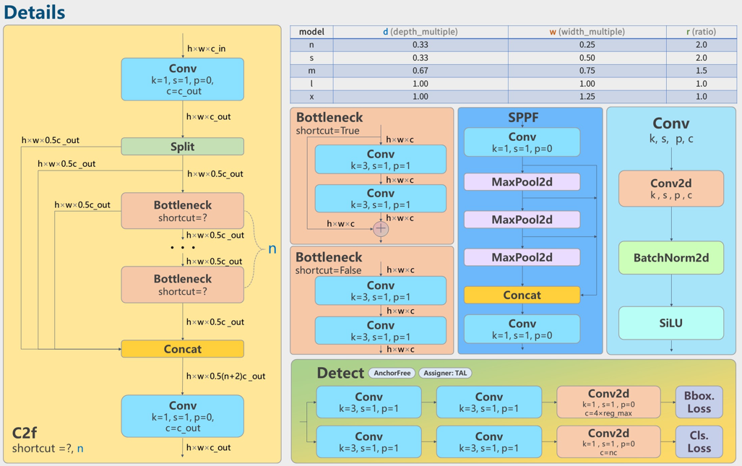
YOLOv8 architecture
blocks
MODEL VARIANTS
Architecture’s blocks:
C2f
Bottleneck
SPPF
Conv
Detect

Slide 34

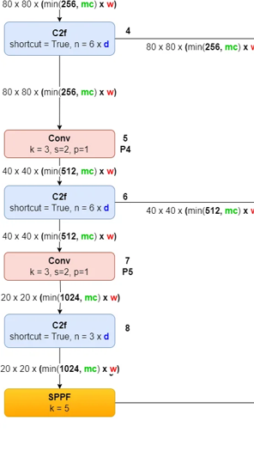
YOLOv8 architecture
Backbone
The backbone is responsible for feature extraction from the input image
Composed by:
Conv layers
C2f blocks
SPPF block

Slide 35
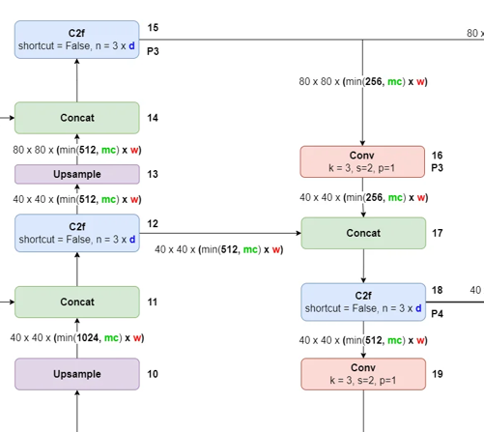
YOLOv8 architecture
Neck
The neck is responsible for integrating information from various resolution scales.
Composed by:
C2f blocks
Concat blocks
Conv layers
Upsample blocks

Slide 36
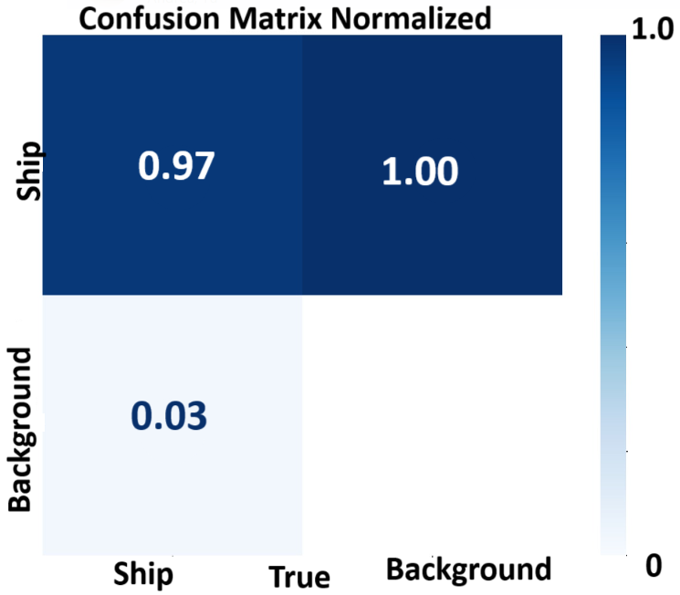
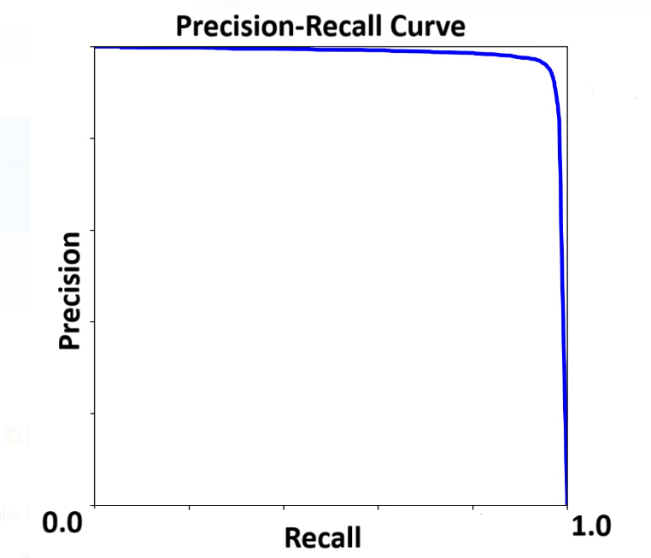
Hyperparameter tuning
Results

Slide 37
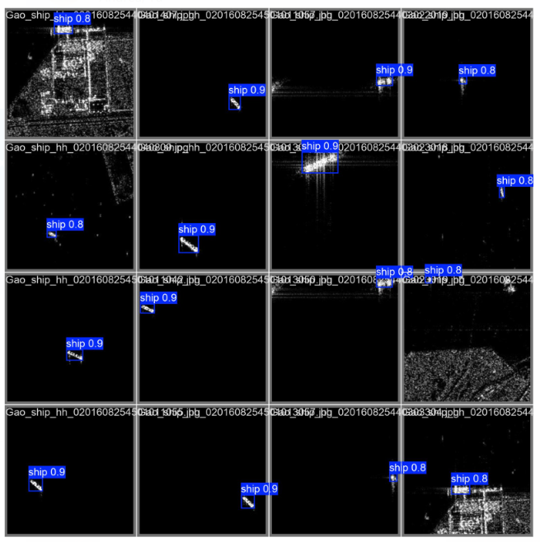
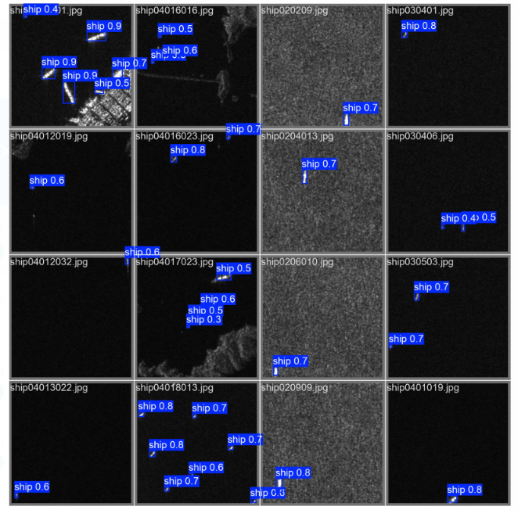
Inference
Examples

