Slide 1
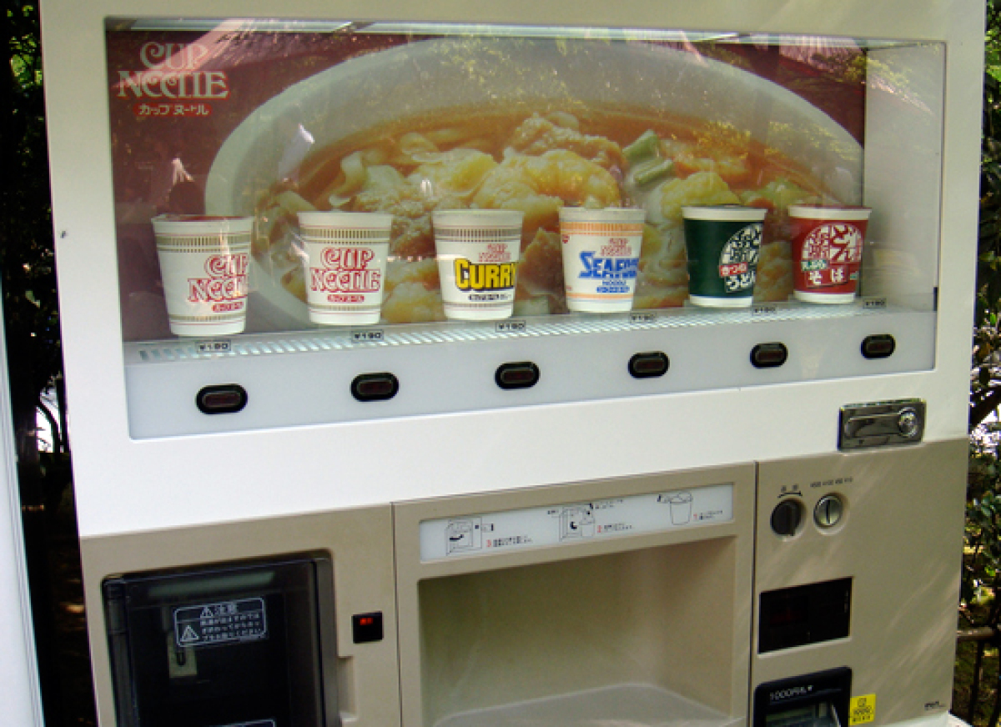
The VendoTron 5000
An Extravagant Guide Into the World’s Most Advanced Text-Only Vending Machine
*VENDOTRON NOT PICTURED
Alex Kronish COMS 143-01 Spring 2017

Slide 2
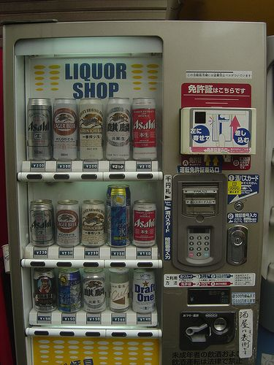
Featuring Vending Machine Innovations Such As…
Three comma delimited text files (CSV’s) storing the machine state
The only vending machine on earth that plays back MIDI audio
Over TWO classes!
Multi-threading
A one in five chance of your product getting stuck & refunding your money
If you turned the code at a 45 degree angle it could be easily used as a background on a network news story about hackers.
Keeps track of internal cash by coin type, lifetime sales stats, and product codes & quantity.
Adaptable based on the structure of VEND_PRODUCTS.csv – will automatically allocate slots based on the csv file.

Slide 3

File Handling!
Using three separate CSV’s to store the state of the machine.
VEND_PRODUCTS.CSV: Stores the product info such as ID Num, Price, Qty, and Name
VEND_PERSIST.CSV: Stores Vendo’s lifetime sales stats, in quantity and dollars.
VEND_CHANGE.CSV: Stores Vendo’s current coinage stash as Dollars, Quarters, Dimes, Nickels, and Pennies.
Writes back to these files any time a change is made or the program exits!
Writes a line to a transaction log for every item successfully dispensed into an XML

Slide 4

Multi-threaded!
Turns out its way easier to do in C++ than in Java
One thread handles Vendo, the other handles the audio player because playing MIDI’s with MCISendString is really frustrating.
Once both threads are flagged as finished the program will exit
One in five chance you will get a song off of hit Nine Inch Nails album “Pretty Hate Machine”

Slide 5

Extra Facts!
Strangely went off the rails to become one of the most complex things I’ve ever coded that doesn’t touch a database.
Detects an error state if there is a jam or the machine is empty!
Bob Dylan’s Exploding Sugar Lumps not available for sale anywhere else on earth!
Checks your input in case when it says enter a number you type in a word

Slide 6

Things I Learned About Myself Along The Way
In a multithreaded setup, competing cout statements can interfere with eachother at << concatenators and you should use \n for newlines.
Did we learn exceptions I don’t actually remember?
A hot trick to get around the limitations of modulus is multiply by 100 then divide by 100 after.
If you forget to do std::noskipws you will be very upset on reading a file.
You can basically sell whatever you want in a vending machine
Generating at string that contains a timestamp is a gigantic nightmare.
Someone is still maintaining a Nine Inch Nails MIDIs website in the year 2017 and that’s kind of rad.

