Slide 1
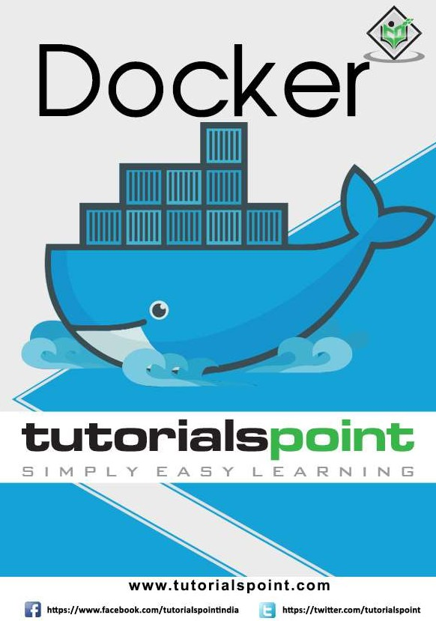

Slide 2

Docker
About the Tutorial
This tutorial explains the various aspects of the Docker Container service. Starting with the basics of Docker which focuses on the installation and configuration of Docker, it gradually moves on to advanced topics such as Networking and Registries. The last few chapters of this tutorial cover the development aspects of Docker and how you can get up and running on the development environments using Docker Containers.
Audience
This tutorial is meant for those who are interested in learning Docker as a container service. This product has spread like wildfire across the industry and is really making an impact on the development of new generation applications. So anyone who is interested in learning all the aspects of Docker should go through this tutorial.
Prerequisites
The prerequisite is that the readers should be familiar with the basic concepts of Windows and the various programs that are already available on the Windows operating system. In addition, it would help if the readers have some exposure to Linux.
Copyright & Disclaimer
© Copyright 2017 by Tutorials Point (I) Pvt. Ltd.
All the content and graphics published in this e-book are the property of Tutorials Point (I) Pvt. Ltd. The user of this e-book is prohibited to reuse, retain, copy, distribute or republish any contents or a part of contents of this e-book in any manner without written consent of the publisher.
We strive to update the contents of our website and tutorials as timely and as precisely as possible, however, the contents may contain inaccuracies or errors. Tutorials Point (I) Pvt. Ltd. provides no guarantee regarding the accuracy, timeliness or completeness of our website or its contents including this tutorial. If you discover any errors on our website or in this tutorial, please notify us at contact@tutorialspoint.com.
i

Slide 3
Docker
Table of Contents
About the Tutorial....................................................................................................................................i
Audience ..................................................................................................................................................i
Prerequisites ............................................................................................................................................i
Copyright & Disclaimer.............................................................................................................................i
Table of Contents ....................................................................................................................................ii
1. DOCKER ─ OVERVIEW ..........................................................................................................1
2. DOCKER – INSTALLING DOCKER ON LINUX ..........................................................................3
Docker Version......................................................................................................................................10
Docker Info ...........................................................................................................................................11
Docker for Windows..............................................................................................................................12
Docker ToolBox .....................................................................................................................................13
3. DOCKER ─ INSTALLATION ..................................................................................................15
Docker for Windows..............................................................................................................................15
Docker ToolBox .....................................................................................................................................16
Working with Docker Toolbox ...............................................................................................................19
4. DOCKER – DOCKER HUB ....................................................................................................22
5. DOCKER ─ IMAGES.............................................................................................................26
Displaying Docker Images......................................................................................................................26
Downloading Docker Images .................................................................................................................27
Removing Docker Images ......................................................................................................................28
docker images -q ...................................................................................................................................29
docker inspect.......................................................................................................................................30
6. DOCKER – CONTAINERS.....................................................................................................31
Running a Container..............................................................................................................................31
ii

Slide 4
Docker
Listing of Containers..............................................................................................................................31
docker ps -a...........................................................................................................................................32
docker history .......................................................................................................................................33
7. DOCKER – WORKING WITH CONTAINERS ..........................................................................34
docker top.............................................................................................................................................34
docker stop ...........................................................................................................................................35
docker rm..............................................................................................................................................35
docker stats...........................................................................................................................................36
docker attach ........................................................................................................................................37
docker pause.........................................................................................................................................38
docker unpause.....................................................................................................................................39
docker kill..............................................................................................................................................39
Docker – Container Lifecycle .................................................................................................................40
8. DOCKER – DOCKER ARCHITECTURE ...................................................................................42
9. DOCKER – CONTAINER AND HOSTS ...................................................................................44
Docker Images.......................................................................................................................................44
Running a Container..............................................................................................................................44
Listing All Containers.............................................................................................................................45
Stopping a Container.............................................................................................................................45
10. DOCKER – CONFIGURING DOCKER ....................................................................................46
service docker stop ...............................................................................................................................46
service docker start ...............................................................................................................................46
11. DOCKER – CONTAINERS AND SHELLS.................................................................................48
nsenter..................................................................................................................................................49
12. DOCKER – DOCKER FILE .....................................................................................................51
iii

Slide 5
Docker
13. DOCKER – BUILDING DOCKER FILES...................................................................................53
docker build ..........................................................................................................................................53
14. DOCKER – PUBLIC REPOSITORIES.......................................................................................56
docker tag .............................................................................................................................................58
docker push...........................................................................................................................................59
15. DOCKER – MANAGING PORTS ...........................................................................................61
docker inspect.......................................................................................................................................63
16. DOCKER – PRIVATE REGISTRIES .........................................................................................66
17. DOCKER – BUILDING A WEB SERVER DOCKER FILE ............................................................70
18. DOCKER – INSTRUCTION COMMANDS ..............................................................................73
CMD Instruction ....................................................................................................................................73
ENTRYPOINT .........................................................................................................................................74
ENV .......................................................................................................................................................75
WORKDIR ..............................................................................................................................................77
19. DOCKER – CONTAINER LINKING.........................................................................................79
20. DOCKER – DOCKER STORAGE ............................................................................................81
Data Volumes........................................................................................................................................83 Changing the Storage Driver for a Container .........................................................................................85 Creating a Volume.................................................................................................................................86
Listing all the Volumes ..........................................................................................................................87
21. DOCKER ─ DOCKER NETWORKING .....................................................................................88
Listing All Docker Networks...................................................................................................................88
Inspecting a Docker network.................................................................................................................89
Creating Your Own New Network .........................................................................................................91
iv

Slide 6
Docker
22. DOCKER – SETTING NODE.JS..............................................................................................93
23. DOCKER – SETTING MONGODB .........................................................................................96
24. DOCKER – SETTING NGINX...............................................................................................101
25. DOCKER – DOCKER TOOLBOX ..........................................................................................105
Running in Powershell.........................................................................................................................106
Pulling Images and Running Containers...............................................................................................106 Kitematic.............................................................................................................................................107
26. DOCKER – SETTING ASP.NET............................................................................................112
Prerequisites .......................................................................................................................................112
Installing the ASP.Net Container .........................................................................................................114
27. DOCKER – DOCKER CLOUD ..............................................................................................117
Getting started ....................................................................................................................................117
Connecting to the Cloud Provider........................................................................................................118
Setting Up Nodes ................................................................................................................................125
Deploying a Service .............................................................................................................................127
28. DOCKER – LOGGING ........................................................................................................129
Daemon Logging..................................................................................................................................129
Container Logging ...............................................................................................................................131
29. DOCKER – DOCKER COMPOSE .........................................................................................132
Docker Compose ─ Installation............................................................................................................132
Creating Your First Docker-Compose File ............................................................................................133
30. DOCKER – CONTINUOUS INTEGRATION...........................................................................136
31. DOCKER – KUBERNETES ARCHITECTURE..........................................................................140
32. DOCKER – WORKING OF KUBERNETES ............................................................................142
v

Slide 7
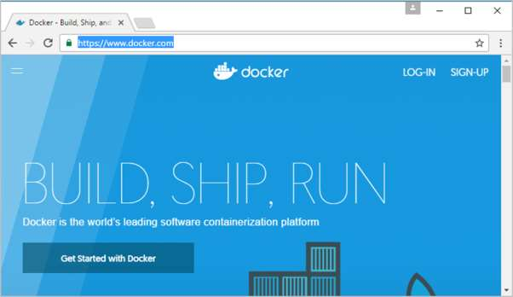
1. Docker ─ Overview
Docker
Docker is a container management service. The keywords of Docker are develop, ship and run anywhere. The whole idea of Docker is for developers to easily develop applications, ship them into containers which can then be deployed anywhere.
The initial release of Docker was in March 2013 and since then, it has become the buzzword for modern world development, especially in the face of Agile-based projects.
Features of Docker
Docker has the ability to reduce the size of development by providing a smaller footprint of the operating system via containers.
With containers, it becomes easier for teams across different units, such as development, QA and Operations to work seamlessly across applications.
You can deploy Docker containers anywhere, on any physical and virtual machines and even on the cloud.
Since Docker containers are pretty lightweight, they are very easily scalable.
Components of Docker
Docker has the following components
Docker for Mac – It allows one to run Docker containers on the Mac OS.
Docker for Linux - It allows one to run Docker containers on the Linux OS.

Slide 8
Docker
Docker for Windows - It allows one to run Docker containers on the Windows OS.
Docker Engine – It is used for building Docker images and creating Docker containers.
Docker Hub – This is the registry which is used to host various Docker images.
Docker Compose – This is used to define applications using multiple Docker containers.
We will discuss all these components in detail in the subsequent chapters.
The official site for Docker is https://www.docker.com/ The site has all information and documentation about the Docker software. It also has the download links for various operating systems.

Slide 9
2. Docker – Installing Docker on Linux
Docker
To start the installation of Docker, we are going to use an Ubuntu instance. You can use Oracle Virtual Box to setup a virtual Linux instance, in case you don’t have it already.
The following screenshot shows a simple Ubuntu server which has been installed on Oracle Virtual Box. There is an OS user named demo which has been defined on the system having entire root access to the sever.
To install Docker, we need to follow the steps given below.
Step 1: Before installing Docker, you first have to ensure that you have the right Linux kernel version running. Docker is only designed to run on Linux kernel version 3.8 and higher. We can do this by running the following command:
uname
This method returns the system information about the Linux system.
Syntax
uname -a
Options
a – This is used to ensure that the system information is returned.
Return Value
This method returns the following information on the Linux system:
kernel name
node name
kernel release
kernel version
machine
processor
hardware platform
operating system
Example
uname –a

Slide 10

Docker
Output
When we run above command, we will get the following result:
From the output, we can see that the Linux kernel version is 4.2.0-27 which is higher than version 3.8, so we are good to go.
Step 2: You need to update the OS with the latest packages, which can be done via the following command:
apt-get
This method installs packages from the Internet on to the Linux system.
Syntax
sudo apt-get update
Options
sudo - The sudo command is used to ensure that the command runs with root access.
update - The update option is used ensure that all packages are updated on the Linux system.
Return Value
None
Example
sudo apt-get update

Slide 11
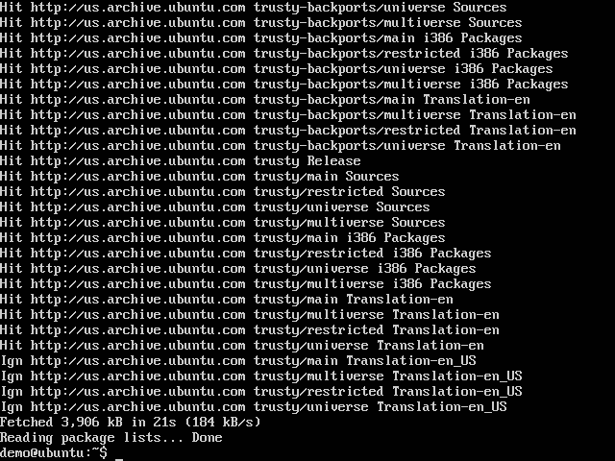
Docker
Output
When we run the above command, we will get the following result:
This command will connect to the internet and download the latest system packages for Ubuntu.
Step 3: The next step is to install the necessary certificates that will be required to work with the Docker site later on to download the necessary Docker packages. It can be done with the following command:
sudo apt-get install apt-transport-https ca-certificates

Slide 12
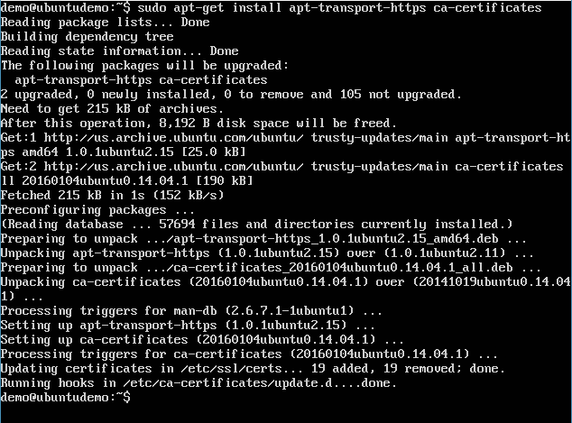
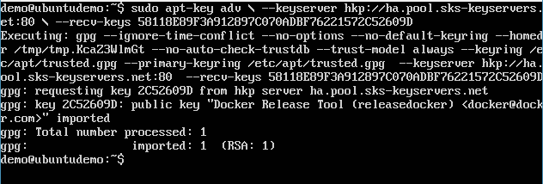
Docker
Step 4: The next step is to add the new GPG key. This key is required to ensure that all data is encrypted when downloading the necessary packages for Docker.
The following command will download the key with the ID 58118E89F3A912897C070ADBF76221572C52609D from the keyserver
hkp://ha.pool.sks-keyservers.net:80 and adds it to the adv keychain. Please note that this particular key is required to download the necessary Docker packages.
sudo apt-key adv \
--keyserver hkp://ha.pool.sks-keyservers.net:80 \
--recv-keys 58118E89F3A912897C070ADBF76221572C52609D

Slide 13
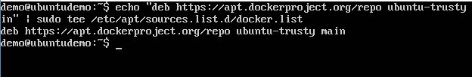
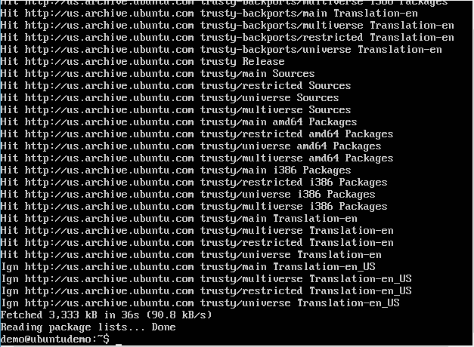
Docker
Step 5: Next, depending on the version of Ubuntu you have, you will need to add the relevant site to the docker.list for the apt package manager, so that it will be able to detect the Docker packages from the Docker site and download them accordingly.
Precise 12.04 (LTS) ─ deb https://apt.dockerproject.org/repo ubuntu-precise main
Trusty 14.04 (LTS) ─ deb https://apt.dockerproject.org/repo ubuntu-trusty main
Wily 15.10 ─ deb https://apt.dockerproject.org/repo ubuntu-wily main
Xenial 16.04 (LTS) ─ deb https://apt.dockerproject.org/repo ubuntu-xenial main
Since our OS is Ubuntu 14.04, we will use the Repository name as “deb https://apt.dockerproject.org/repo ubuntu-trusty main”
And then, we will need to add this repository to the docker.list as mentioned above.
echo "deb https://apt.dockerproject.org/repo ubuntu-trusty main” | sudo tee
/etc/apt/sources.list.d/docker.list
Step 6: Next, we issue the apt-get update command to update the packages on the Ubuntu system.

Slide 14
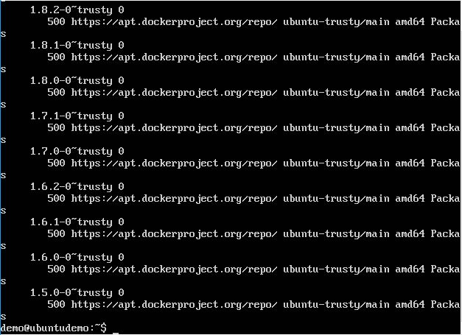
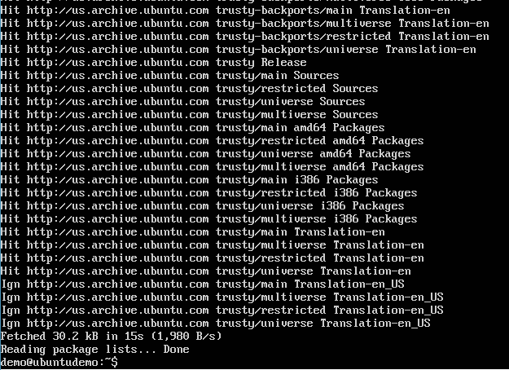
Docker
Step 7: If you want to verify that the package manager is pointing to the right repository, you can do it by issuing the apt-cache command.
apt-cache policy docker-engine
In the output, you will get the link to https://apt.dockerproject.org/repo/
Step 8: Issue the apt-get update command to ensure all the packages on the local system are up to date.

Slide 15
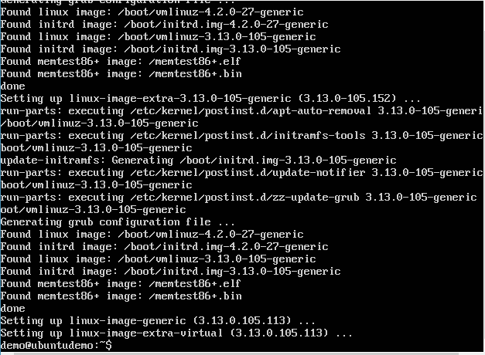
Docker
Step 9: For Ubuntu Trusty, Wily, and Xenial, we have to install the linux-image-extra-* kernel packages, which allows one to use the aufs storage driver. This driver is used by the newer versions of Docker.
It can be done by using the following command:
sudo apt-get install linux-image-extra-$(uname -r) linux-image-extra-virtual
Step 10: The final step is to install Docker and we can do this with the following command:
sudo apt-get install –y docker-engine
Here, apt-get uses the install option to download the Docker-engine image from the Docker website and get Docker installed.
The Docker-engine is the official package from the Docker Corporation for Ubuntu-based systems.

Slide 16
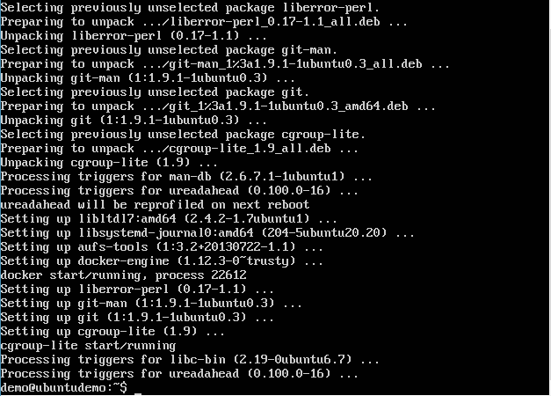
Docker
In the next section, we will see how to check for the version of Docker that was installed.
Docker Version
To see the version of Docker running, you can issue the following command:
Syntax
docker version
Options
version – It is used to ensure the Docker command returns the Docker version installed.
Return Value
The output will provide the various details of the Docker version installed on the system.
Example
sudo docker version

Slide 17
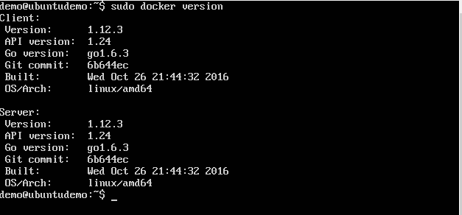
Docker
Output
When we run the above program, we will get the following result:
Docker Info
To see more information on the Docker running on the system, you can issue the following command:
Syntax
docker info
Options
info – It is used to ensure that the Docker command returns the detailed information on the Docker service installed.
Return Value
The output will provide the various details of the Docker installed on the system such as
Number of containers
Number of images
The storage driver used by Docker
The root directory used by Docker
The execution driver used by Docker
Example
sudo docker info

Slide 18
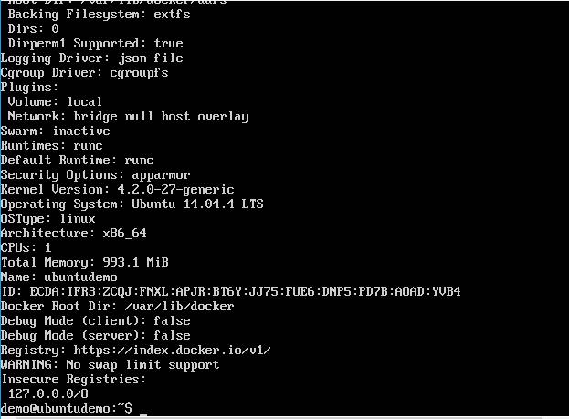
Docker
Output
When we run the above command, we will get the following result:
Docker for Windows
Docker has out-of-the-box support for Windows, but you need to have the following configuration in order to install Docker for Windows.
System Requirements
Windows OS | Windows 10 64 bit
Memory | 2 GB RAM (recommended)

Slide 19
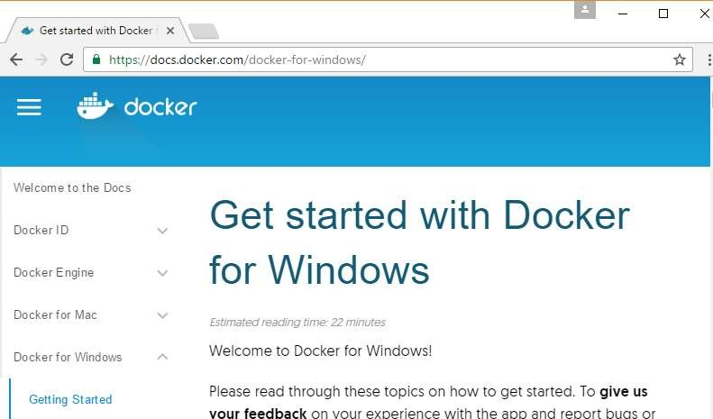
Docker
You can download Docker for Windows from: https://docs.docker.com/docker-for-windows/
Docker ToolBox
Docker ToolBox has been designed for older versions of Windows, such as Windows 8.1 and Windows 7. You need to have the following configuration in order to install Docker for Windows.
System Requirements
Windows OS | Windows 7 , 8, 8.1
Memory | 2 GB RAM (recommended)
Virtualization | This should be enabled.

Slide 20
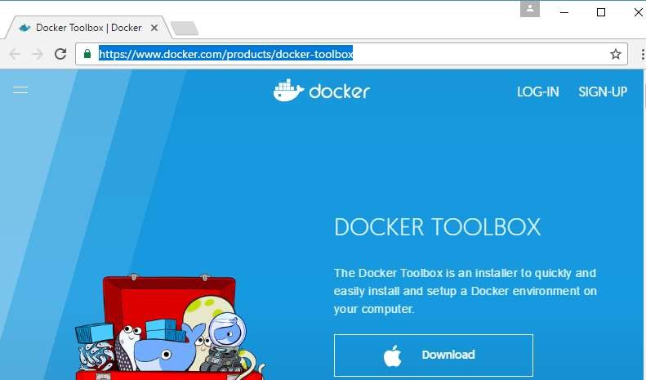
Docker
You can download Docker ToolBox from: https://www.docker.com/products/docker- toolbox

Slide 21
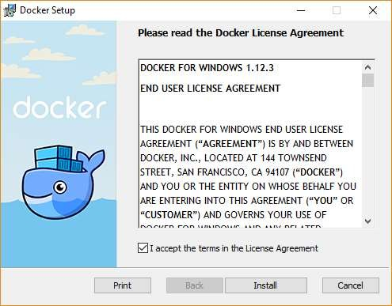
3. Docker ─ Installation
Docker
Let’s go through the installation of each product.
Docker for Windows
Once the installer has been downloaded, double-click it to start the installer and then follow the steps given below.
Step 1: Click on the Agreement terms and then the Install button to proceed ahead with the installation.

Slide 22
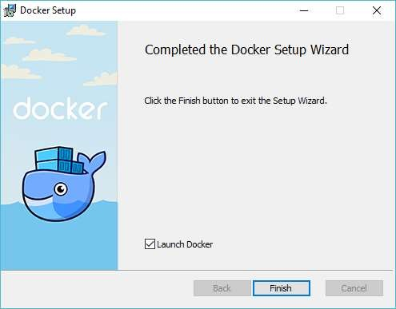
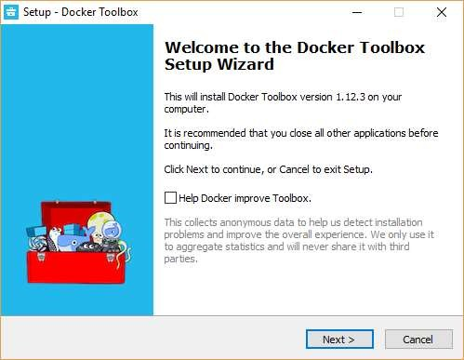
Docker
Step 2: Once complete, click the Finish button to complete the installation.
Docker ToolBox
Once the installer has been downloaded, double-click it to start the installer and then follow the steps given below.
Step 1: Click the Next button on the start screen.

Slide 23
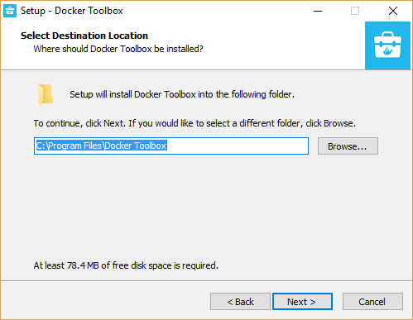
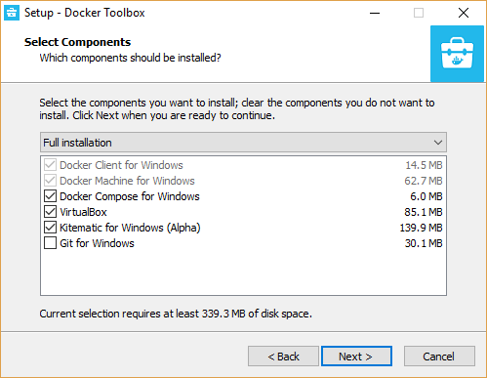
Docker
Step 2: Keep the default location on the next screen and click the Next button.
Step 3: Keep the default components and click the Next button to proceed.

Slide 24
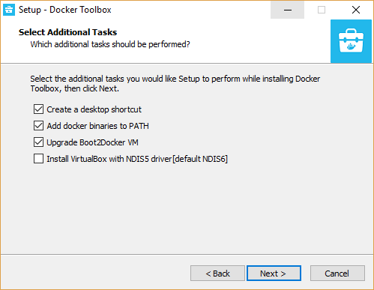
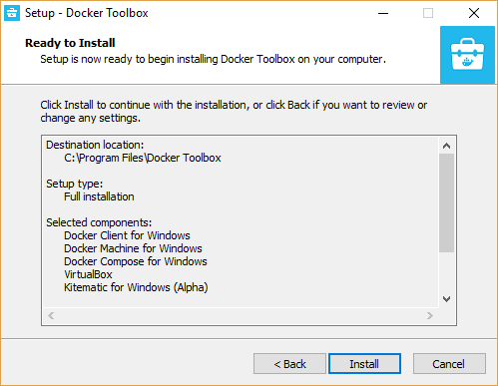
Docker
Step 4: Keep the Additional Tasks as they are and then click the Next button.
Step 5: On the final screen, click the Install button.

Slide 25
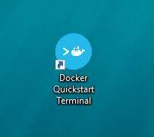
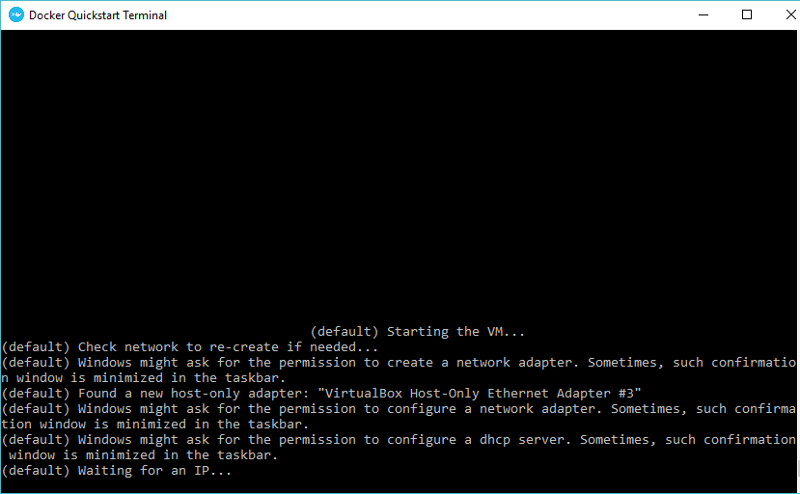
Docker
Working with Docker Toolbox
Let’s now look at how Docker Toolbox can be used to work with Docker containers on Windows. The first step is to launch the Docker Toolbox application for which the shortcut is created on the desktop when the installation of Docker toolbox is carried out.
Next, you will see the configuration being carried out when Docker toolbox is launched.

Slide 26
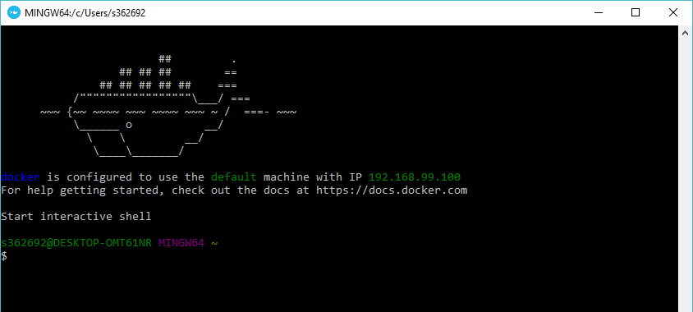
Docker
Once done, you will see Docker configured and launched. You will get an interactive shell for Docker.
To test that Docker runs properly, we can use the Docker run command to download and run a simple HelloWorld Docker container.
The working of the Docker run command is given below:
docker run
This command is used to run a command in a Docker container.
Syntax
docker run image
Options
Image – This is the name of the image which is used to run the container.
Return Value
The output will run the command in the desired container.
Example
sudo docker run hello-world
This command will download the hello-world image, if it is not already present, and run the hello-world as a container.

Slide 27
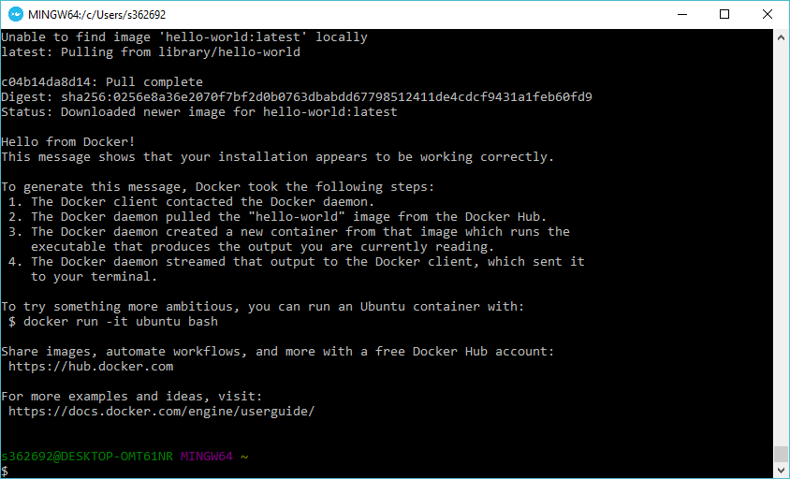
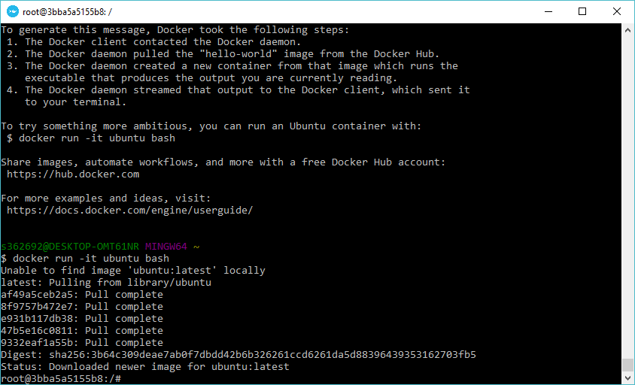
Docker
Output
When we run the above command, we will get the following result:
If you want to run the Ubuntu OS on Windows, you can download the Ubuntu Image using the following command:
Docker run –it Ubuntu bash
Here you are telling Docker to run the command in the interactive mode via the –it option.
In the output you can see that the Ubuntu image is downloaded and run and then you will be logged in as a root user in the Ubuntu container.

Slide 28
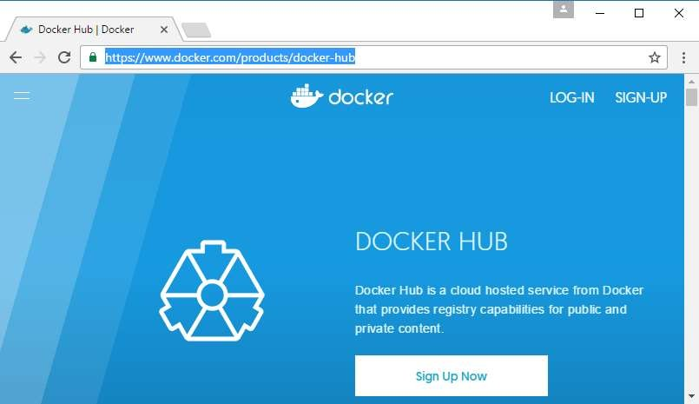
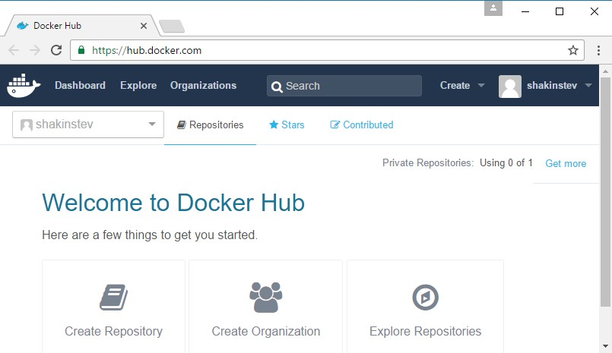
4. Docker – Docker Hub
Docker
Docker Hub is a registry service on the cloud that allows you to download Docker images that are built by other communities. You can also upload your own Docker built images to Docker hub. In this chapter, we will see how to download and the use the Jenkins Docker image from Docker hub.
The official site for Docker hub is: https://www.docker.com/products/docker-hub
Step 1: First you need to do a simple sign-up on Docker hub.
Step 2: Once you have signed up, you will be logged into Docker Hub.

Slide 29
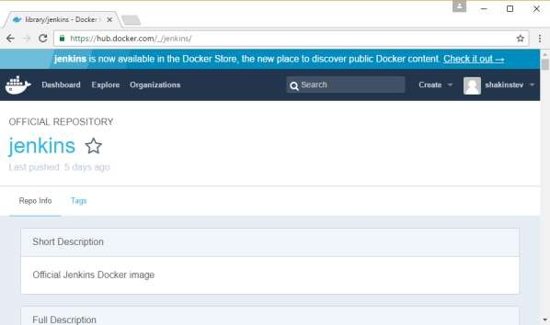
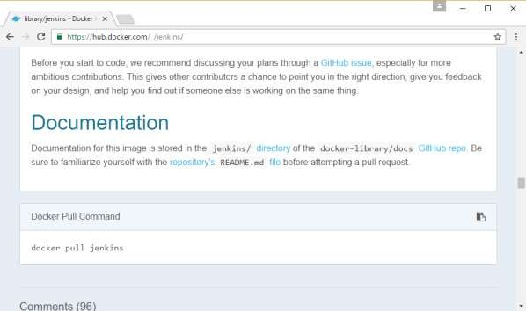
Docker
Step 3: Next, let’s browse and find the Jenkins image.
Step 4: If you scroll down on the same page, you can see the Docker pull command. This will be used to download the Jenkins image onto the local Ubuntu server.

Slide 30
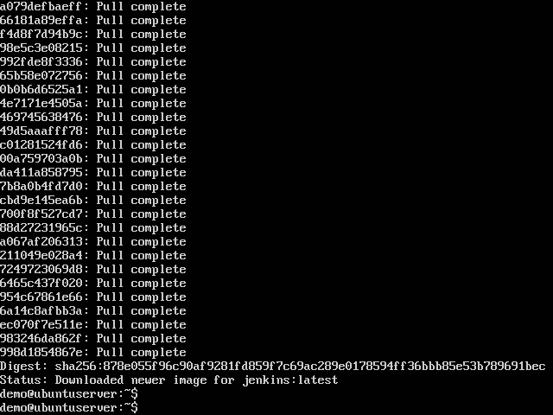
Docker
Step 5: Now, go to the Ubuntu server and run the following command:
sudo docker pull jenkins
To run Jenkins, you need to run the following command:
sudo docker run -p 8080:8080 -p 50000:50000 jenkins
Note the following points about the above sudo command:
We are using the sudo command to ensure it runs with root access.
Here, jenkins is the name of the image we want to download from Docker hub and install on our Ubuntu machine.
-p is used to map the port number of the internal Docker image to our main Ubuntu server so that we can access the container accordingly.

Slide 31
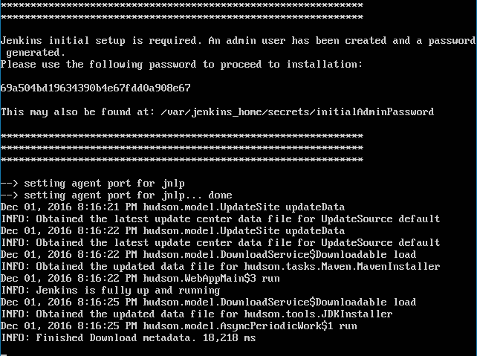
Docker
You will then have Jenkins successfully running as a container on the Ubuntu machine.

