Slide 1
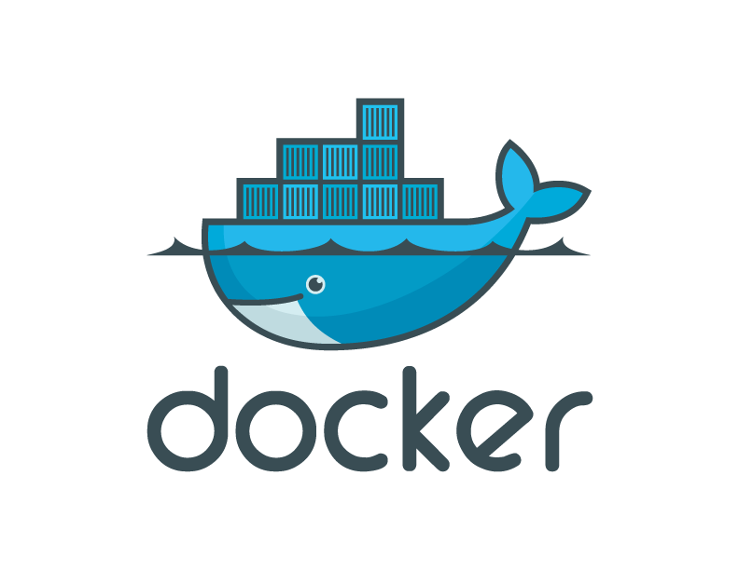
Introduction to Docker

Slide 2
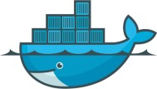
Contents
Introduction to Containers
What is Docker?
Docker Architecture
Installing Docker
Docker Engine
Docker Images
Docker File
Docker Hub
Docker CLI
Kubernetes
Hands On Demo

Slide 3
Containers
LXC (Linux Containers) is an operating-system-level virtualization method for running multiple isolated Linux systems (containers) on a control host using a single Linux kernel.
The Linux kernel provides the cgroups functionality that allows limitation and prioritization of resources (CPU, memory, block I/O, network, etc.) without the need for starting any virtual machines, and namespace isolation functionality that allows complete isolation of an applications' view of the operating environment, including process trees, networking, user IDs and mounted file systems

Slide 4
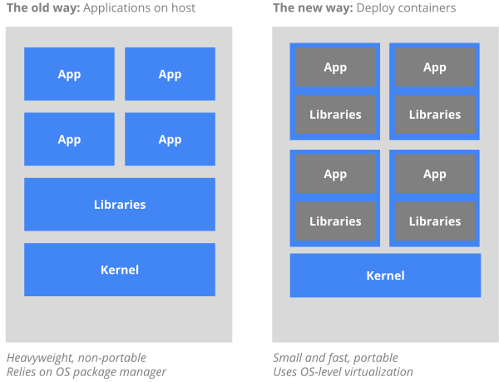
Why Containers

Slide 5
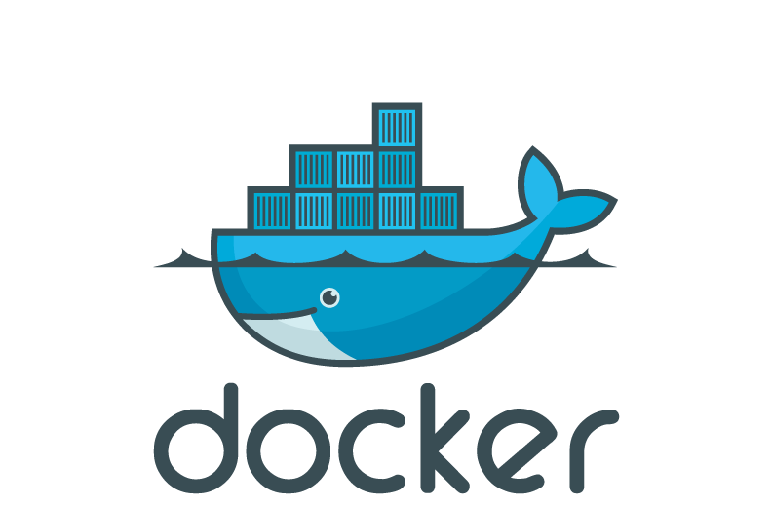
What is Docker
Docker is an open-source project that automates the deployment of applications inside software container
Docker containers wrap up a piece of software in a complete file system that contains everything it needs to run: code, runtime, system tools, system libraries – anything you can install on a server.
This guarantees that it will always run the same, regardless of the environment it is running in.

Slide 6








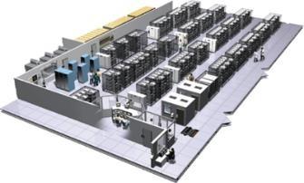
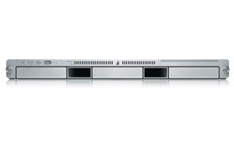
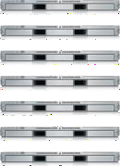
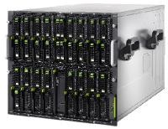

The Challenge
User DB
postgresql + pgv8 + v8
Do services and apps interact appropriately?
Multiplicity of Stacks
Static website
nginx 1.5 + modsecurity + openssl + bootstrap 2
Queue
Redis + redis-sentinel
Analytics DB
hadoop + hive + thrift + OpenJDK
Background workers
Python 3.0 + celery + pyredis + libcurl + ffmpeg + libopencv + nodejs + phantomjs
Web frontend
Ruby + Rails + sass + Unicorn
API endpoint
Python 2.7 + Flask + pyredis + celery + psycopg + postgresql-client
Multiplicity of hardware environments
Development VM
Production Cluster
Public Cloud
Can I migrate smoothly and quickly?
QA server
Disaster recovery
Customer Data Center
Contributor’s laptop
Production Servers

Slide 7






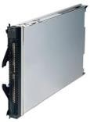
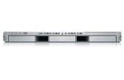
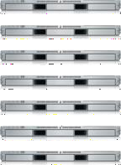
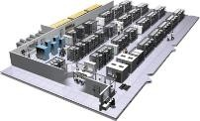

The Matrix From Hell
Static website | ? | ? | ? | ? | ? | ? | ?
Web frontend | ? | ? | ? | ? | ? | ? | ?
Background workers | ? | ? | ? | ? | ? | ? | ?
User DB | ? | ? | ? | ? | ? | ? | ?
Analytics DB | ? | ? | ? | ? | ? | ? | ?
Queue | ? | ? | ? | ? | ? | ? | ?
 | Development VM | QA Server | Single Prod Server | Onsite Cluster | Public Cloud | Contributor’s laptop | Customer Servers

Slide 8

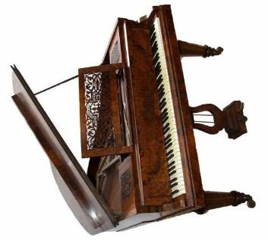

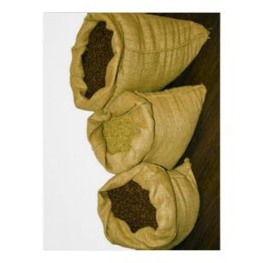

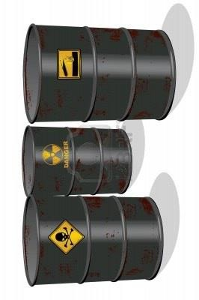

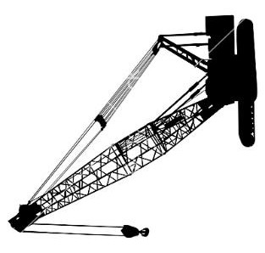
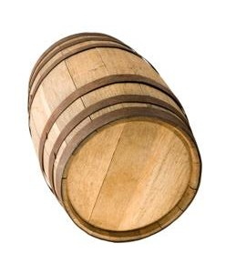

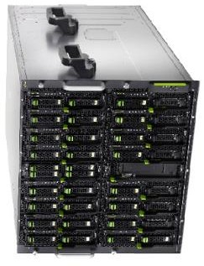
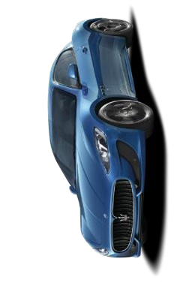
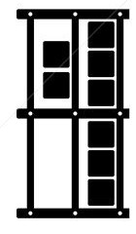

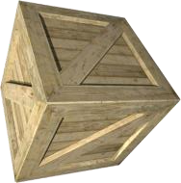
Do I worry about how goods interact (e.g. coffee beans next to spices)
Can I transport quickly and smoothly (e.g. from boat to train to truck)
Cargo Transport Pre-1960
g
Goods
transporting/storin
Multiplicity of
methods for
Multipilicity of

Slide 9
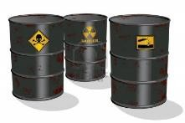
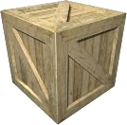
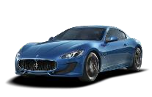
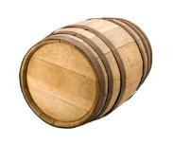
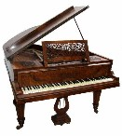
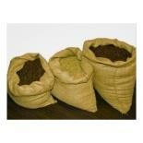

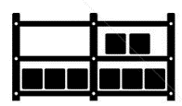
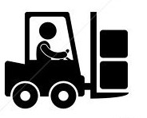
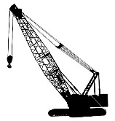



Also a matrix from hell
 | ? | ? | ? | ? | ? | ? | ?
 | ? | ? | ? | ? | ? | ? | ?
 | ? | ? | ? | ? | ? | ? | ?
 | ? | ? | ? | ? | ? | ? | ?
 | ? | ? | ? | ? | ? | ? | ?
 | ? | ? | ? | ? | ? | ? | ?

Slide 10

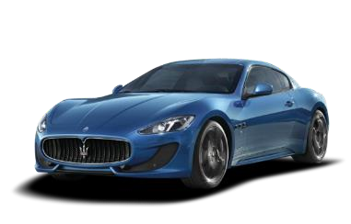
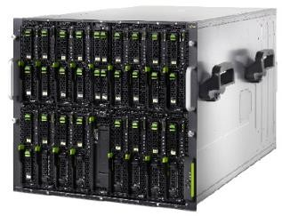
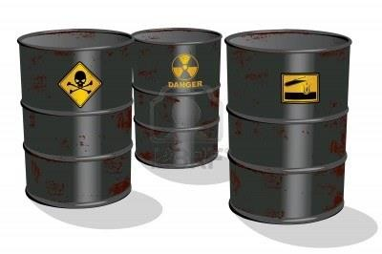


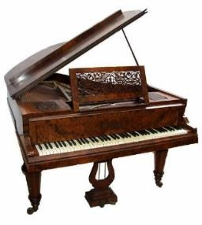
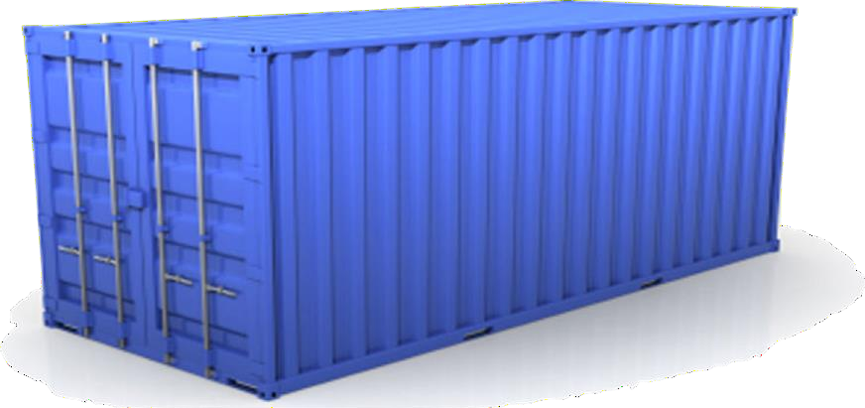






Solution: Intermodal Shipping Container
Do I worry about how goods interact (e.g. coffee beans next to spices)
Multiplicity of Goods
A standard container that is loaded with virtually any goods, and stays sealed until it reaches final delivery.
…in between, can be loaded and unloaded, stacked, transported efficiently over long distances, and transferred from one mode of transport to another
Multiplicity of methods for transporting/stori ng
Can I transport quickly and smoothly
(e.g. from boat to
train to truck)

Slide 11




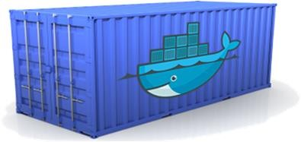
Docker is a shipping container system for code
Static website
User DB Web frontend Queue
Analytics DB
Do services and apps interact appropriately?
Multiplicity of Stacks
An engine that enables any payload to be encapsulated as a lightweight, portable, self- sufficient container…
…that can be manipulated using standard operations and run consistently on virtually any hardware platform
Multiplicity of hardware environments
Can I migrate smoothly and quickly
Development
VM
QA server
Customer Data Center
Public Cloud
Production
Cluster
Contributor’s laptop

Slide 12

Docker eliminates the matrix from Hell
Static website
Web frontend
Background workers
User DB
Analytics DB
Queue
 | Development VM | QA Server | Single Prod Server | Onsite Cluster | Public Cloud | Contributor’s laptop | Customer Servers

Slide 13
Why Developers Care
Build once, run anywhere
A clean, safe, hygienic and portable runtime environment for your app.
No worries about missing dependencies, packages and other pain points during subsequent deployments.
Run each app in its own isolated container, so you can run various versions of libraries and other dependencies for each app without worrying

Slide 14
Why Developers Care
Automate testing, integration, packaging…anything you can script
Reduce/eliminate concerns about compatibility on different platforms, either your own or your customers.
Cheap, zero-penalty containers to deploy services? A VM without the overhead of a VM? Instant replay and reset of image snapshots? That’s the power of Docker

Slide 15
Why Devops Cares?
Configure once…run anything
Make the entire lifecycle more efficient, consistent, and repeatable
Increase the quality of code produced by developers.
Eliminate inconsistencies between development, test, production, and customer environments

Slide 16
Why Devops Cares?
Support segregation of duties
Significantly improves the speed and reliability of continuous deployment and continuous integration systems
Because the containers are so lightweight, address significant performance, costs, deployment, and portability issues normally associated with VMs

Slide 17
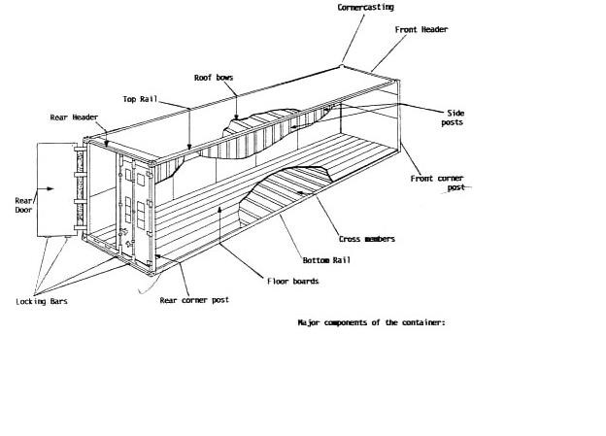
Why it works—separation of concerns
The Developer
Worries about what’s “inside” the container
His code
His Libraries
His Package Manager
His Apps
His Data
All Linux servers look the same
The Administrator
Worries about what’s “outside” the container
Logging
Remote access
Monitoring
Network config
All containers start, stop, copy, attach, migrate, etc. the same way

Slide 18
WHAT
More technical explanation
WHY
Run everywhere
Regardless of kernel version (2.6.32+)
Regardless of host distro
Physical or virtual, cloud or not
Container and host architecture must match*
Run anything
If it can run on the host, it can run in the container
i.e. if it can run on a Linux
kernel, it can run
High Level—It’s a lightweight VM
Own process space
Own network interface
Can run stuff as root
Can have its own /sbin/init (different from host)
Low Level—It’s chroot on steroids
Can also not have its own /sbin/init
Container=isolated processes
Share kernel with host
No device emulation (neither HVM nor PV) from host)

Slide 19
Containers vs. VMs
Containers are isolated, but share OS and, where appropriate, bins/libraries
…result is significantly faster deployment, much less overhead, easier migration, faster restart
App A
App A’
App B
Bins/ Libs
Bins/ Libs
Bins/
Libs
VM
Guest
Guest
Guest
OS
Guest OS
OS
OS
Guest OS
Docker
App B’ App B’
App B’
App B App A’ App A
Container
Hypervisor (Type 2)
Bins/Libs
Bins/Libs
Host OS
Host OS
Server
Server

Slide 20
Why are Docker containers lightweight?
VMs
Containers
App A’
App A
App A
App Δ
App A
App A
Bins/ Libs
Bins/ Libs
Bins/ Libs
Bins/
Libs
Guest OS
Original App
(No OS to take
up space, resources, or require restart)
Modified App
Copy on write capabilities allow us to only save the diffs
Between container A and container
A’
Guest OS
Guest OS
Guest OS
Copy of App
No OS. Can Share bins/libs
VMs
Every app, every copy of an
app, and every slight modification
of the app requires a new virtual server

Slide 21
What are the basics of the Docker system?
Container A
Push
Docker Container Image Registry
Search
Pull
Run
Build
Dockerfile For
A
Source Code Repository
Container A
Container B
Container C
Docker
Docker Engine
Host 1 OS (Linux)
Host 2 OS (Linux)

Slide 22
Changes and Updates
App A
App Δ
Push
Docker Container Image Registry
Bins/
Libs
Base Container Image
Container Mod A’
Container Mod A’’
App Δ
Update
App A’’
Bins/ Libs
Docker Engine
App A
Bins/
Libs
Docker Engine
Host is now running A’’
Host running A wants to upgrade to A’’. Requests update. Gets only diffs

Slide 23
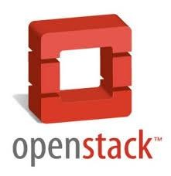

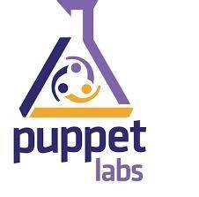






Ecosystem Support
Operating systems
Virtually any distribution with a 2.6.32+ kernel
Red Hat/Docker collaboration to make work across RHEL 6.4+, Fedora, and other members of the family (2.6.32 +)
CoreOS—Small core OS purpose built with Docker
OpenStack
Docker integration into NOVA (& compatibility with Glance, Horizon, etc.) accepted for Havana release
Private PaaS
OpenShift
Solum (Rackspace, OpenStack)
Other TBA
Public PaaS
Deis, Voxoz, Cocaine (Yandex), Baidu PaaS

Slide 24
Ecosystem Support
Public IaaS
Native support in Rackspace, Digital Ocean,+++
AMI (or equivalent) available for AWS & other
DevOps Tools
Integrations with Chef, Puppet, Jenkins, Travis, Salt, Ansible +++
Orchestration tools
Mesos, Heat, ++
Shipyard & others purpose built for Docker
Applications
1000’s of Dockerized applications available at index.docker.io

Slide 25
Use Cases
Use Case | Examples
 | Building a MongoDB cluster using docker
Clusters | Production Quality MongoDB Setup with Docker
 | Wildfly cluster using Docker on Fedora
Build your own PaaS | OpenSource PaaS built on Docker, Chef, and Heroku Buildpacks
Web Based Environment for Instruction | JiffyLab – web based environment for the instruction, or lightweight use of, Python and UNIX shell
 | Deploy Java Apps With Docker = Awesome
Easy Application Deployment | How to put your development environment on docker
 | Running Drupal on Docker
 | Installing Wordpress on Docker

Slide 26
Use Cases
Use Case | Examples
Create Secure Sandboxes | Docker makes creating secure sandboxes easier than ever
Create your own SaaS | Memcached as a Service
Automated Application Deployment | Multi-cloud Deployment with Docker
Continuous Integration and Deployment | Next Generation Continuous Integration & Deployment with dotCloud’s Docker and Strider
 | Testing Salt States Rapidly With Docker
Lightweight Desktop Virtualization | Docker Desktop: Your Desktop Over SSH Running Inside Of A Docker Container

Slide 27
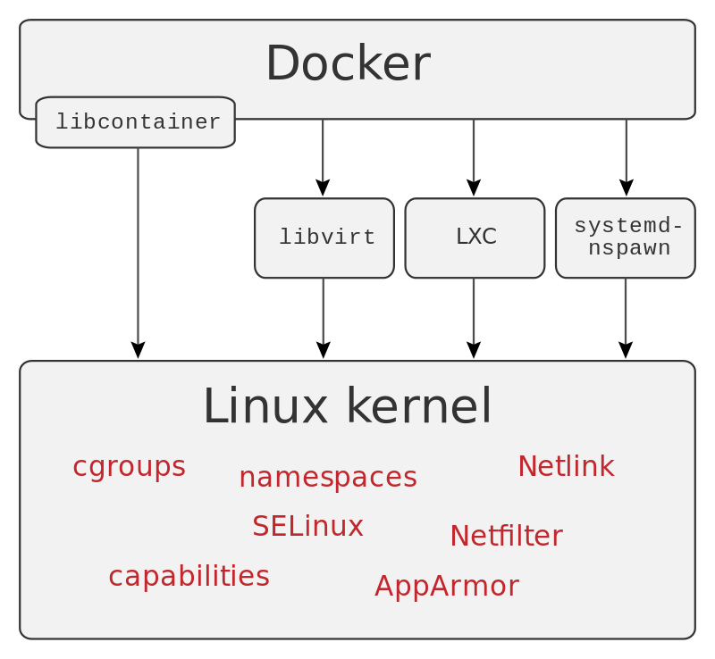
Docker Architecture

Slide 28
Namespaces
Docker takes advantage of a technology called namespaces to provide the isolated workspace we call the container.
When you run a container, Docker creates a set of namespaces for
that container.
Some of the namespaces that Docker Engine uses on Linux are:
The pid namespace: Process isolation (PID: Process ID).
The net namespace: Managing network interfaces (NET: Networking).
The ipc namespace: Managing access to IPC resources (IPC: InterProcess Communication).
The mnt namespace: Managing mount-points (MNT: Mount).
The uts namespace: Isolating kernel and version identifiers. (UTS: Unix Timesharing System)

Slide 29
Control groups
Docker Engine on Linux also makes use of another technology called cgroups or control groups.
A key to running applications in isolation is to have them only use the resources you want.
This ensures containers are good multi-tenant citizens on a host.
Control groups allow Docker Engine to share available hardware resources to containers and, if required, set up limits and constraints.
For example, limiting the memory available to a specific container.

Slide 30
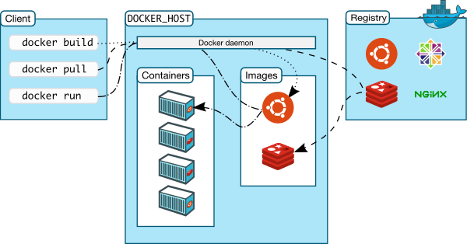
Docker Architecture

Slide 31
Docker Engine
Docker Engine is a client-server application with these major components:
A server which is a type of long-running program called a daemon process.
A REST API which specifies interfaces that programs can use to talk to the daemon and instruct it what to do.
A command line interface (CLI) client.

Slide 32
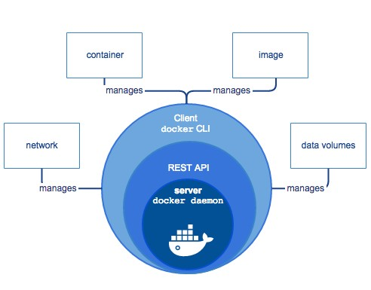
Docker Engine

Slide 33
Docker images
A Docker image is a read-only template. For example, an image could contain an Ubuntu operating system with Apache and your web application installed.
Images are used to create Docker containers. Docker provides a simple way to build new images or update existing images, or you can download Docker images that other people have already created.
Docker images are the build component of Docker.

Slide 34
Docker File
Docker can build images instructions from a Dockerfile.
automatically by reading the
A Dockerfile is a text document that contains all the commands a user could call on the command line to assemble an image.
Using docker build users can create an automated build that executes several command-line instructions in succession.
The docker build command builds an image from a Dockerfile and a context.

Slide 35
Docker File - Example
Instructions INSTRUCTION arguments
Eg. RUN echo 'we are running some # of cool things!’
Parser directives:
FROM ImageName
Example:
#Comment
FROM windowsservercore COPY testfile.txt c:\
RUN dir c:\
To Build image using this file:
docker build -f /path/to/a/Dockerfile .

Slide 36
Docker Hub
Docker registries hold images.
These are public or private stores from which you upload or download images.
The public Docker registry is provided with the Docker Hub. (hub.docker.com)
It serves a huge collection of existing images for your use. These can be images you create yourself or you can use images that others have previously created.
Docker registries are the distribution component of Docker.

Slide 37
Docker CLI
The CLI makes use of the Docker REST API to control or interact with the Docker daemon through scripting or direct CLI commands.
Many other Docker applications make use of the underlying API and CLI.
The CLI is also used to issue commands.

Slide 38
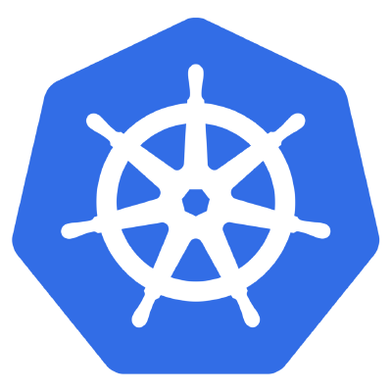
Kubernetes
Kubernetes is an open-source platform for automating deployment, scaling, and operations of application containers across clusters of hosts, providing container-centric infrastructure.
With Kubernetes, you can:
Deploy your applications quickly and predictably.
Scale your applications on the fly.
Seamlessly roll out new features.
Optimize use of your hardware by using only the resources you need

Slide 39
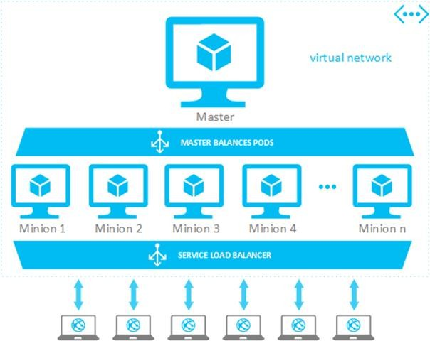
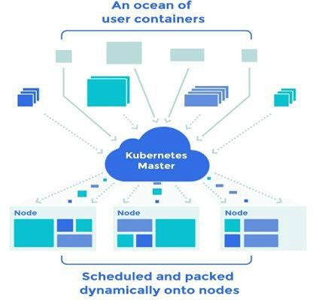
Kubernetes Architecture

Slide 40
Kubernetes Features
Kubernetes is:
portable: public, private, hybrid, multi-cloud
extensible: modular, pluggable, hookable, composable
self-healing: auto-placement, auto-restart, auto-replication, auto-scaling
The Kubernetes project was started by Google in 2014.

Slide 41
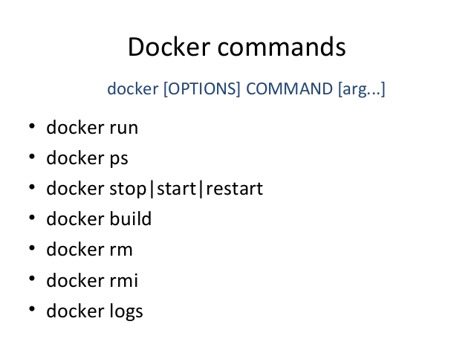

Slide 42
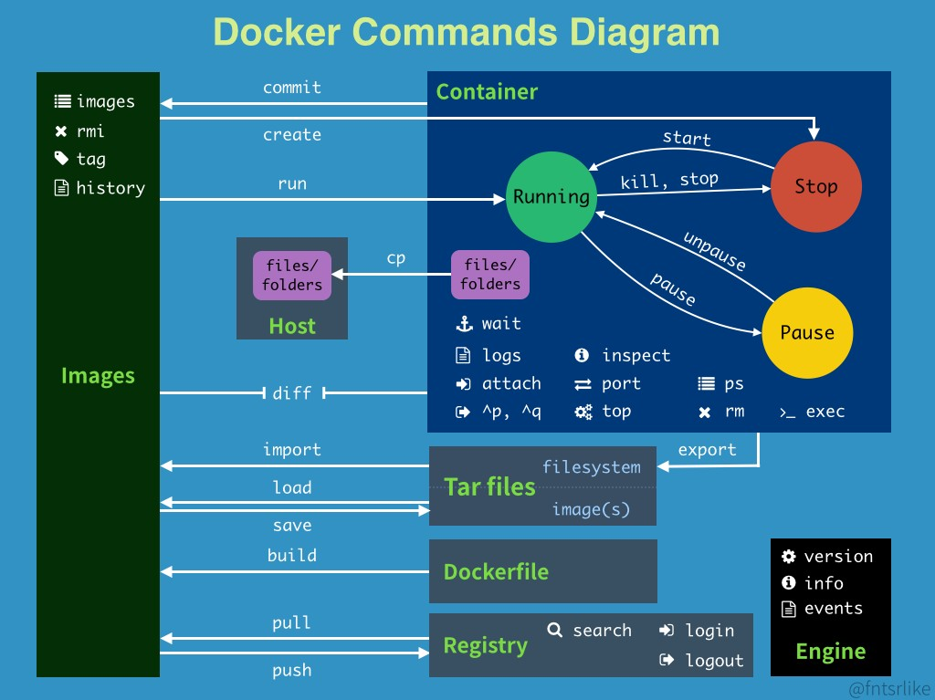

Slide 43
Demo Time!

Slide 44
Q&A

Slide 45
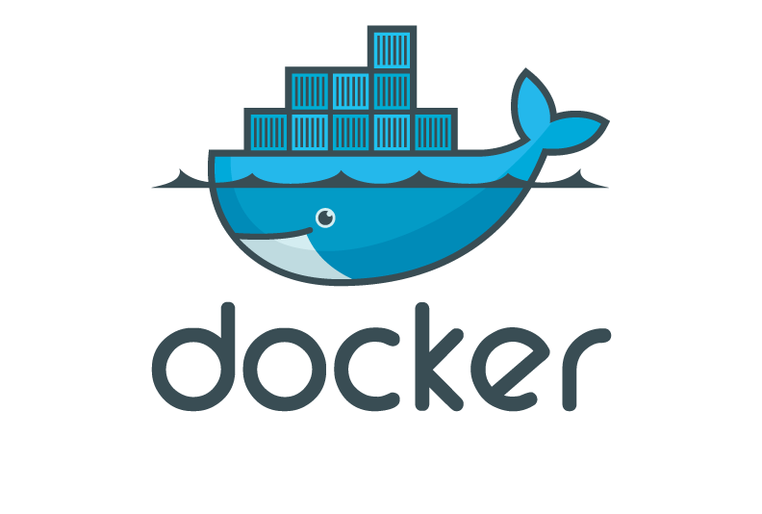
Thank you

