Slide 1
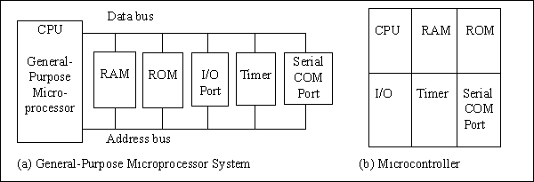
Figure 1-1. Microprocessor System Contrasted With Microcontroller System

Slide 2
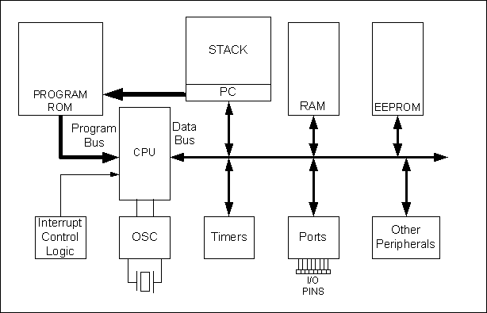
Figure 1-2. Simplified View of a PIC Microcontroller

Slide 3
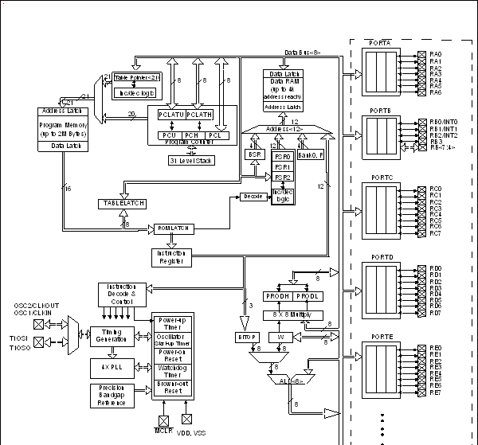
Figure 1-3. PIC18 Block Diagram

Slide 4
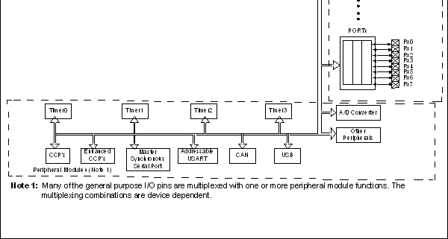
Figure 1-3. PIC18 Block Diagram (continued)

Slide 5
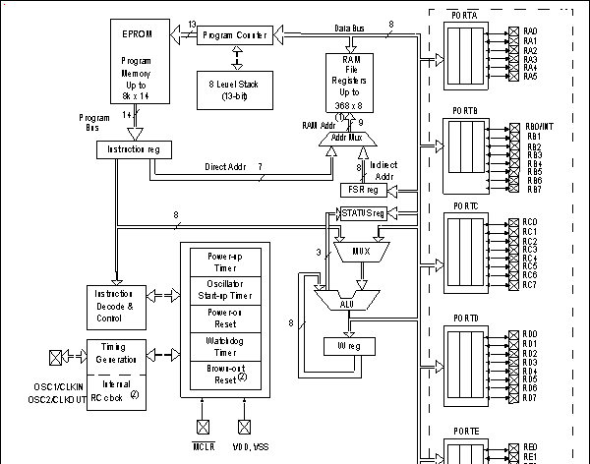
Figure 1-4. PIC16 Block Diagram

Slide 6
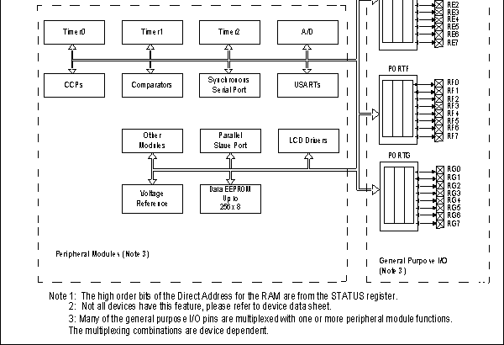
Figure 1-4. PIC16 Block Diagram (continued)

