Slide 1
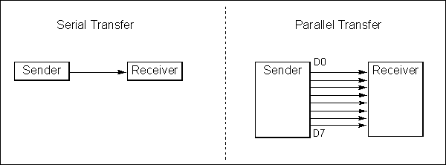
Figure 10-1. Serial versus Parallel Data Transfer

Slide 2
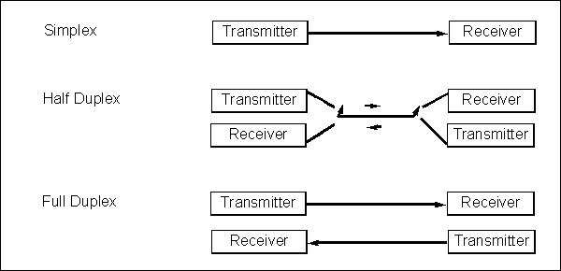
Figure 10-2. Simplex, Half-, and Full-Duplex Transfers

Slide 3
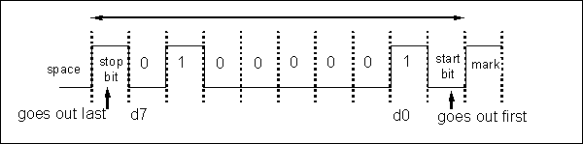
Figure 10-3. Framing ASCII ‘A’ (41H)

Slide 4
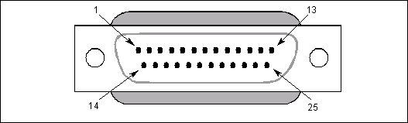
Figure 10-4. RS232 Connector DB-25

Slide 5
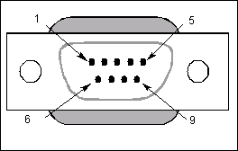
Figure 10-5. DB-9 9-Pin Connector

Slide 6
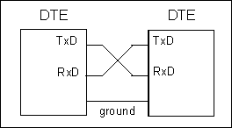
Figure 10-6. Null Modem Connection

Slide 7
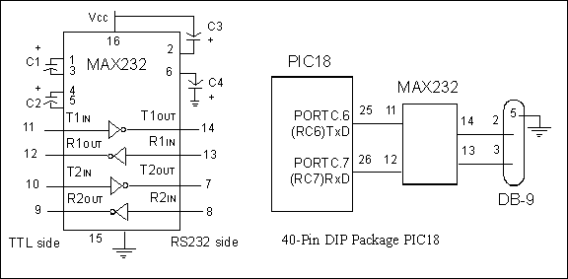
Figure 10-7. (a) Inside MAX232 and (b) its Connection to the PIC18 (Null Modem)

Slide 8
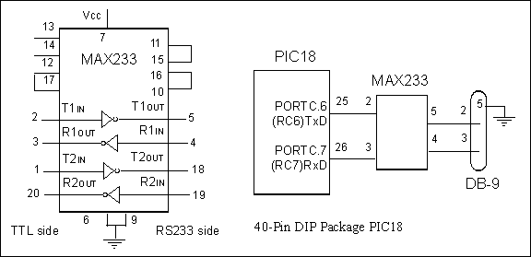
Figure 10-8. (a) Inside MAX233 and (b) Its Connection to the PIC18 (Null Modem)

Slide 9
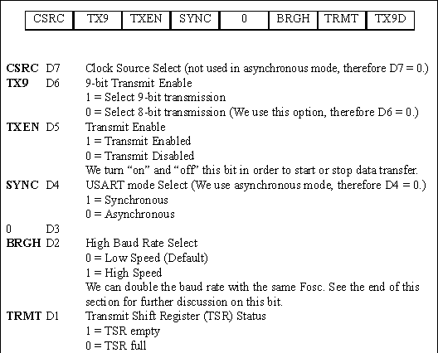
Figure 10-9. TXSTA: Transmit Status and Control Register

Slide 10
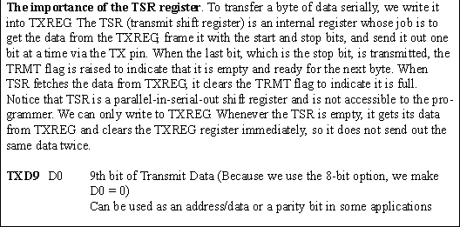
Figure 10-9. TXSTA: Transmit Status and Control Register (cont.)

Slide 11
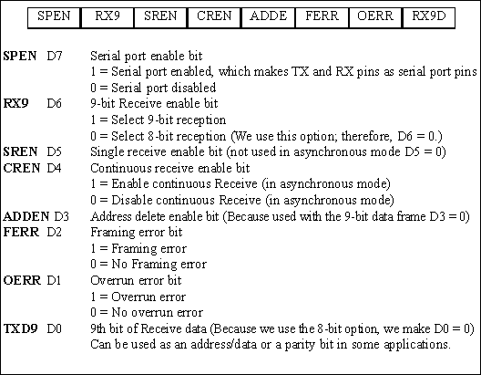
Figure 10-10. RCSTA: Receive Status and Control Register

Slide 12
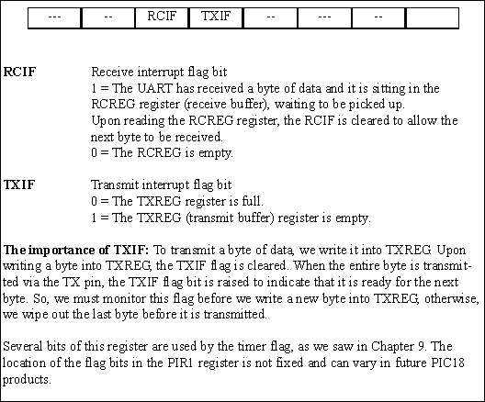
Figure 10-11. PIR1 (Peripheral Interrupt Register 1)

Slide 13
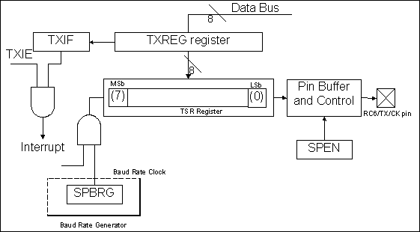
Figure 10-12. Simplified USART Transmit Block Diagram

