Slide 1
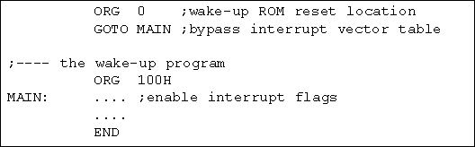
Figure 11-1. Redirecting the PIC18 from the Interrupt Vector Table at Power-Up

Slide 2
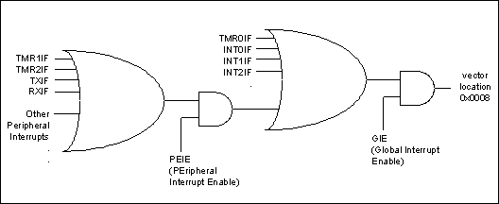
Figure 11-2. Simplified View of Interrupts (default for power-on reset)

Slide 3
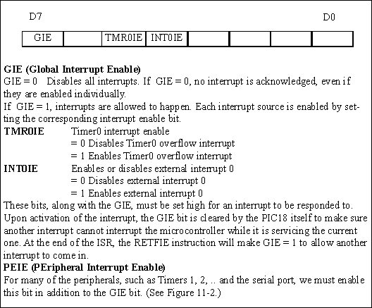
Figure 11-3. INTCON (Interrupt Control) Register

Slide 4
Figure 11-4. INTCON Register with Timer0 Interrupt Enable and Interrupt Flag

Slide 5
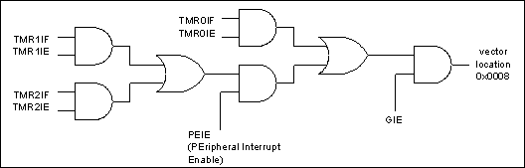
Figure 11-5. The Role of Timer Interrupt Enable Flag (TMRxIE)

Slide 6
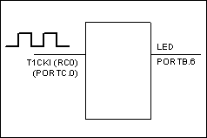
Figure 11-6. For Program 11-3

Slide 7
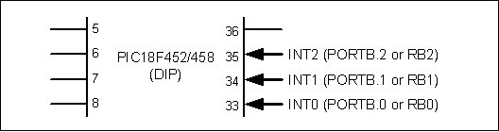
Figure 11-7. PIC18 External Hardware Interrupt Pins

Slide 8
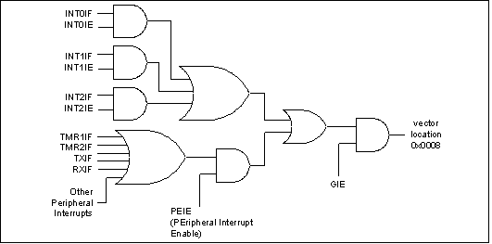
Figure 11-8. INT0–INT2 Hardware Interrupts

Slide 9
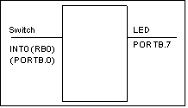
Figure 11-9. For Program 11-4

Slide 10
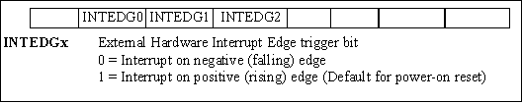
Figure 11-10. INTCON2 Register INTEDG Allows Positive or Negative Edge Trigger

Slide 11
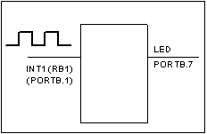
Figure 11-11. For Program 11-5

Slide 12
Figure 11-12. PIE1 Register Bits Holding TXIE and RCIE

Slide 13
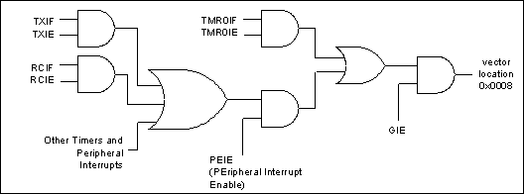
Figure 11-13: Serial Interrupt Enable Flags

Slide 14
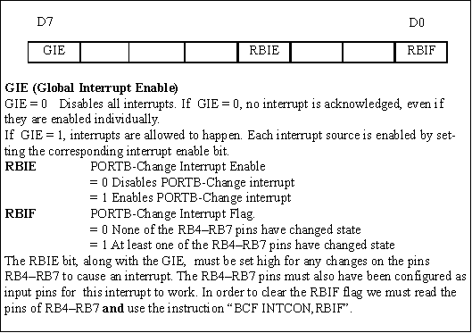
Figure 11-14. INTCON (Interrupt Control) Register

Slide 15
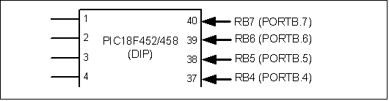
Figure 11-15. PORTB-Change Interrupt Pins

Slide 16
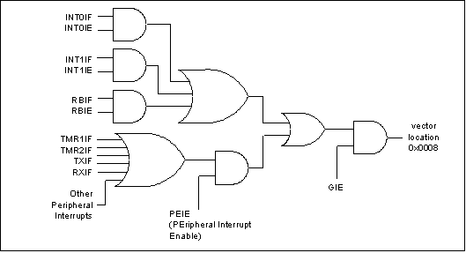
Figure 11-16. PORTB-Change Interrupt (RBIF)

Slide 17
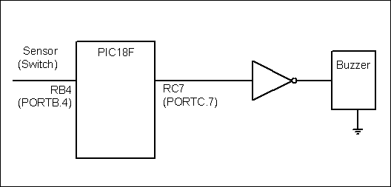
Figure 11-17. PORTB-Change Interrupt for Program 11-8

Slide 18
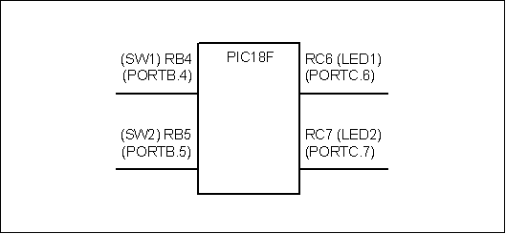
Figure 11-18: PORTB-Change Interrupt for Program 11-9

Slide 19
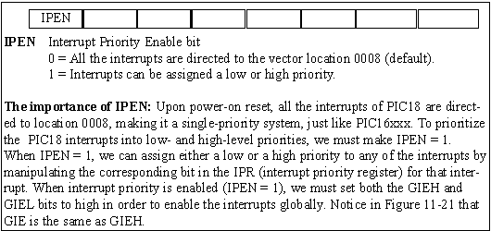
Figure 11-19. RCON Register. IPEN Allows Prioritizing the Interrupt into 2 Levels

Slide 20
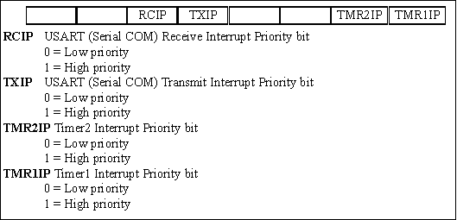
Figure 11-20. IPR1 Peripheral Interrupt Priority Register 1

Slide 21
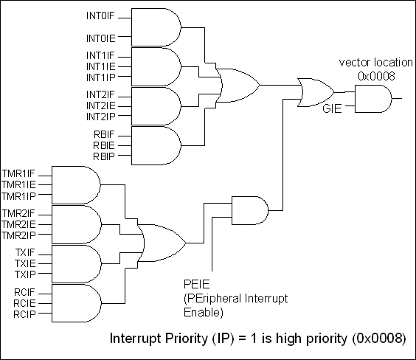
Figure 11-22. Interrupts with High-Priority (IP) Flag

Slide 22
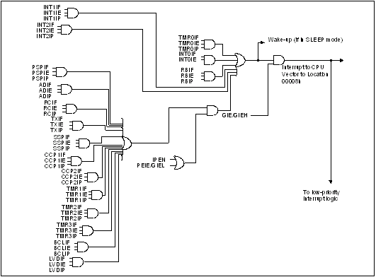
Figure 11-23. High-Priority Interrupts (Redrawn from PIC18 Manual)

Slide 23
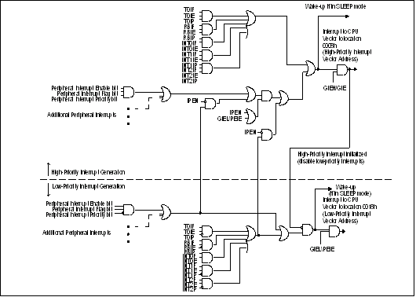
Figure 11-24. Low- and High-Priority Interrupt Selection (Redrawn from PIC18 Manual)

Slide 24
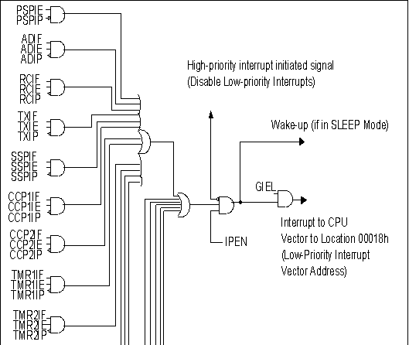
Figure 11-25. Low-Priority Interrupt Selection with IP Flag (Redrawn from PIC18 Manual)

Slide 25
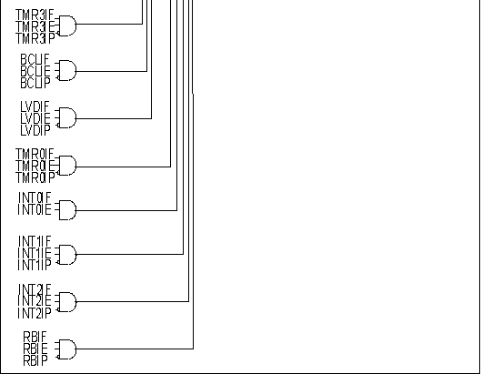
Figure 11-25. Low-Priority Interrupt Selection with IP Flag (Redrawn from PIC18 Manual) (cont.)

