Slide 1
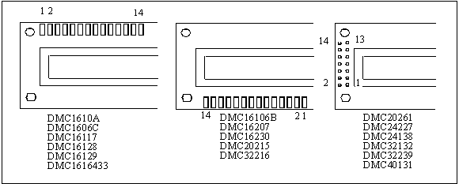
Figure 12-1. Pin Positions for Various LCDs from Optrex

Slide 2
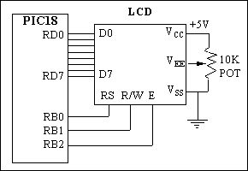
Figure 12-2. LCD Connections

Slide 3
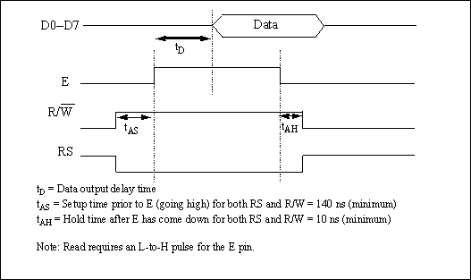
Figure 12-3. LCD Timing for Read ( L-to-H for E line)

Slide 4
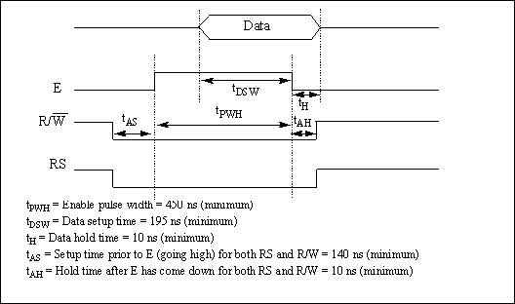
Figure 12-4. LCD Timing for Write (H-to-L for E line)

Slide 5
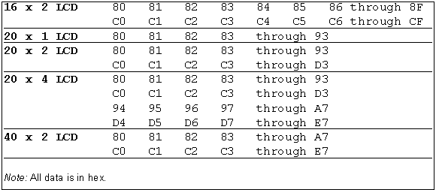
Figure 12-5. Cursor Addresses for Some LCDs

Slide 6
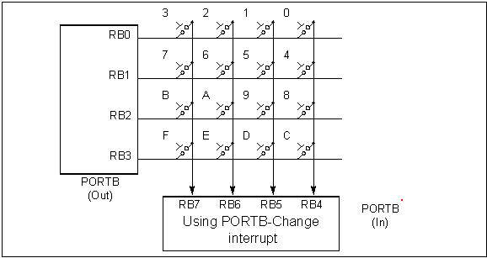
Figure 12-6. Matrix Keyboard Connection to Ports

Slide 7
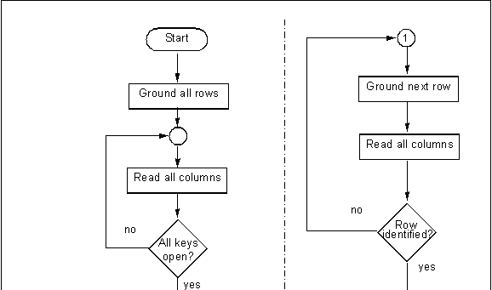
Figure 12-7. Flowchart for Program 12-4

Slide 8
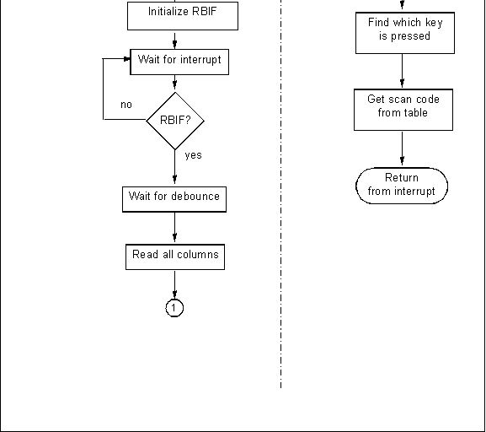
Figure 12-7. Flowchart for Program 12-4 (cont.)

Slide 9
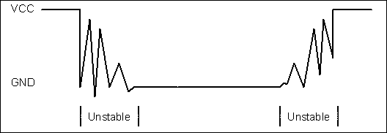
Figure 12-8. Keyboard Debounce

Slide 10
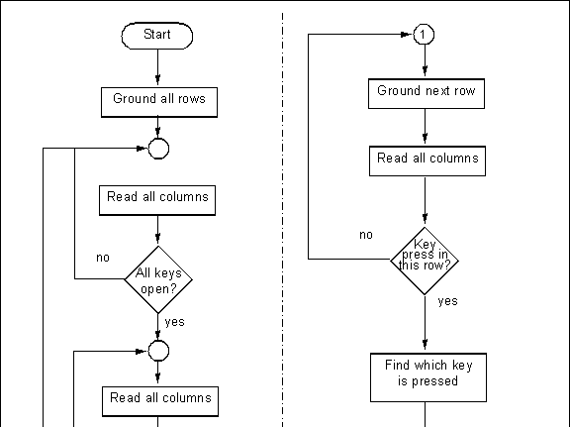
Figure 12-9. Flowchart of Scanning Method for Key Press Detection

Slide 11
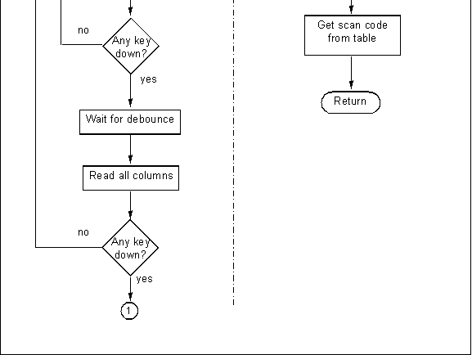
Figure 12-9. Flowchart of Scanning Method for Key Press Detection (cont.)

