Slide 1
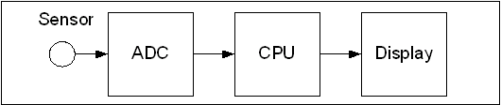
Figure 13-1. Microcontroller Connection to Sensor via ADC

Slide 2
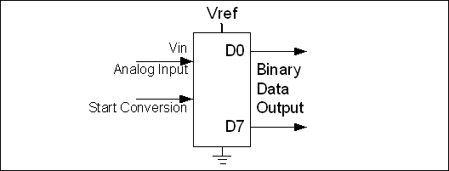
Figure 13-2. An 8-bit ADC Block Diagram

Slide 3
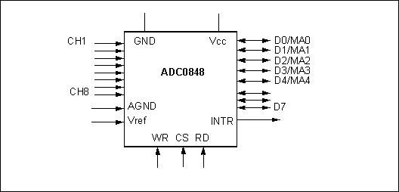
Figure 13-3. ADC0848 Parallel ADC Block Diagram

Slide 4
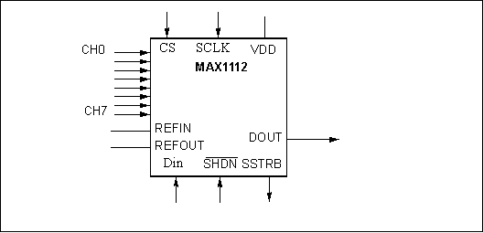
Figure 13-4. MAX1112 Serial ADC Block Diagram

Slide 5
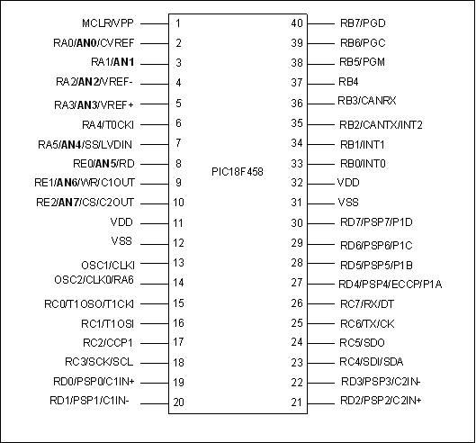
Figure 13-5A: PIC18F458 Pins with ADC Channels Shown in Bold

Slide 6
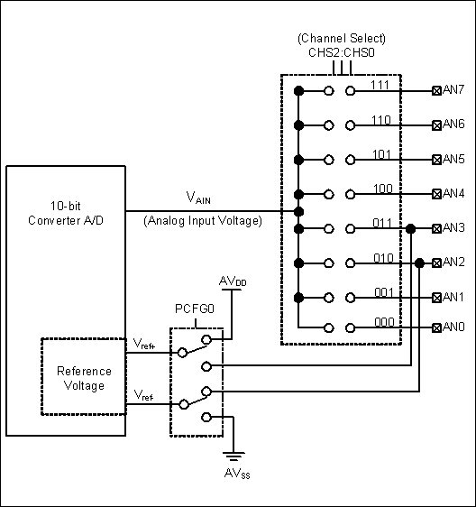
Figure 13-5B: PIC18 ADC Channel and Reference Selection

Slide 7
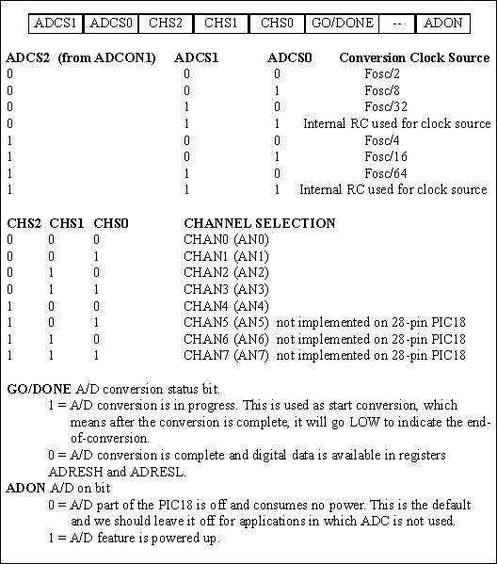
Figure 13-6. ADCON0 (A/D Control Register 0)

Slide 8
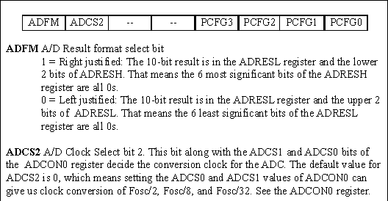
Figure 13-7. ADCON1 (A/D Control Register 1)

Slide 9
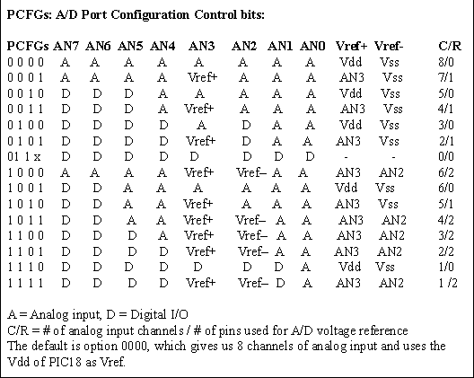
Figure 13-7. ADCON1 (A/D Control Register 1) (cont.)

Slide 10
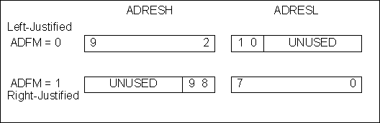
Figure 13-8. ADFM Bit and ADRESx Registers

Slide 11
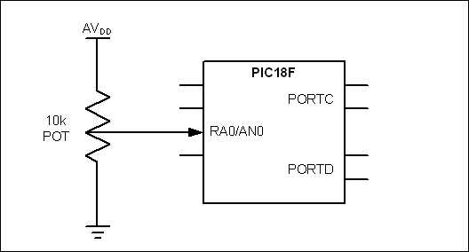
Figure 13-9. A/D Connection for Program 13-1

Slide 12
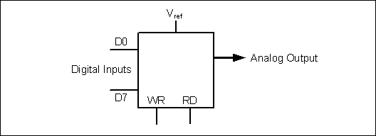
Figure 13-10. DAC Block Diagram

Slide 13
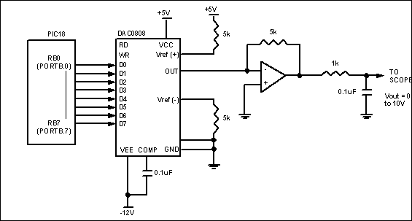
Figure 13-11. PIC18 Connection to DAC0808

Slide 14
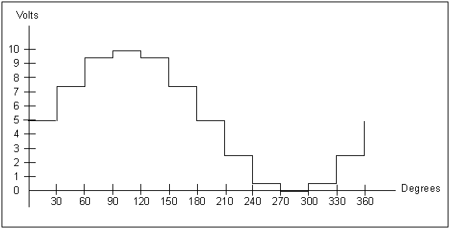
Figure 13-12. Angle vs. Voltage Magnitude for Sine Wave

Slide 15
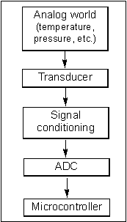
Figure 13-13. Getting Data From the Analog World

Slide 16
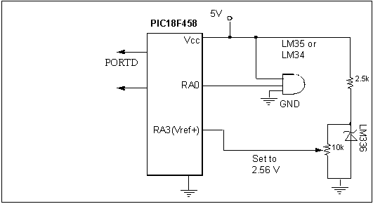
Figure 13-14. PIC18F458 Connection to Temperature Sensor

