Slide 1
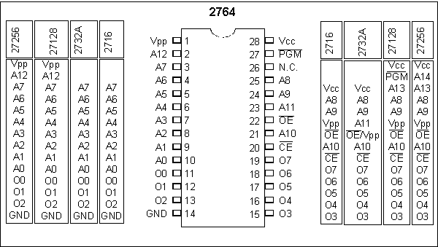
Figure 14-1. Pin Configurations for 27xx ROM Family

Slide 2
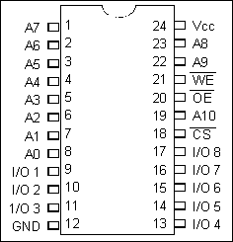
Figure 14-2. 2Kx8 SRAM Pins

Slide 3
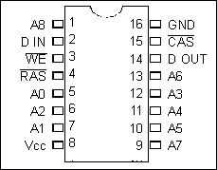
Figure 14-3. 256Kx1 DRAM

Slide 4
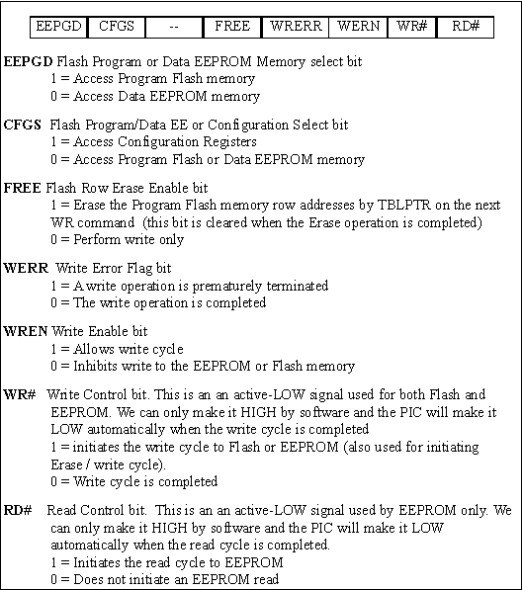
Figure 14-4. EECON1 (EEPROM Control Register, also used for Flash)

Slide 5
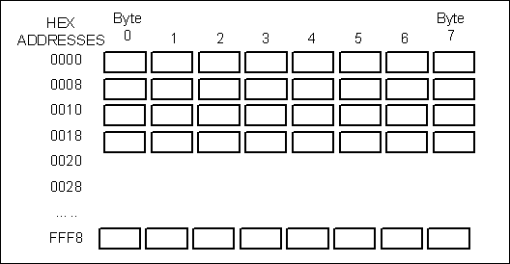
Figure 14-5. Flash Memory 8-Byte Boundaries

Slide 6
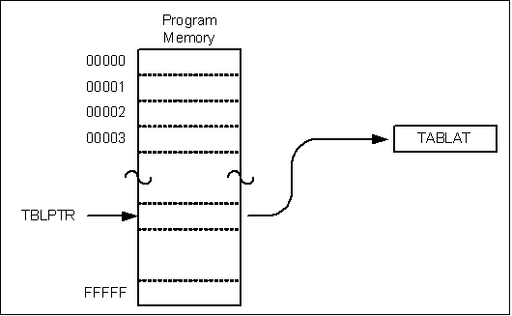
Figure 14-6. Reading from Flash

Slide 7
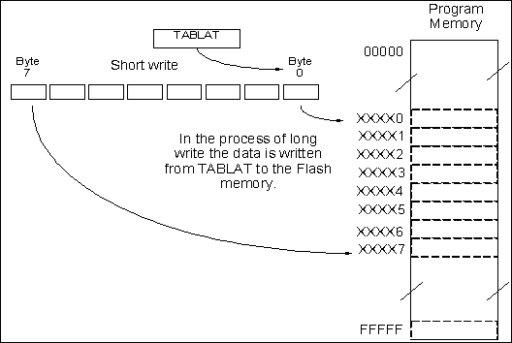
Figure 14-7. Writing to Flash

Slide 8
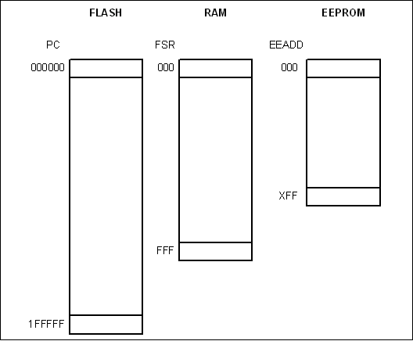
Figure 14-8. Contrasting PIC18F Memories

