Slide 1
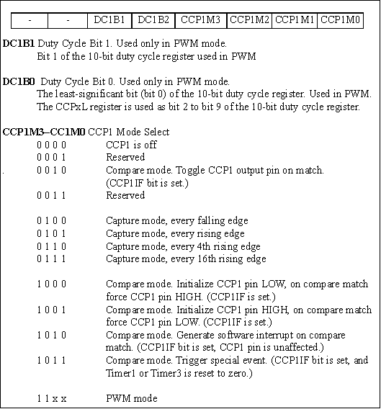
Figure 15-1. CCP1 Control Register

Slide 2
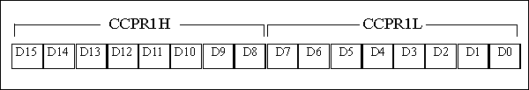
Figure 15-2. CCP High and Low Registers

Slide 3
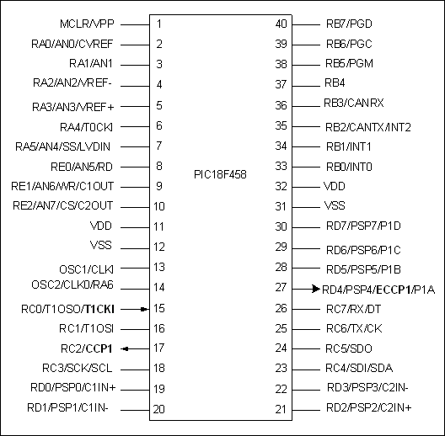
Figure 15-3. Standard CCP Pins in PIC18F458/4580 (452/4520)

Slide 4
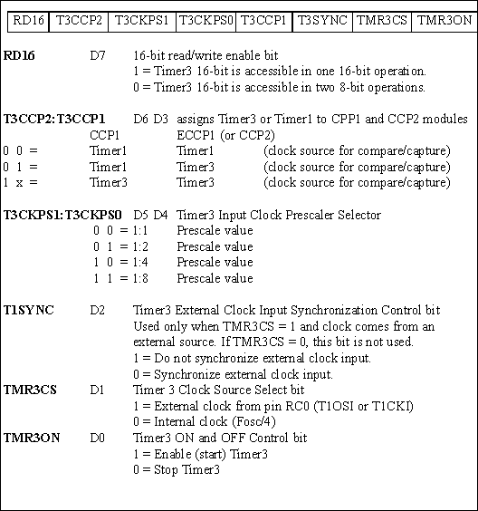
Figure 15-4. T3CON (Timer 3 Control) Register

Slide 5
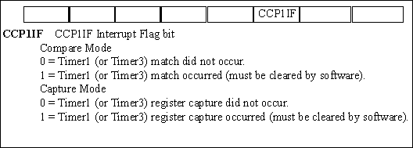
Figure 15-5. PIR1 (Peripheral Interrupt flag register 1) Contains the CCP1IF Flag

Slide 6
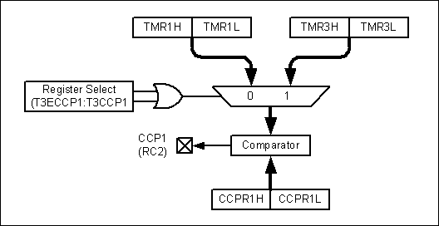
Figure 15-6. Compare Mode Operation

Slide 7
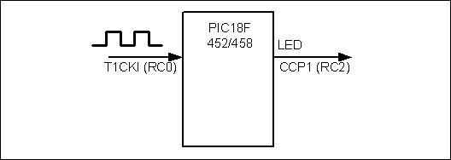
Figure 15-7. Drawing for Programs 15-1 and 15-1C

Slide 8
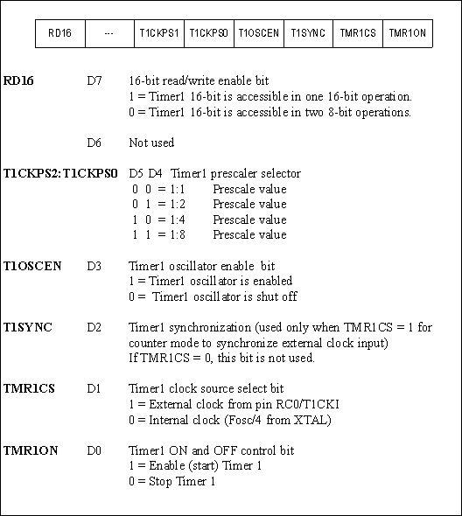
Figure 15-8. T1CON (Timer 1 Control) Register

Slide 9
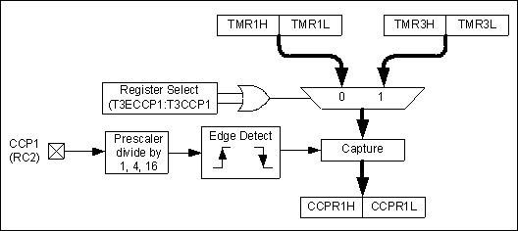
Figure 15-9. Capture Mode Operation

Slide 10

Figure 15-10. Measuring Pulse Period in Terms of Fosc/4 Clock Period

Slide 11
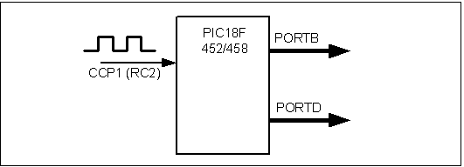
Figure 15-11. Drawing for Examples 15-3 and 15-3C.

Slide 12
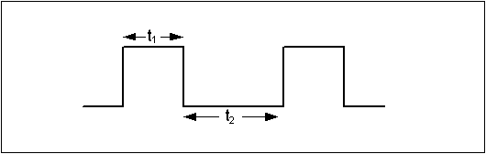
Figure 15-12. Duty Cycle for MAX6666/76 Temperature Sensor (Maxim Corp.)

Slide 13
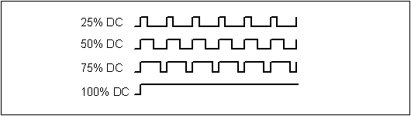
Figure 15-13. Period and Duty Cycle

Slide 14
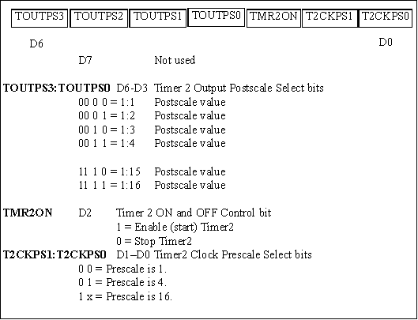
Figure 15-14. T2CON (Timer2 Control) Register

Slide 15
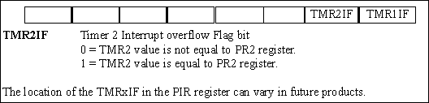
Figure 15-15. PIR1 (Peripheral Interrupt Flag Register 1) Has the TMR2IF Flag

Slide 16
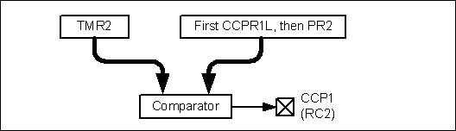
Figure 15-16. TMR2 and PR2 Role in Creating the Duty Cycle

Slide 17
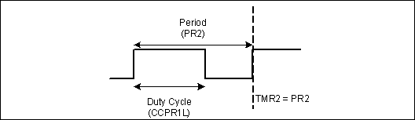
Figure 15-17. TMR2 Relation to CCPR1L and PR2 in PWM

Slide 18
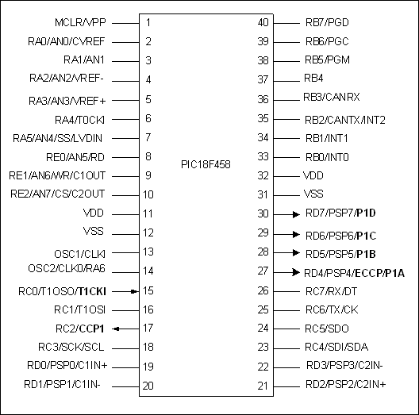
Figure 15-18. ECCP Pins for PWM in PIC18F458/4580 (452/4520)

Slide 19
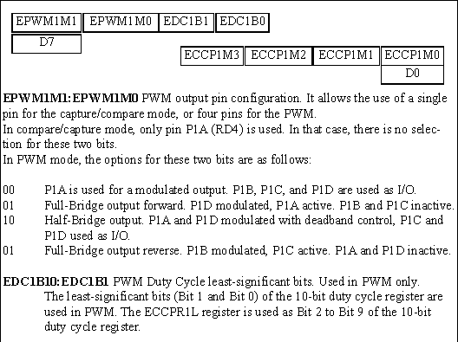
Figure 15-19. ECCP1 Control Register

Slide 20
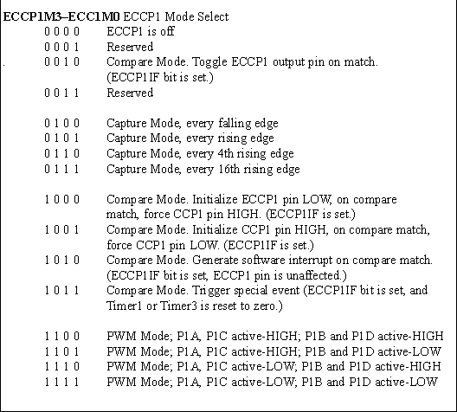
Figure 15-19. ECCP1 Control Register (cont.)

Slide 21
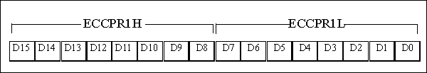
Figure 15-20. ECCP High and Low Registers

Slide 22
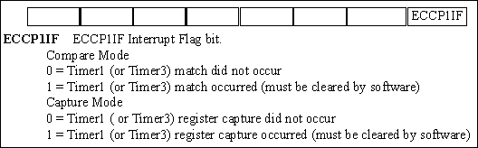
Figure 15-21. PIR2 (Peripheral Interrupt Flag Register 2) Contains the ECCP1IF Flag

