Slide 1
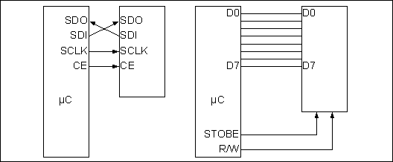
Figure 16-1. SPI Bus vs. Traditional Parallel Bus Connection to Microcontroller

Slide 2
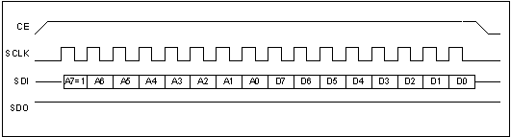
Figure 16-2. SPI Single-Byte Write Timing (Notice A7 = 1)

Slide 3

Figure 16-3. SPI Burst (MultiByte) Mode Writing

Slide 4
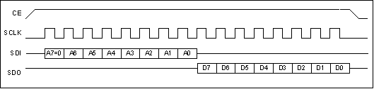
Figure 16-4. SPI Single-Byte Read Timing (Notice A7 = 0)

Slide 5

Figure 16-5. SPI Burst (MultiByte) Mode Reading

Slide 6
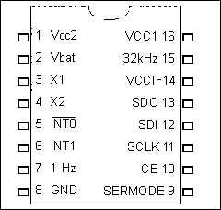
Figure 16-6. DS1306 RTC Chip (from Maxim/Dallas Semiconductor)

Slide 7
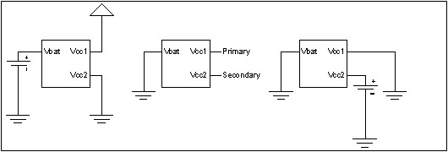
Figure 16-7. DS1306 Power Connection Options (Maxim/Dallas Semiconductor)

Slide 8
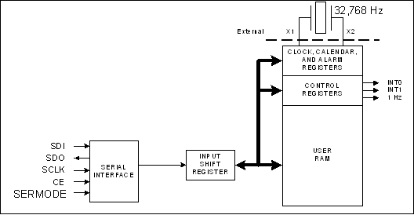
Figure 16-8. Simplified Block Diagram of DS1306 (Maxim/Dallas Semiconductor)

Slide 9
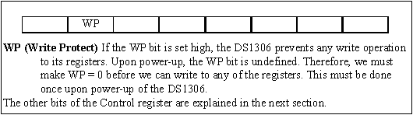
Figure 16-9. WP Bit of DS1306 Control Register (write location address is 8FH)

Slide 10
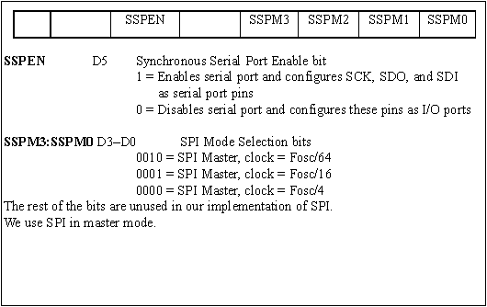
Figure 16-10. SSPCON1 - SSP Control Register 1. Note: Portion shown is used for SPI.

Slide 11
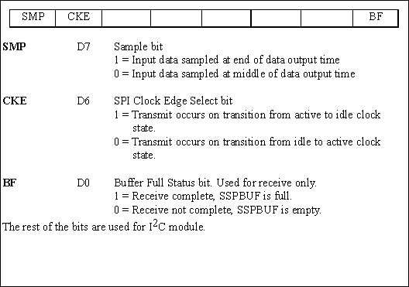
Figure 16-11. SSPSTAT - SSP Status Register. Note: Portion shown is used for SPI.

Slide 12
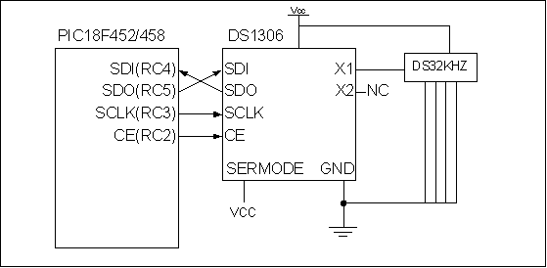
Figure 16-12. DS1306 Connection to PIC18

Slide 13
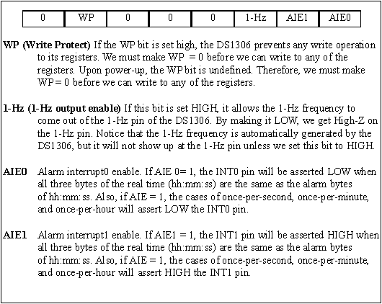
Figure 16-13. DS1306 Control Register (Write location address is 8FH)

Slide 14
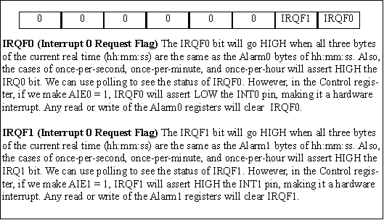
Figure 16-14. Status Register (Read location address is 10H)

Slide 15
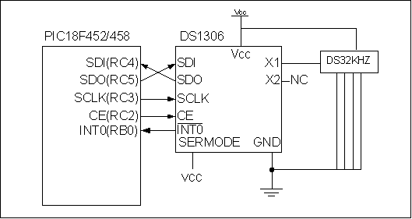
Figure 16-15. DS1306 Connection to PIC18 with Hardware INT0

Slide 16
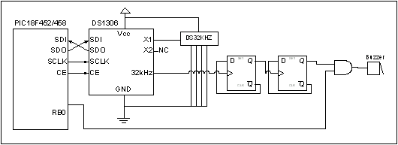
Figure 16-16. DS1306 Connection to PIC18 with Buzzer Control

