Slide 1
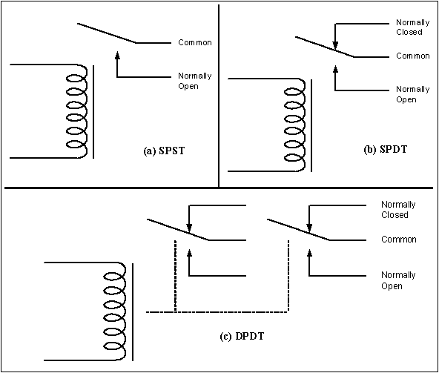
Figure 17-1. Relay Diagrams

Slide 2
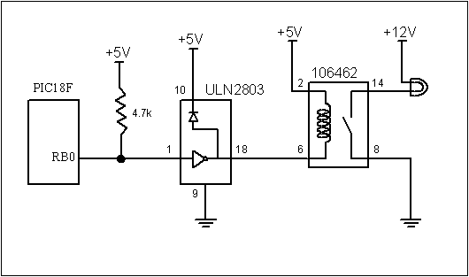
Figure 17-2. PIC18 Connection to Relay

Slide 3
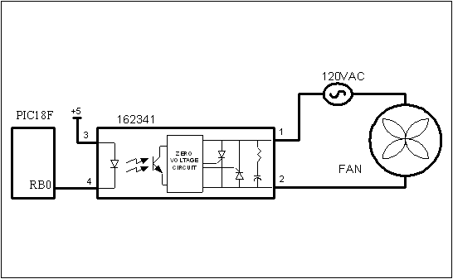
Figure 17-3. PIC18 Connection to a Solid-State Relay

Slide 4
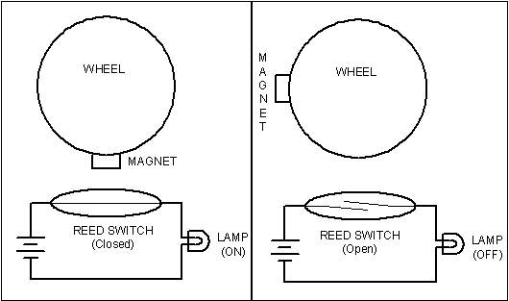
Figure 17-4. Reed Switch and Magnet Combination

Slide 5
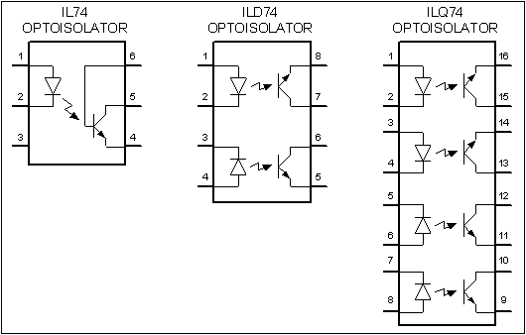
Figure 17-5. Optoisolator Package Examples

Slide 6
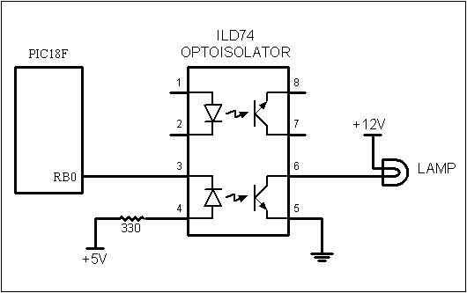
Figure 17-6. Controlling a Lamp via an Optoisolator

Slide 7
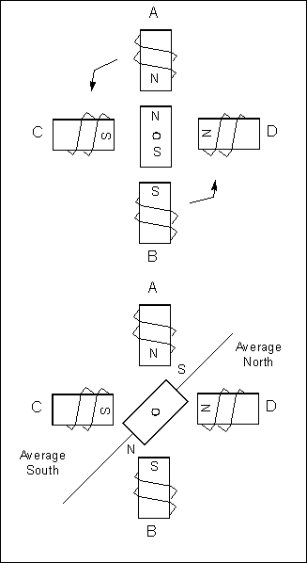
Figure 17-7. Rotor Alignment

Slide 8
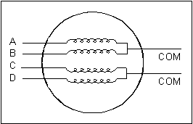
Figure 17-8. Stator Winding Configuration

Slide 9
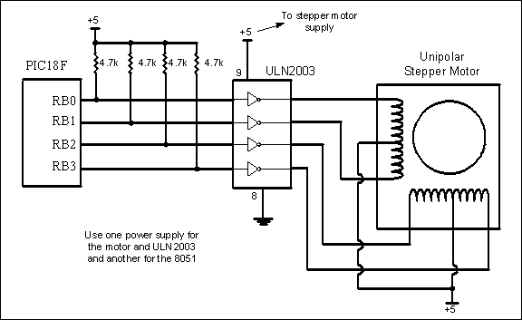
Figure 17-9. PIC18 Connection to Stepper Motor

Slide 10
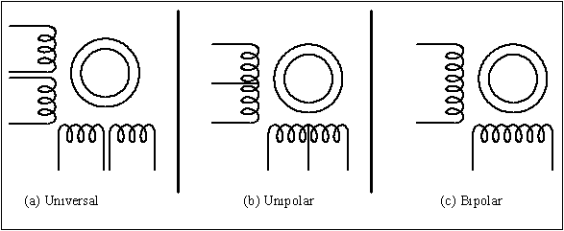
Figure 17-10. Common Stepper Motor Types

Slide 11
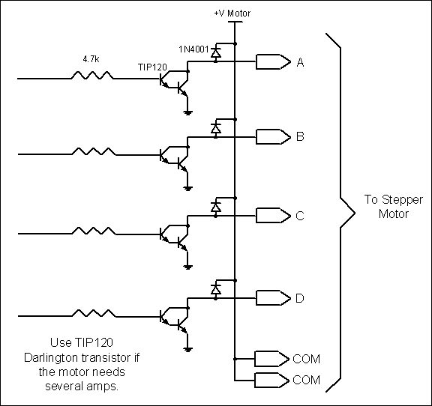
Figure 17-11. Using Transistors for Stepper Motor Driver

Slide 12
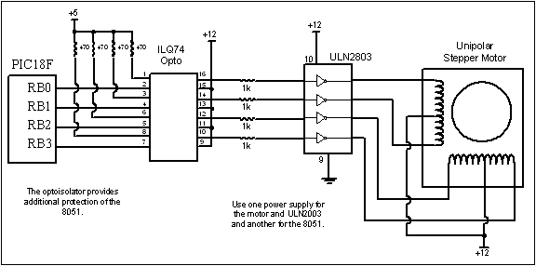
Figure 17-12. Controlling Stepper Motor via Optoisolator

Slide 13
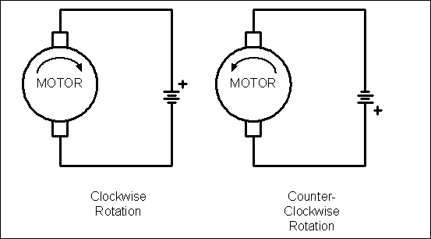
Figure 17-13. DC Motor Rotation (Permanent Magnet Field)

Slide 14
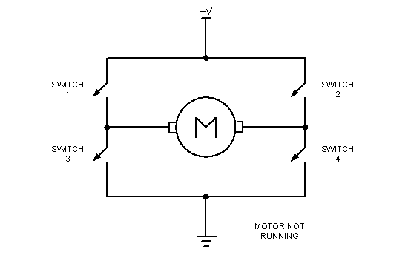
Figure 17-14. H-Bridge Motor Configuration

Slide 15
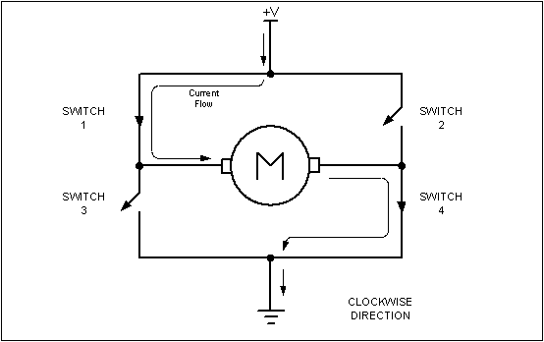
Figure 17-15. H-Bridge Motor Clockwise Configuration

Slide 16
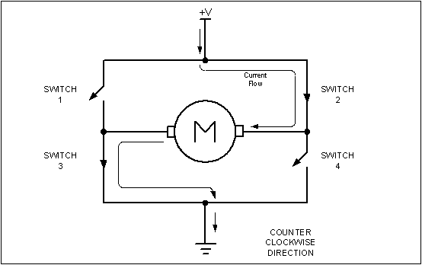
Figure 17-16. H-Bridge Motor Counterclockwise Configuration

Slide 17
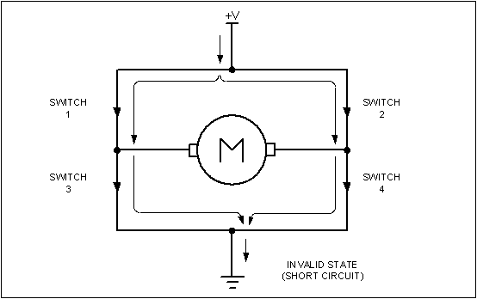
Figure 17-17. H-Bridge in an Invalid Configuration

Slide 18
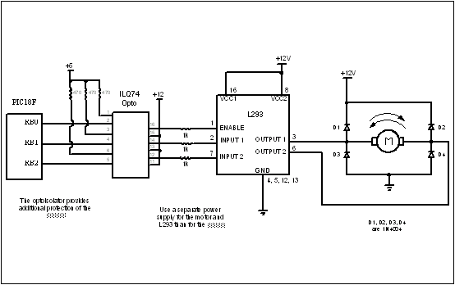
Figure 17-18. Bidirectional Motor Control Using an L293 Chip

Slide 19
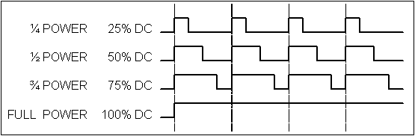
Figure 17-19. Pulse Width Modulation Comparison

Slide 20
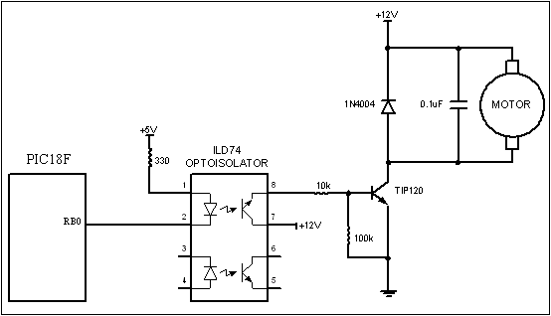
Figure 17-20. DC Motor Connection using a Darlington Transistor

Slide 21
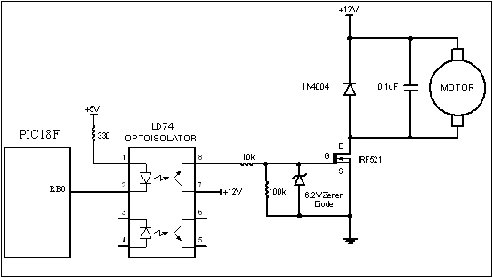
Figure 17-21. DC Motor Connection using a MOSFET Transistor

Slide 22
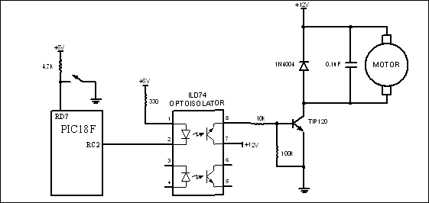
Figure 17-22: DC Motor Control Using CCP1 Pin

Slide 23
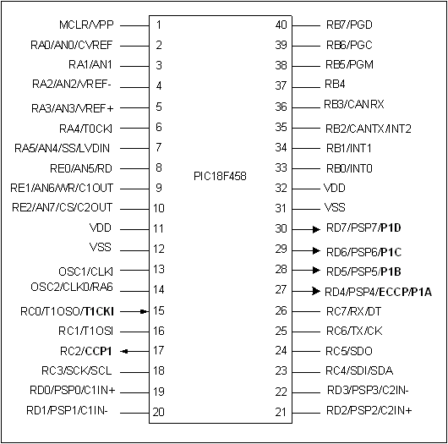
Figure 17-23. ECCP Pins for PWM in PIC18F458/4580 (452/4520)

Slide 24
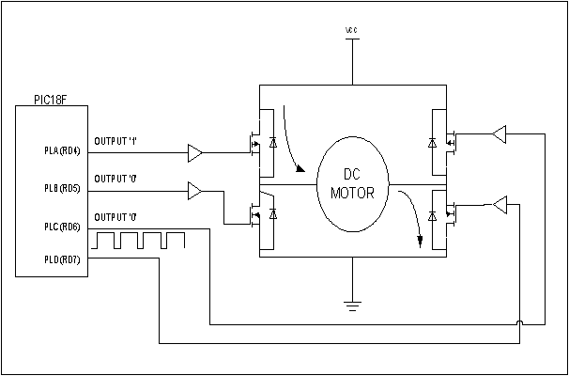
Figure 17-24. Forward Current Flow Using ECCP (from Microchip)

Slide 25
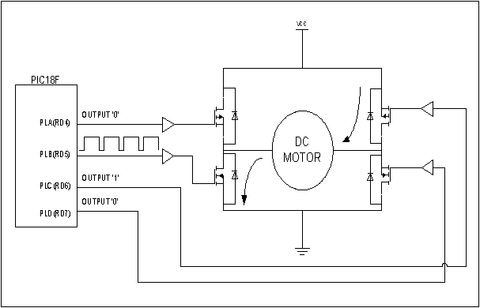
Figure 17-25. Reverse Current Flow Using ECCP (from Microchip)

Slide 26
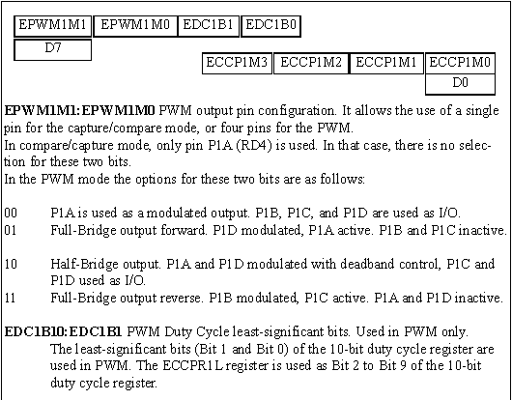
Figure 17-26. ECCP1 Control Register

Slide 27
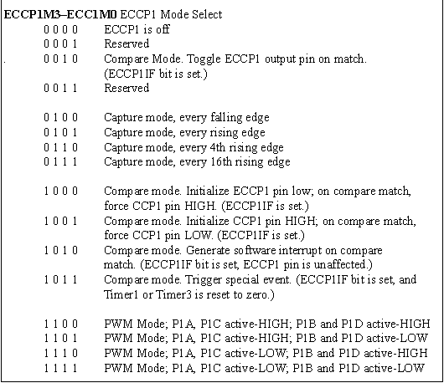
Figure 17-26. ECCP1 Control Register (cont.)

