Slide 1
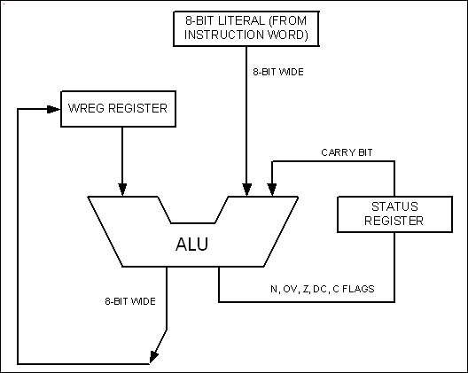
Figure 2-1. PIC WREG and ALU Using Literal Value

Slide 2
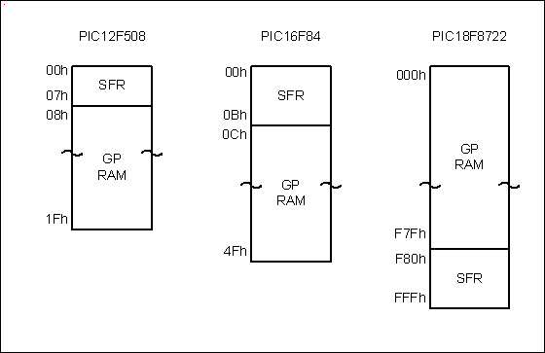
Figure 2-2. File Registers of PIC12, PIC16, and PIC18

Slide 3
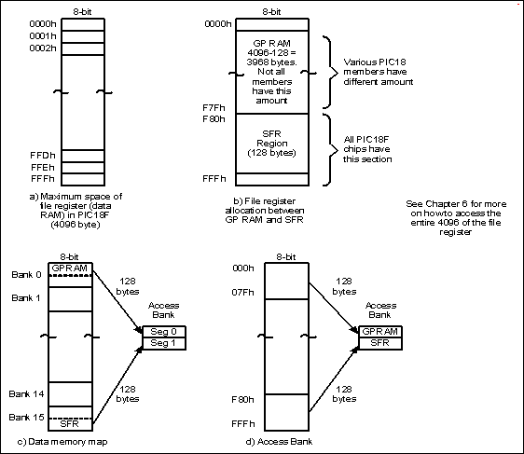
Figure 2-3. File Register for PIC18 Family

Slide 4
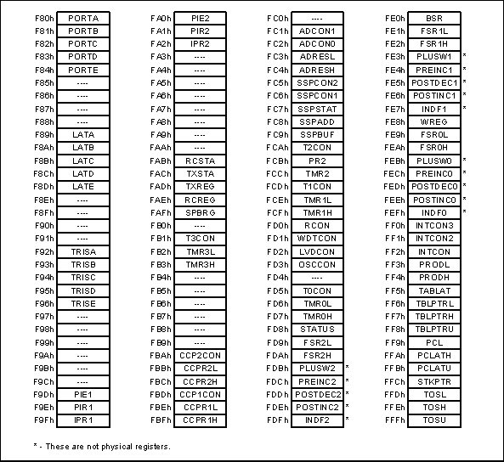
Figure 2-4. Special Function Registers of the PIC18 Family.

Slide 5
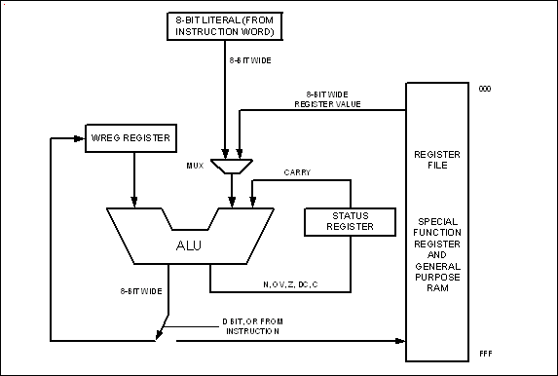
Figure 2-5. WREG, fileReg, and ALU in PIC18

Slide 6
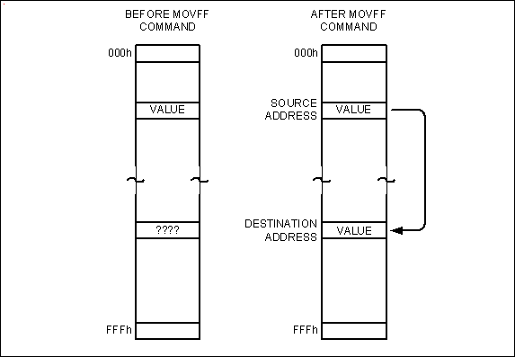
Figure 2-6. Moving Data Directly Among the fileReg Locations

Slide 7
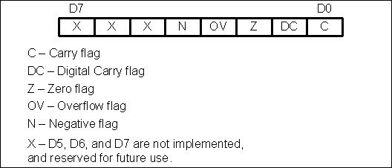
Figure 2-7. Bits of Status Register

Slide 8
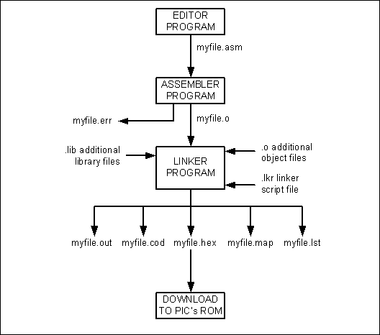
Figure 2-8. Steps to Create a Program

Slide 9
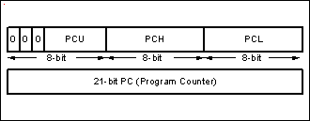
Figure 2-9. Program Counter in PIC18

Slide 10
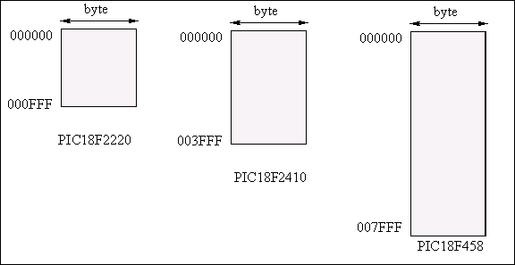
Figure 2-10. PIC18 On-Chip Program (code) ROM Address Range

Slide 11
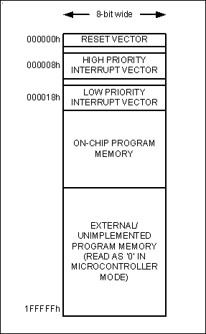
Figure 2-11. PIC18 Program ROM Space

Slide 12
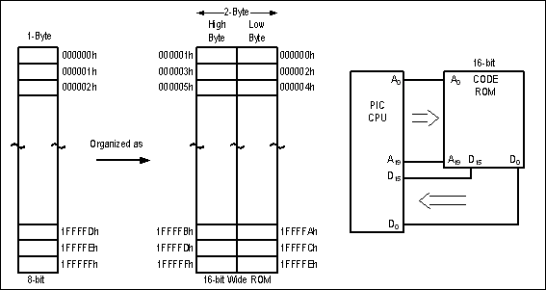
Figure 2-12. Program ROM Width for the PIC18

Slide 13
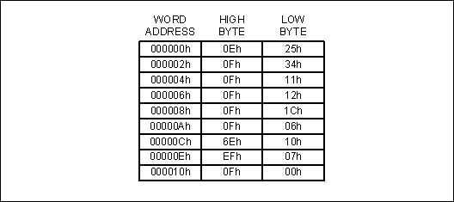
Figure 2-13. PIC18 Program ROM Contents for Program 2-1 List File

Slide 14
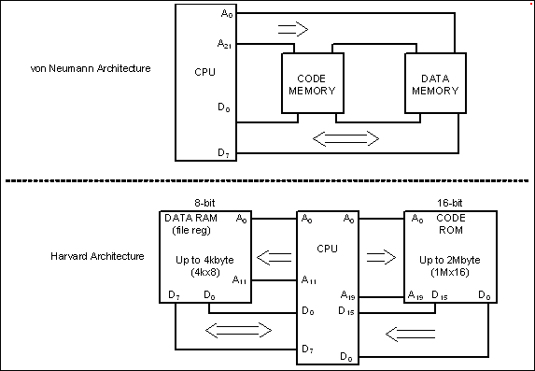
Figure 2-14. von Neumann vs. Harvard Architecture

Slide 15
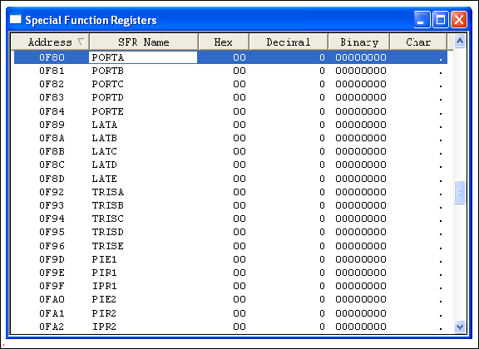
Figure 2-15. SFR Window in MPLAB Simulator

Slide 16
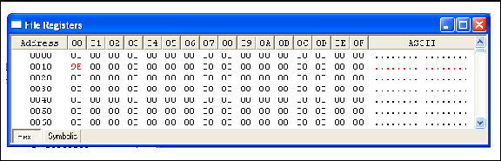
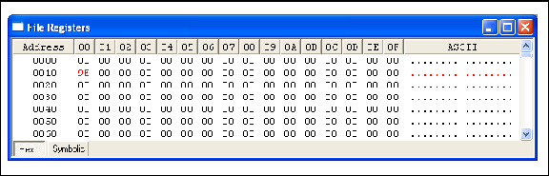
Figure 2-16. File Register (Data RAM) Window in MPLAB Simulator

Slide 17
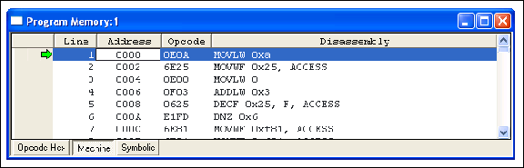
Figure 2-17. Program (Code) ROM Window in MPLAB Simulator

