Slide 1
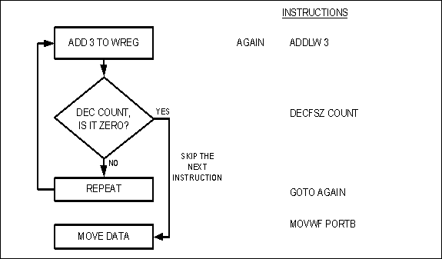
Figure 3-1. Flowchart for the DECFSZ Instruction

Slide 2
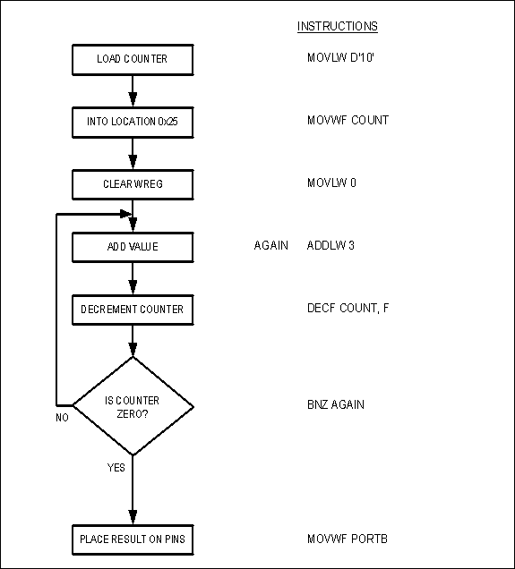
Figure 3-2. Flowchart for Example 3-2

Slide 3
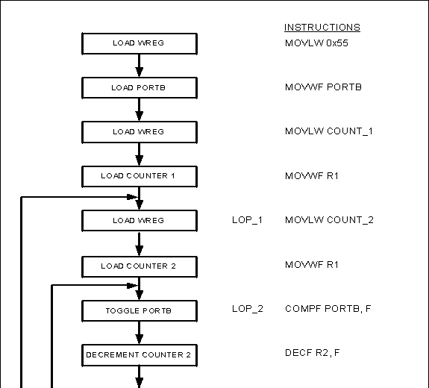
Figure 3-3. Flowchart for Example 3-4

Slide 4
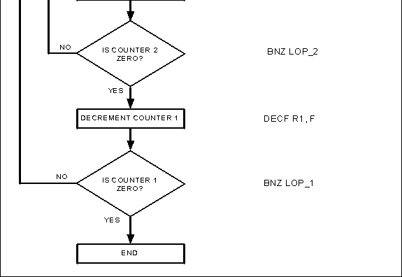
Figure 3-3. Flowchart for Example 3-4 (continued)

Slide 5
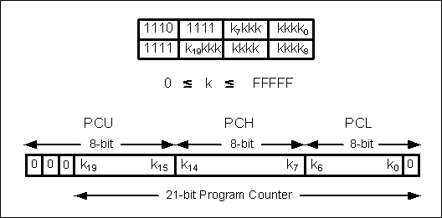
Figure 3-4. GOTO Instruction

Slide 6
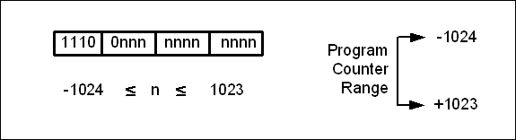
Figure 3-5. BRA (Branch Unconditionally) Instruction Address Range

Slide 7
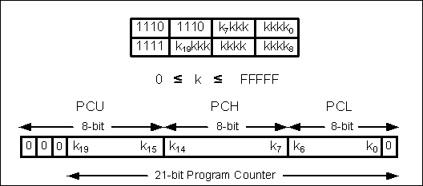
Figure 3-6. CALL Instruction

Slide 8
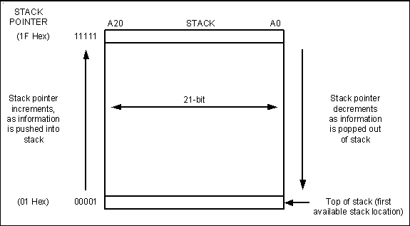
Figure 3-7. PIC Stack 31 × 21

Slide 9
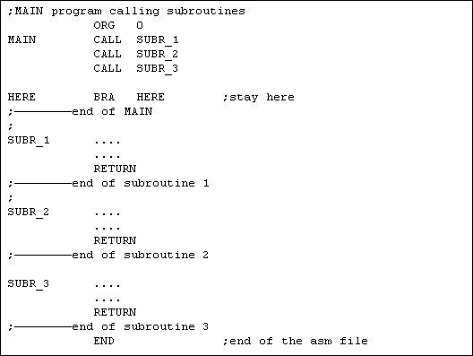
Figure 3-8. PIC Assembly Main Program That Calls Subroutines

Slide 10
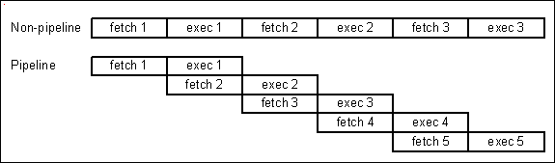
Figure 3-9. Pipeline vs. Non-pipeline

Slide 11
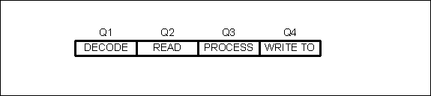
Figure 3-10. Pipeline Activity After the Instruction Has Been Fetched

Slide 12
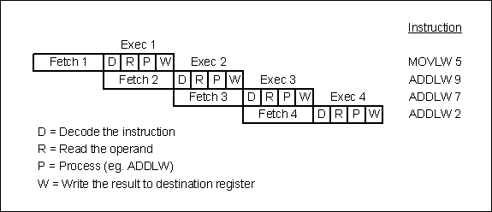
Figure 3-11. Pipeline Activity for Both Fetch and Execute

