Slide 1
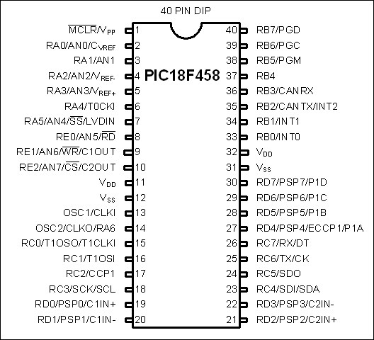
Figure 4-1. PICF458 Pin Diagram

Slide 2
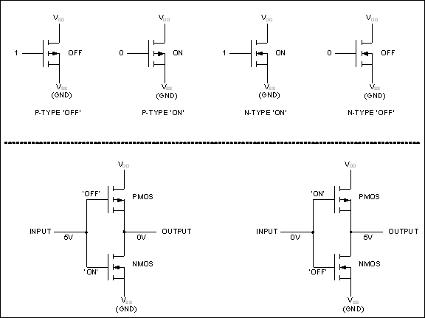
Figure 4-2. CMOS States for P and N Transistors

Slide 3
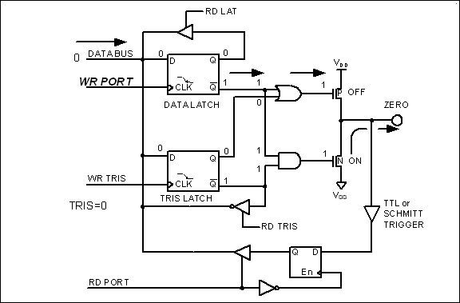
Figure 4-3. Outputting (Writing) 0 to a Pin in the PIC18

Slide 4
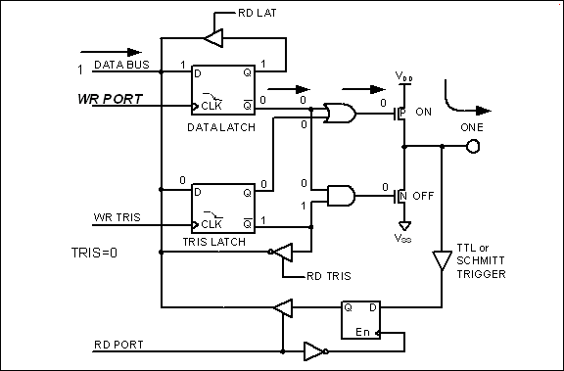
Figure 4-4. Outputting (Writing) 1 to a Pin in the PIC18

Slide 5
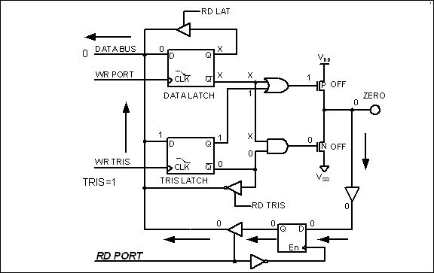
Figure 4-5. Inputting (Reading) 0 from a Pin in the PIC18

Slide 6
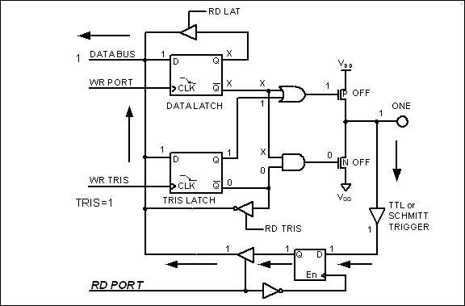
Figure 4-6. Inputting (Reading) 1 from a Pin in the PIC18

Slide 7
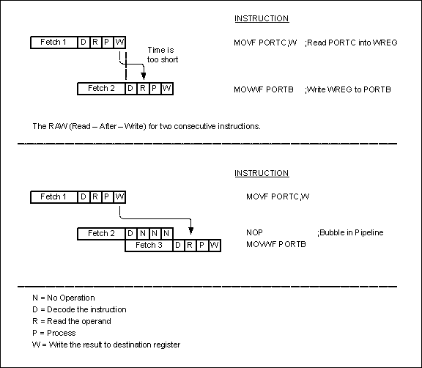
Figure 4-7. Pipeline for Read Followed by Write I/O

Slide 8
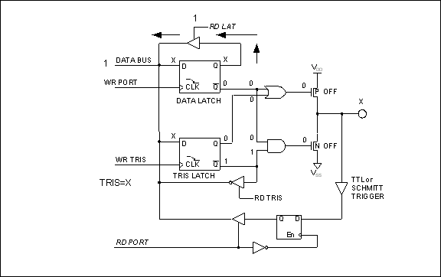
Figure 4-8. LATx Register Role in Reading a Port or Latch

