Slide 1
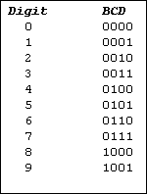
Figure 5-1. BCD Code

Slide 2
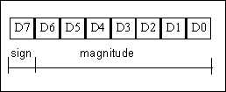
Figure 5-2. 8-Bit Signed Operand

Slide 3
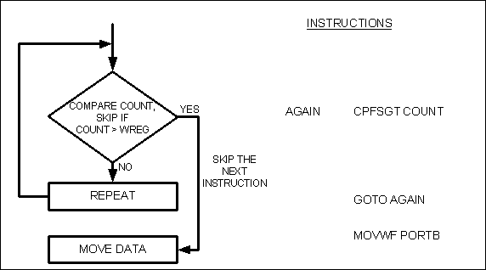
Figure 5-3. Flowchart for CPFSGT

Slide 4

Figure 5-4. Flowchart for CPFSEQ

Slide 5

Figure 5-5. Flowchart for CPFSLT

