Slide 1
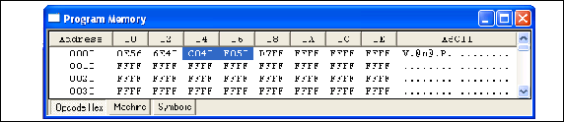
Figure 6-1a. MOVFF Direct Addressing Opcode

Slide 2
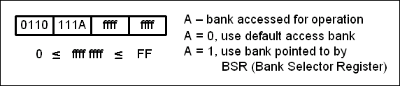
Figure 6-1b. MOVWF Direct Addressing Opcode

Slide 3
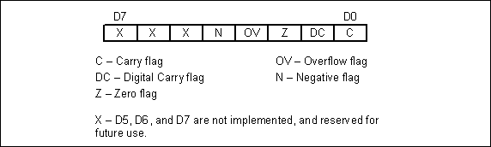
Figure 6-2. Bits of the Status Register

Slide 4
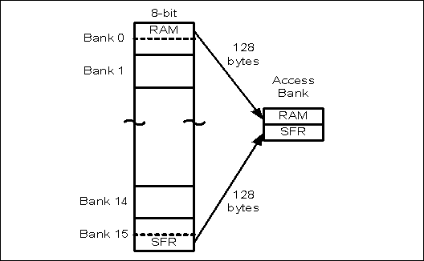
Figure 6-3. Data RAM Registers

Slide 5
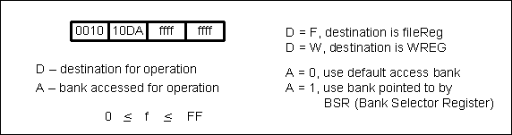
Figure 6-4. A Bit in the Instruction Field for INCF

Slide 6
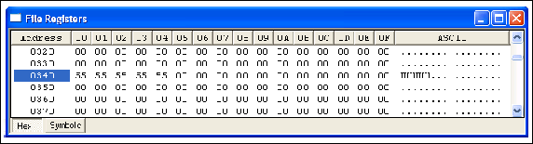
Figure 6-5. Data RAM Shown for Example 6-25

Slide 7
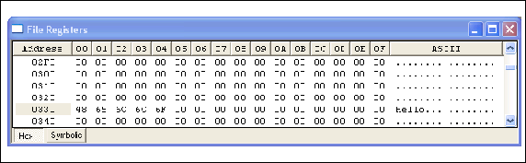
Figure 6-6. Example 6-26 Data RAM Dump in MPLAB

Slide 8
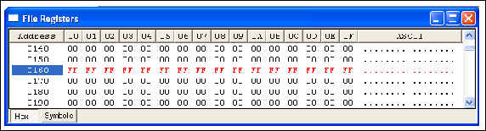
Figure 6-7. Data Example 6-27 Data RAM Dump

Slide 9
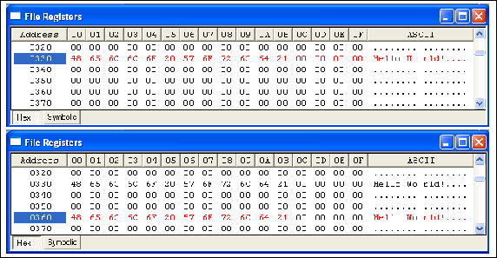
Figure 6-8. Before and After Example 6-28 is Run

Slide 10
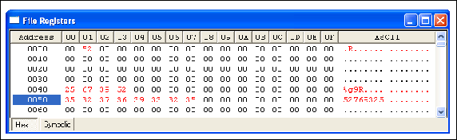
Figure 6-9. Results of Program 6-2 After it Ran.

Slide 11
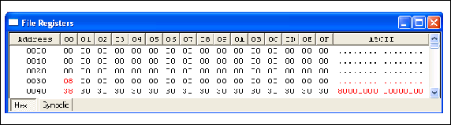
Figure 6-10. Results of Program 6-3 After it Ran. (Note the contents of locations 0030H, 0040H, and 0041H.)

Slide 12
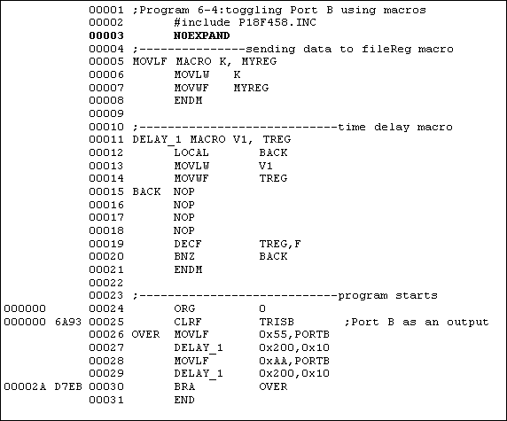
Figure 6-11. List File with NOEXPAND Option for Program 6-4

Slide 13
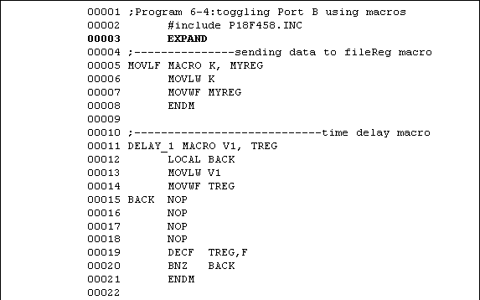
Figure 6-12. List File with EXPAND Option for Program 6-4

Slide 14
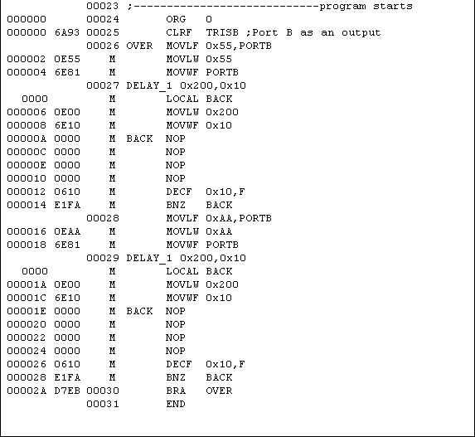
Figure 6-12. List File with EXPAND Option for Program 6-4 (cont.)

