Slide 1
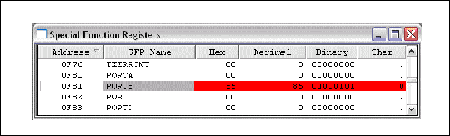
Figure 7-1. Examining the Special Function Registers Using MPLAB

Slide 2
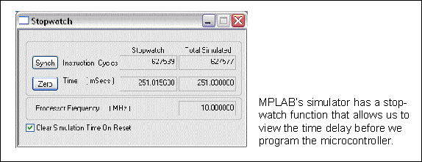
Figure 7-2. Time Delay Measurement for Example 7-8 Using MPLAB

Slide 3
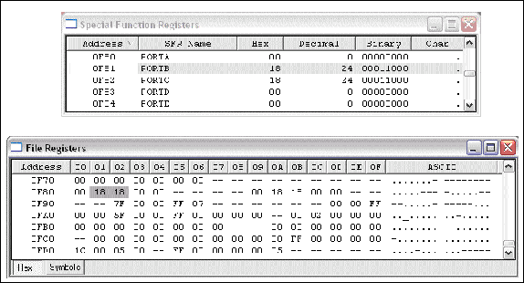
Figure 7-3. Example 7-9 Results After 24 Iterations

Slide 4
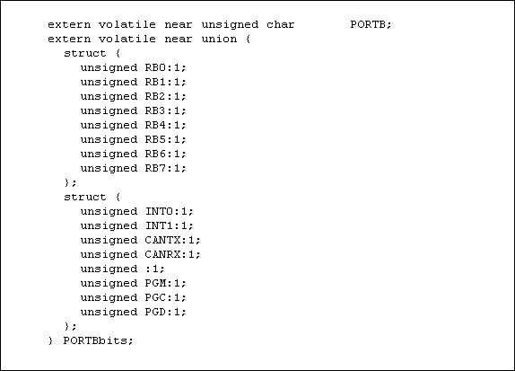
Figure 7-4. Port B Bit Structure

Slide 5
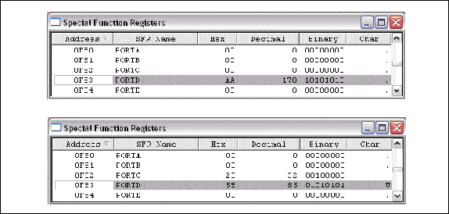
Figure 7-5. Example 7-13 Results on MPLAB Simulator

Slide 6
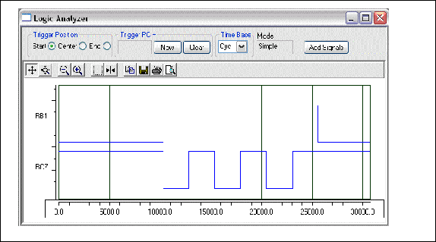
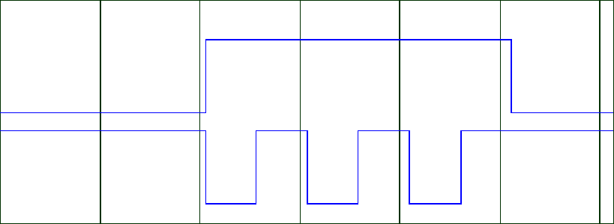
Figure 7-6. MPLAB Logic Analyzer for Example 7-14

Slide 7
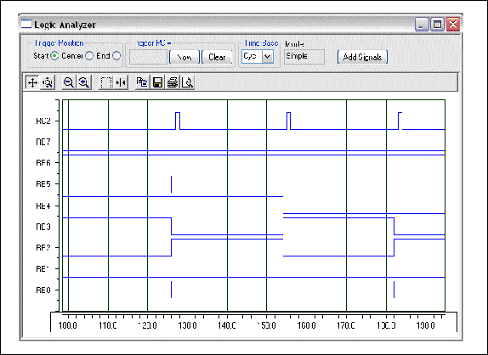
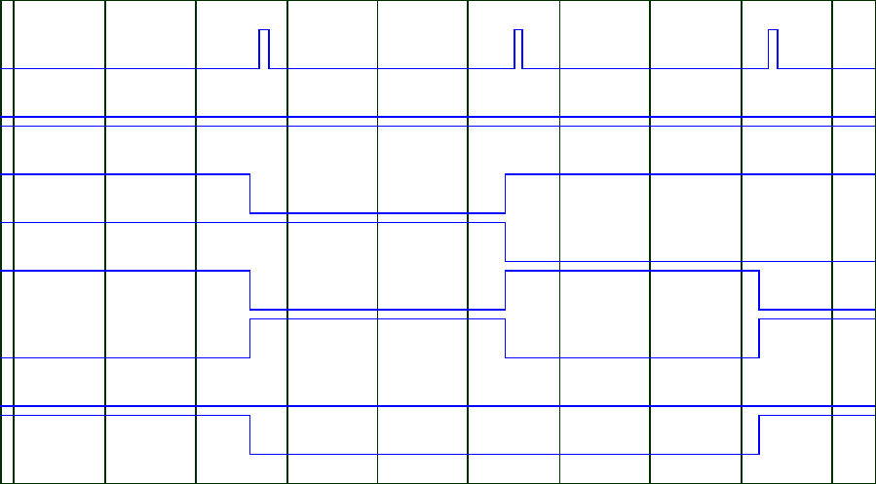
Figure 7-7. MPLAB Logic Analyzer Results for Example 7-15

Slide 8
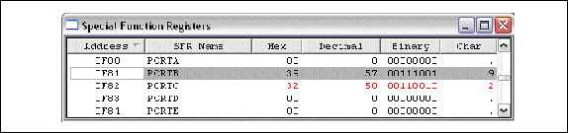
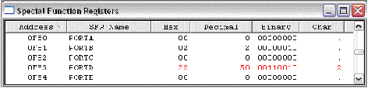
Figure 7-8. Result of Example 7-23 on MPLAB Simulator.

Slide 9
Figure 7-9. Result of Example 7-24 on MPLAB Simulator.

Slide 10
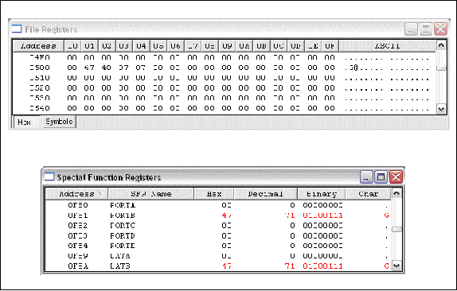
Figure 7-10. Result of Example 7-25 on MPLAB Simulator

Slide 11

Figure 7-11. Shifting Bits Out (LSB Going First)

Slide 12

Figure 7-12. Shifting Bits in (Bring in LSB First)

Slide 13
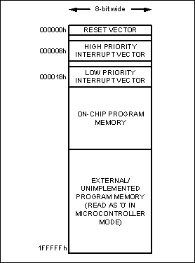
Figure 7-13. PIC18 Program ROM Space

Slide 14
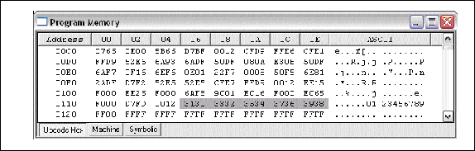
Figure 7-14. Fixed Data Placed in Program ROM as Shown in MPLAB

Slide 15
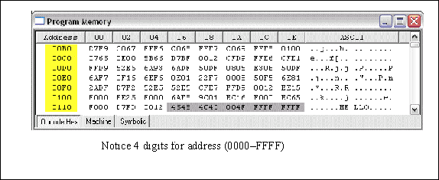
Figure 7-15. Using Near Storage Qualifier as Shown by MPLAB

Slide 16
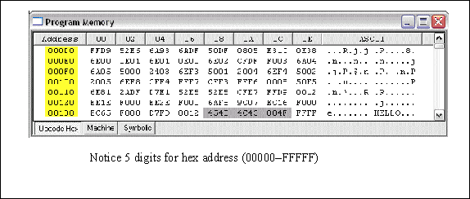
Figure 7-16. Far Storage Qualifier as Shown in MPLAB

Slide 17
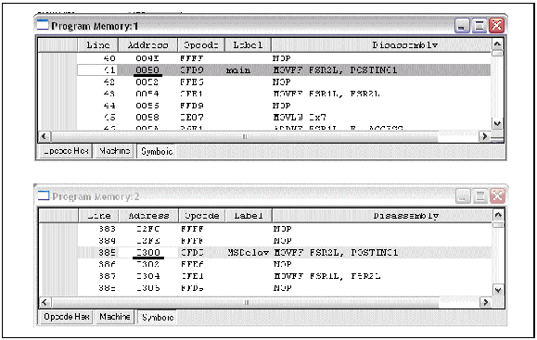
Figure 7-17. Screen Shot for Program 7-3

Slide 18
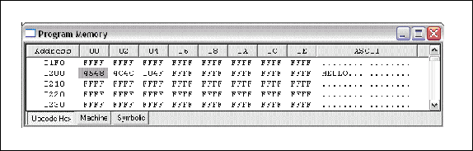
Figure 7-18. Screen Shot for Program 7-4

Slide 19
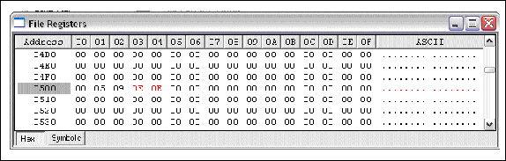
Figure 7-19. Screen Shot for Program 7-5

Slide 20
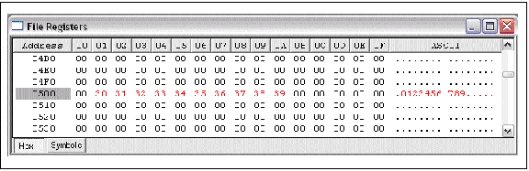
Figure 7-20. Screen Shot for Program 7-6

Slide 21
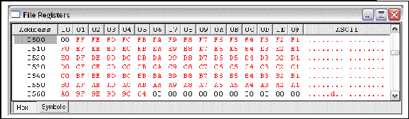
Figure 7-21. Screen Shot for Program 7-7

Slide 22
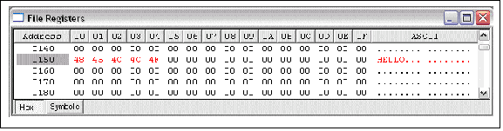
Figure 7-22. Screen Shot for Program 7-9

Slide 23
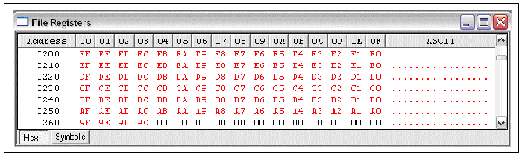
Figure 7-23. Screen Shot for Program 7-10

Slide 24
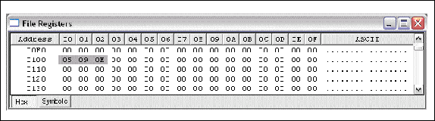
Figure 7-24. Screen Shot for Program 7-11

