Slide 1
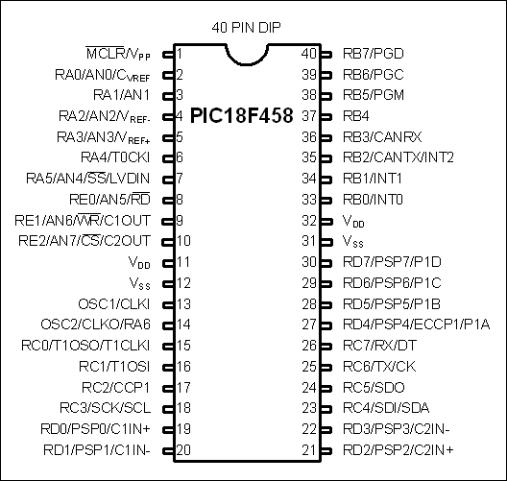
Figure 8-1. PIC18F458 Pin Diagram

Slide 2
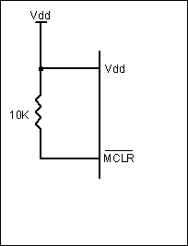
Figure 8-2a. PIC18F458 Power-On Reset Circuit

Slide 3
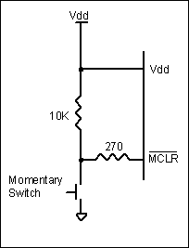
Figure 8-2b. PIC18F458 Power-On Reset with a Momentary Switch

Slide 4
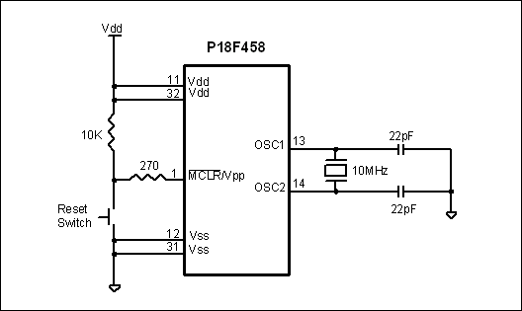
Figure 8-3. Minimum Connection for PIC18F458

Slide 5
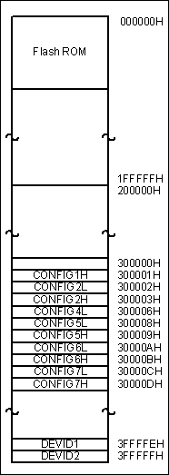
Figure 8-4. CONFIG Register Memory Map

Slide 6
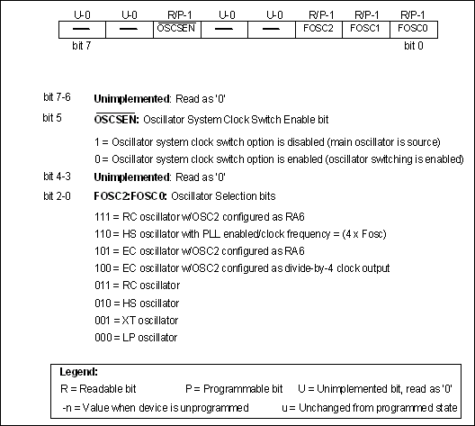
Figure 8-5. CONFIG1H Register for Frequency Selection

Slide 7
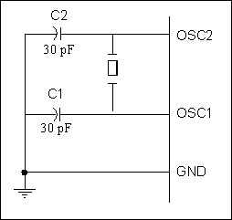
Figure 8-6a. OSC1–OSC2 Connection to Crystal Oscillator

Slide 8
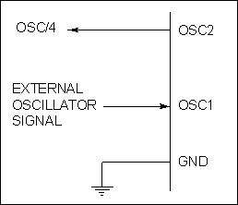
Figure 8-6b. OSC Connection to an External Clock Source

Slide 9
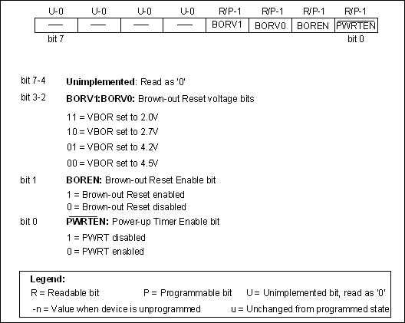
Figure 8-7. CONFIG2L Configuration Register for Reset Voltage

Slide 10
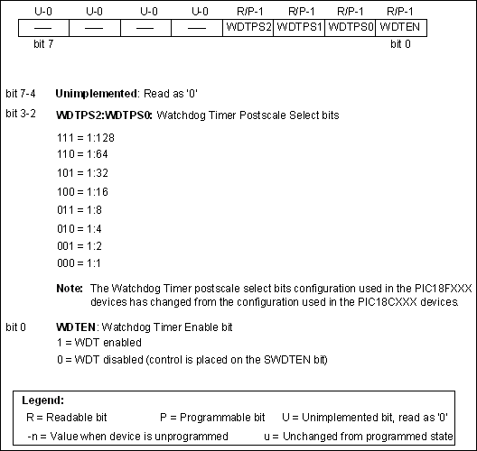
Figure 8-8. CONFIG2H Configuration Register for Watchdog Timer

Slide 11
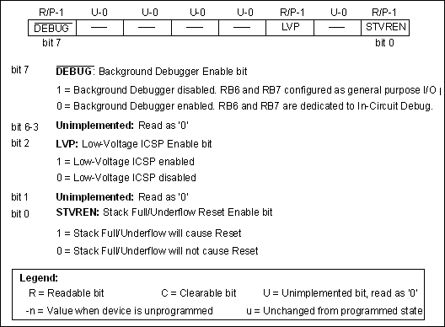
Figure 8-9. CONFIG4L Configuration Register for Background Debugger

Slide 12
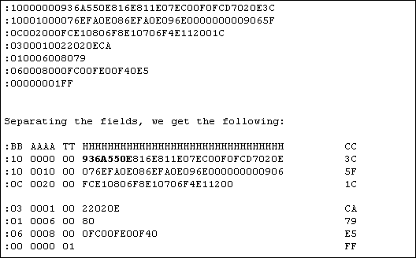
Figure 8-10. Intel Hex File Test Program with the INHX8M Option

Slide 13
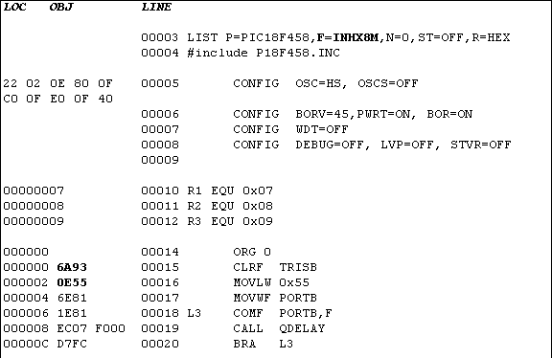
Figure 8-11. List File for Test Program with the INHX8M Option

Slide 14
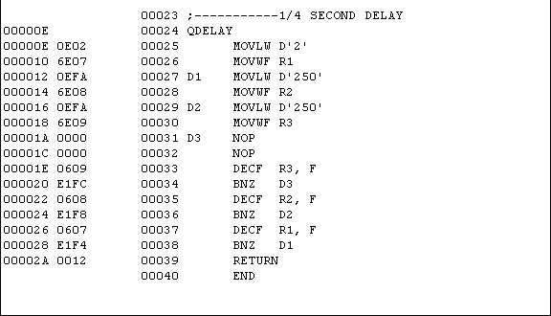
Figure 8-11. List File for Test Program with the INHX8M Option (cont.)

Slide 15
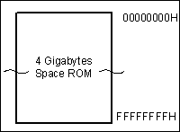
Figure 8-12. ROM Space for Chips with 32-bit Addressing

Slide 16
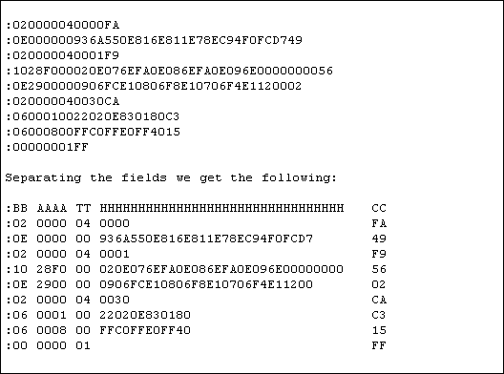
Figure 8-13. Intel Hex (INHX32) File Test Program as Provided by the Assembler

Slide 17
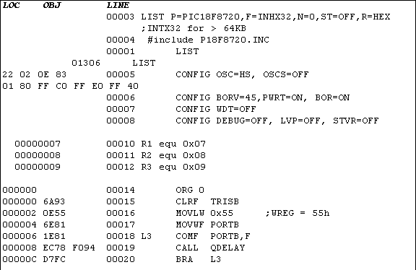
Figure 8-14. List File for Test Program with INHX32 Option (Notice ORG address for QDELAY)

Slide 18
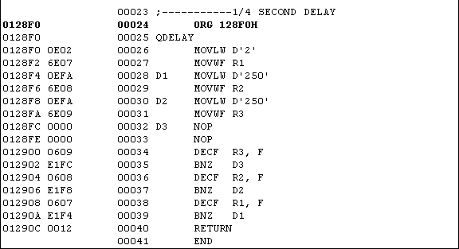
Figure 8-14. List File for Test Program with INHX32 Option (Notice ORG address for QDELAY) (cont.)

Slide 19
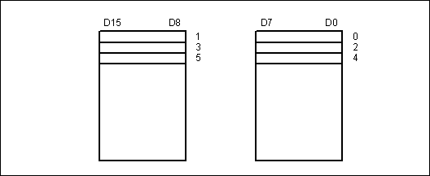
Figure 8-15. The Odd and Even Banks for External Memory of PIC18

Slide 20
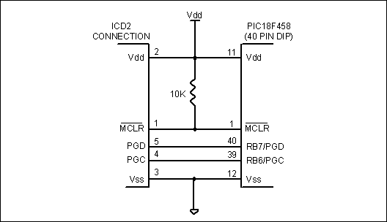
Figure 8-16. ICSP Connections

Slide 21
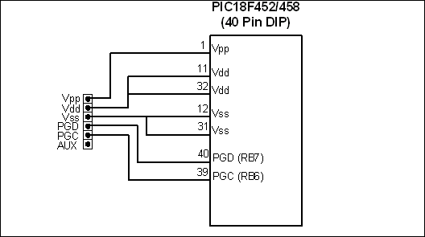
Figure 8-17. PIC18F Connection to PICkit 2 with 6-Pin Header

Slide 22
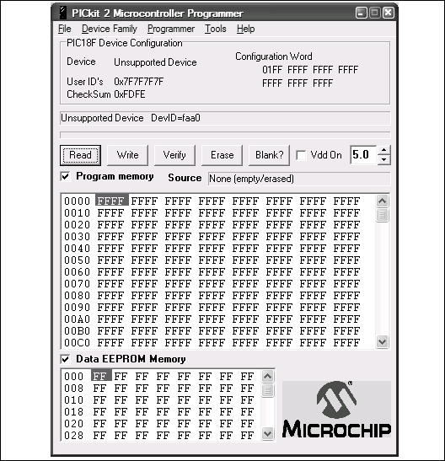
Figure 8-18. PICkit 2 Programmer Utility

Slide 23
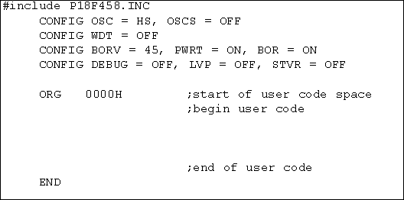
Figure 8-19: Shell of a Simple Assembly Language Program for MPLAB

Slide 24
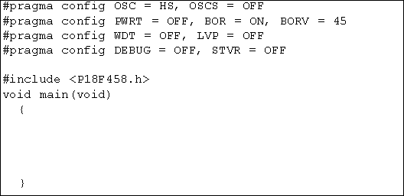
Figure 8-20: Shell of a Simple C Language Program for MPLAB

