Slide 1
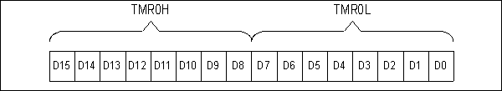
Figure 9-1. Timer 0 High and Low Registers

Slide 2
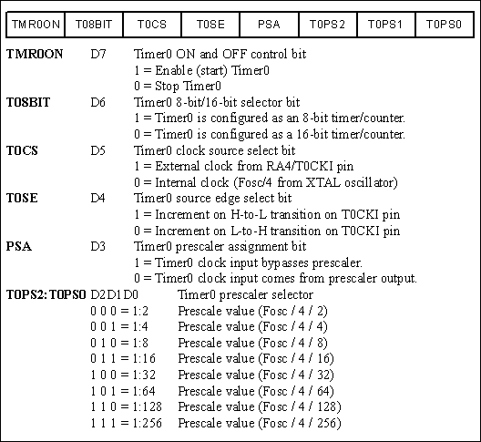
Figure 9-2. T0CON (Timer0 Control) Register

Slide 3
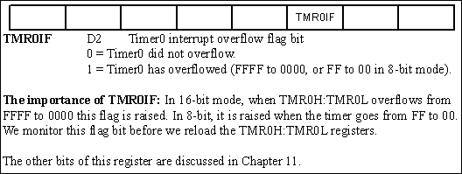
Figure 9-3. INTCON (Interrupt Control Register) has the TMR0IF Flag

Slide 4
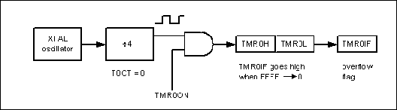
Figure 9-4. Timer0 Overflow Flag

Slide 5
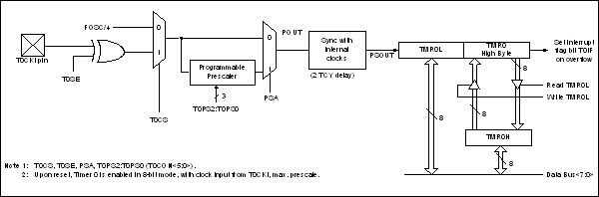
Figure 9-5. Timer0 16-bit Block Diagram

Slide 6
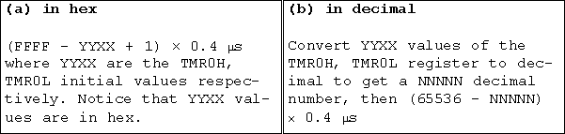
Figure 9-6. Timer Delay Calculation for XTAL = 10 MHz with No Prescaler

Slide 7
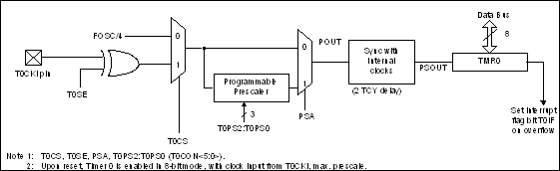
Figure 9-7. Timer0 8-bit Block Diagram

Slide 8
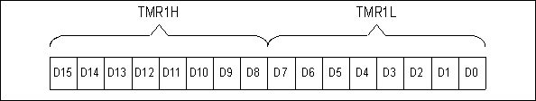
Figure 9-8. Timer1 High and Low Registers

Slide 9
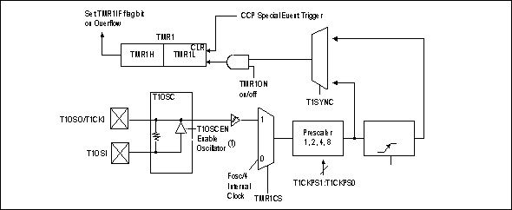
Figure 9-9. Timer1 Block Diagram

Slide 10
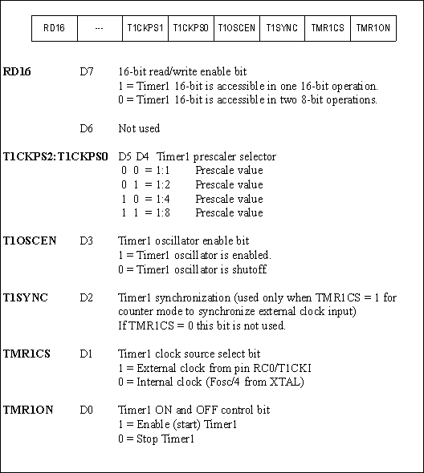
Figure 9-10. T1CON (Timer 1 Control ) Register

Slide 11
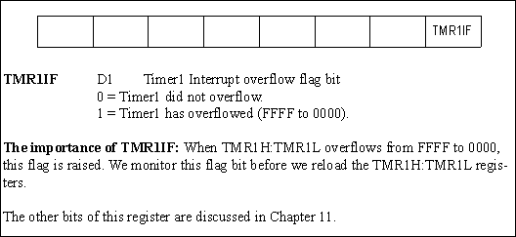
Figure 9-11. PIR1 (Interrupt Control Register 1) Contains the TMR1IF Flag

Slide 12
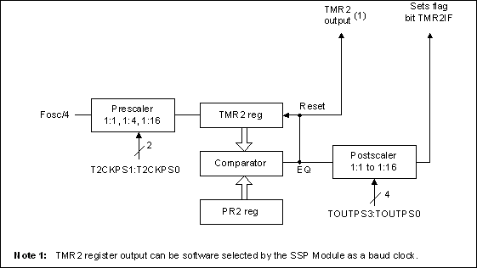
Figure 9-12 Timer2 Block Diagram

Slide 13
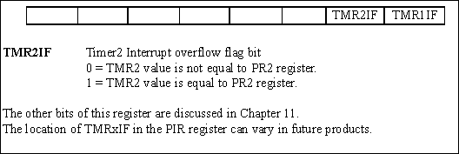
Figure 9-13. PIR1 (Peripheral Interrupt Flag Register 1) Contains TMR2IF Flag

Slide 14
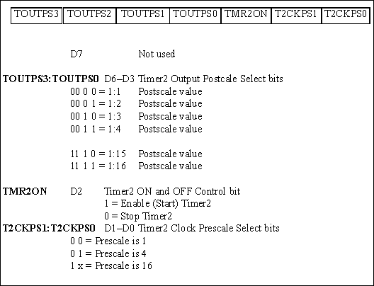
Figure 9-14. T2CON (Timer2 Control) Register

Slide 15
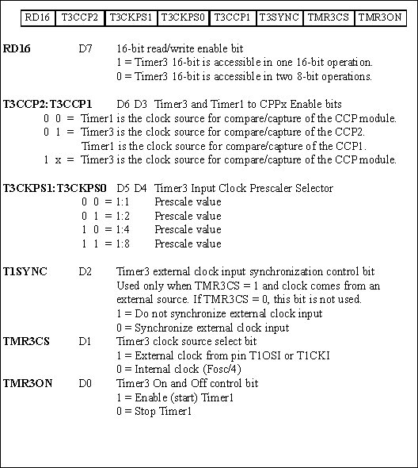
Figure 9-15. T3CON (Timer3 Control) Register

Slide 16
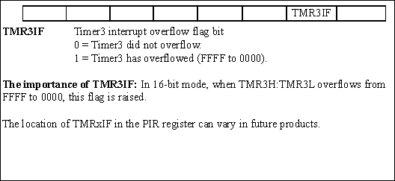
Figure 9-16. PIR2 (Peripheral Interrupt Flag Register 2) Contains the TMR3IF Flag

Slide 17
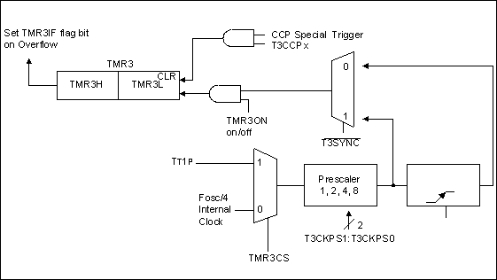
Figure 9-17. Timer3 Block Diagram

