Slide 1


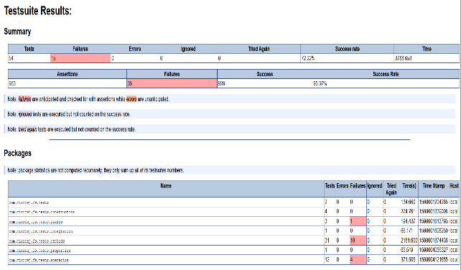



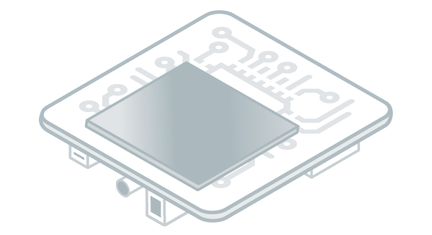


Test Suite
bin
bin
Test Suite Engine
Test 1
Test 2
Test 1
Test 2
Test 3
bin
bin
Test 3
…
Test 4
4
Build report
Test Report
bin
MicroEJ Platform
1
Build
src
Test 1
BSP Code
Test 2
Test 3
Test 4
Run
2
3
Collect results
Serial To Socket
Transmitter

