Slide 1


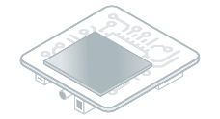

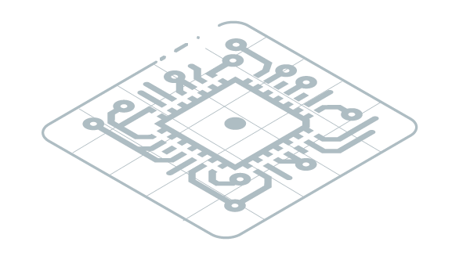

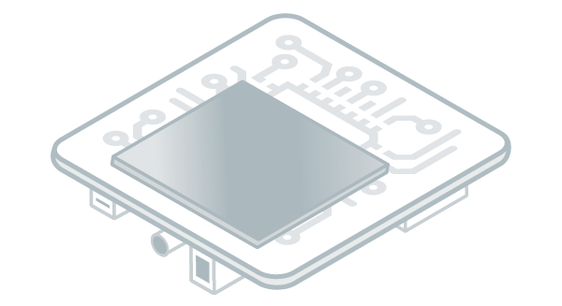

Standalone
Application
Sources
Sandboxed
Application Sources
VEE Port
Simulator
Executable Development
Application Development
Import
Build
Virtual
Device
Build
Target
Local Deploy
MICROEJ
APPLICATION
Executable
Build
Flash
Install
Publish

