Slide 1


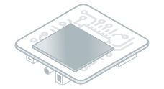

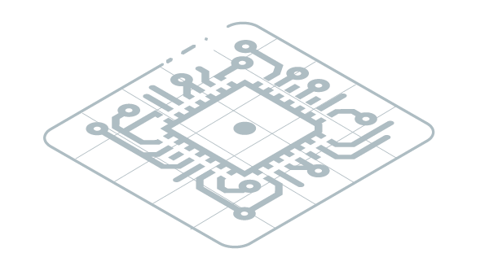

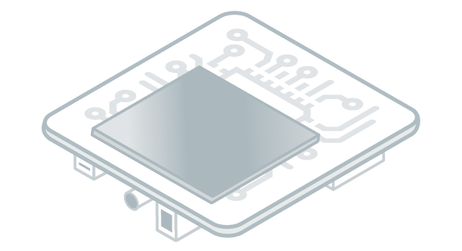

Platform
Firmware
Sources
Application Sources
Simulator
Firmware Development
Application Development
Import
Build
Virtual
Device
Build
Target
Local Deploy
MICROEJ
APPLICATION
Firmware
Build
Flash
Install
Publish

