Slide 1

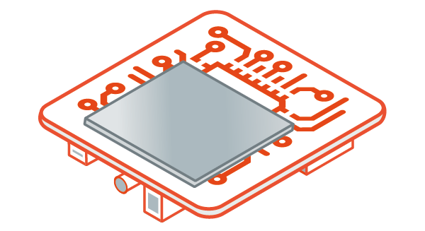


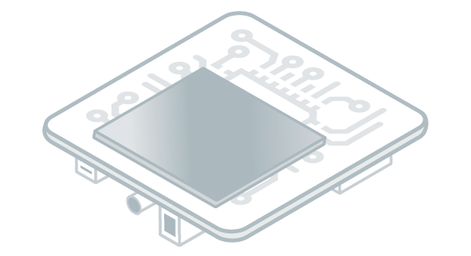


vz
vz
vzv
MicroEJ Virtual Device (.vde)
MicroEJ Firmware (binary)
Software (.exe)
Install
Install
Flash
v
vz
Your Workstation
Target
Local Deploy
with Simulator
Download & Install
Publish

