Slide 1
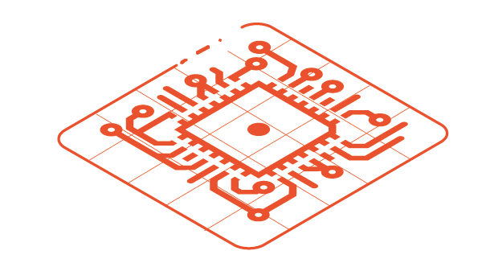

SUPPORTED LANGUAGES
bin
src
src
src
C Code
BSP drivers
+ libraries
Java Application
+ Libraries
JS Application
+ Libraries
MEJ32
C Compiler
Java Compiler
JS Compiler
Bytecode Verifier
Common Language Infrastructure (J2VM ISA)
MicroEJ SOAR : C.L.I. to MEJ32 ISA
MEJ32 ISA
ELF Linker
CPU ISA
bin
Powered by MicroEJ monolithic firmware
Application + Libraries
MicroEJ MEJ32
BSP

