Slide 1




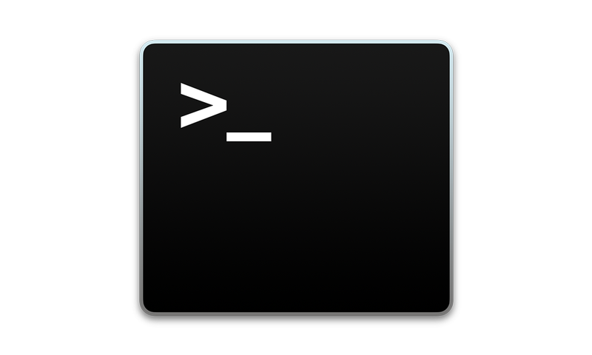


MicroEJ Module Manager
MMM CLI
Memory Map Analyzer
Heap Analyzer
Central Repository
&
Forge Repository
Font Designer
MMM Integration

