Slide 1




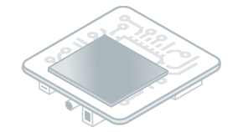


vz
Central Repository
SDK (Desktop)
Architecture
vz
Developer Repository
GitHub Repository
Module Manager

