Slide 1
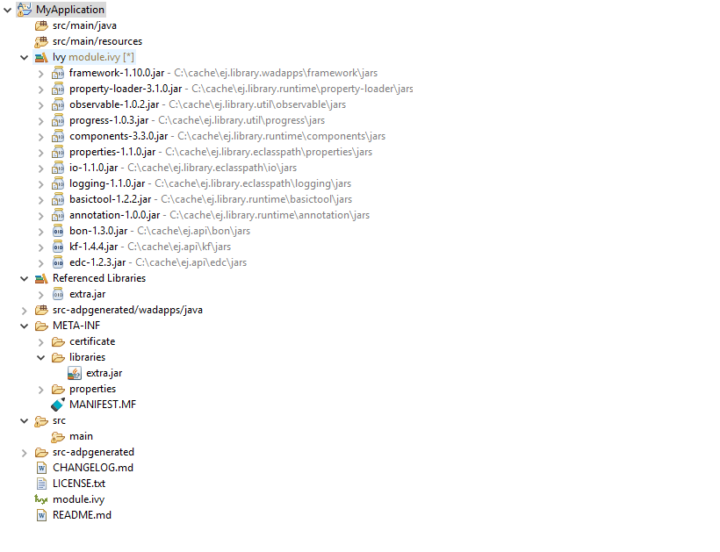
Compiled code and copied resources located in folder MyApplication/bin
Ivy transitive dependencies JAR files located in the Ivy cache folder
CLASSPATH Resolution Order
Additionnal JAR file located in
MyApplication/META-INF/libraries/extra.jar

