Slide 1
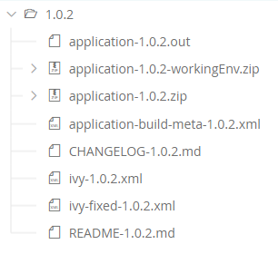
firmware-singleapp
Firmware (ELF Executable)
Build Intermediate Files
Virtual Device
MMM metadata
Changelog
MMM metadata
MMM metadata
README

