Slide 1


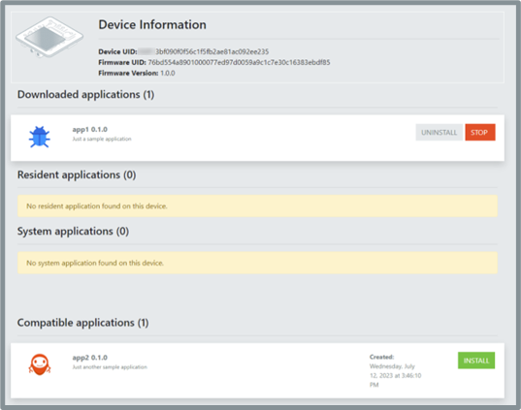
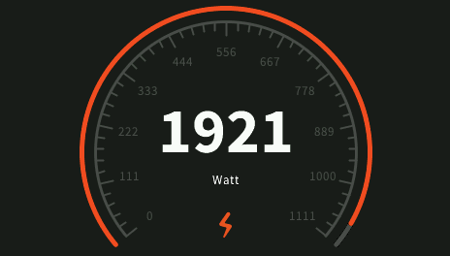

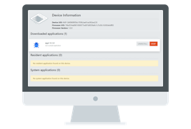

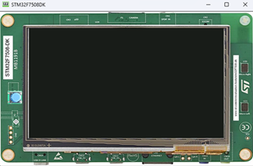
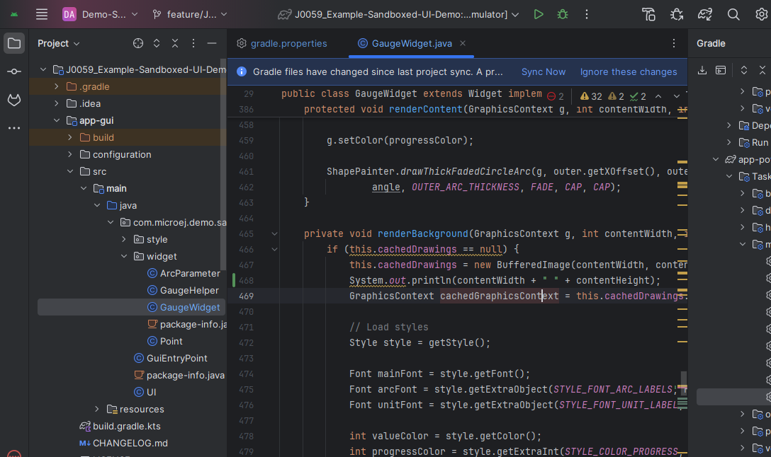




Multi-Sandbox Executable running on STM32F7508-DK
App Developer
App Administrator
GUI App
MyApp
MQTT App
Local Deploy
Dynamic code injection
App Connect
REST APIs (HTTP)
Commands,
Status,
App installation
Executable built from Kernel GREEN sources
Runs App Connect server
Applications stored in File System.
Applications executed in RAM.
MICROEJ SDK 6
APP CONNECT WEB VIEW
Sandboxed Application developed using MICROEJ SDK
Can be launched on simulator or deployed dynamically on the device.
Webapp hosted by the VEE.
Features:
Manage installed apps lifecycle
Can connect to an application store
List compatible applications with the device

Slide 2
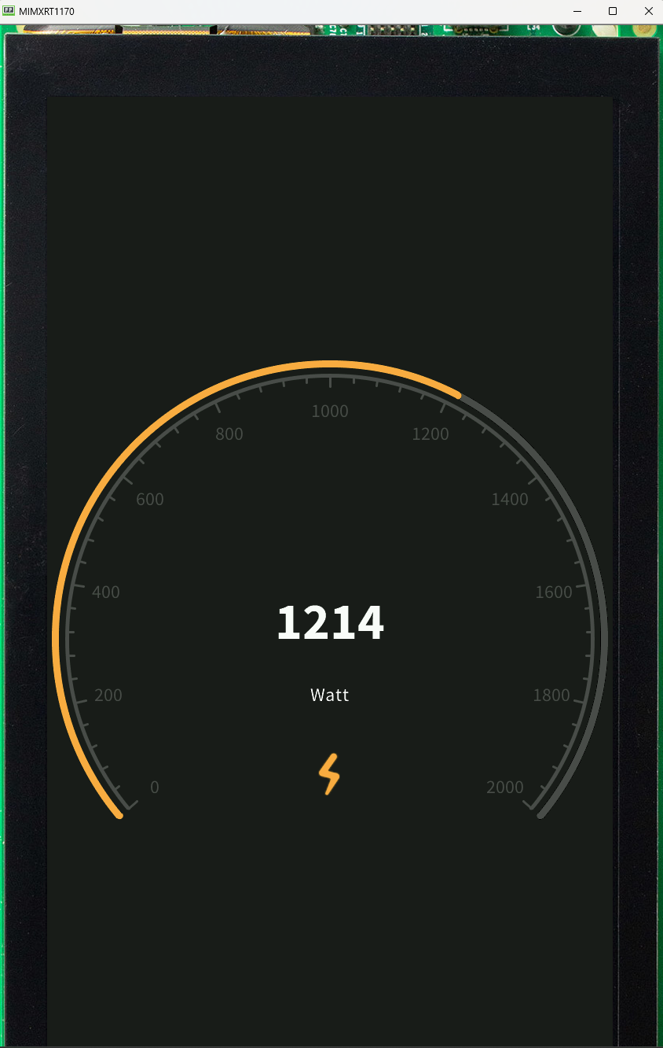
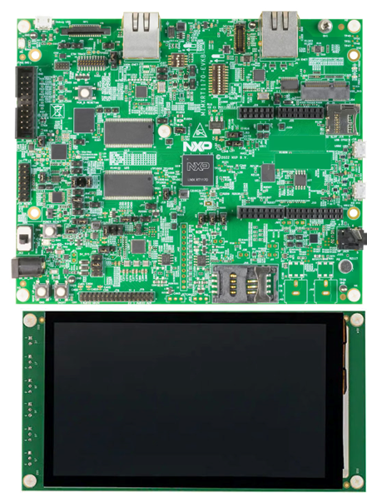
Multi-Sandbox Executable running on NXP i.MXRT1170
App Developer
App Administrator
GUI App
MyApp
MQTT App
Local Deploy
Dynamic code injection
App Connect
REST APIs (HTTP)
Commands,
Status,
App installation
Executable built from Kernel GREEN sources
Runs App Connect server
Applications stored in File System.
Applications executed in RAM.
MICROEJ SDK 6
APP CONNECT WEB VIEW
Sandboxed Application developed using MICROEJ SDK
Can be launched on simulator or deployed dynamically on the device.
Webapp hosted by the VEE.
Features:
Manage installed apps lifecycle
Can connect to an application store
List compatible applications with the device

Slide 3
