Slide 1
font
*.ttf
font
*.ejf
image
*.png
*.class
*.class
*.class
*.class
*.class
*.class
Font
Designer
Java class file
*.class
Java class files
*.jar
resource
*.*
font
*.ejf
image
*.png
image
*.jpg
image
*.bmp
*.class
*.class
*.class
*.class
*.class
*.class
*.class
*.class
*.class
*.class
*.class
*.class
*.class
*.class
SOAR
(smart linker)
Font Generator
Image Generator
MicroEJ Application executable file
MicroEJ platform
(runtime)
UI engines (C modules)
Display / Input / LED

Slide 2
font
*.ttf
font
*.ejf
image
*.png
*.class
*.class
*.class
*.class
*.class
*.class
Font
Designer
Java class file
*.class
Java class files
*.jar
resource
*.*
font
*.ejf
font
*.fnt
image
*.png
image
*.jpg
image
*.bmp
*.class
*.class
*.class
*.class
*.class
*.class
*.class
*.class
*.class
*.class
*.class
*.class
*.class
*.class
*.class
*.class
SOAR
(smart linker)
Font Generator
Image Generator
MicroEJ Application executable file
MicroEJ platform
(runtime)
UI engines (C modules)
Display / Input / LED

Slide 3
font
*.fnt
*.class
*.class
font
*.ttf
RAW
fonts
*.class
*.class
*.class
Font Generator
*.class
image
*.png
font
*.ejf
*.class
*.class
RAW fonts stored
in FLASH memory
*.class
Font
Designer
*.class
font
*.ejf
*.class
*.class

Slide 4
font
*.fnt
*.class
*.class
RAW
fonts
Font Generator
*.class
*.class
font
*.ejf
*.class
*.class
RAW fonts stored
in FLASH memory

Slide 5
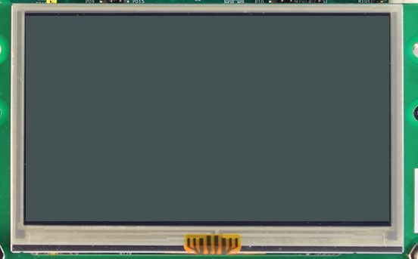
Memory
Width * Height * BPP / 8
Drawings

Slide 6
MCU
Display module
Memory
Memory
SPI
LCDC

Slide 7
MCU
Display module
Memory
LCDC
LCDC

Slide 8
MCU
Display module
Back buffer
Front buffer
Drawings
SPI
LCDC
Flush

Slide 9
MCU
Display module
Memory
Drawings
LCDC
LCDC

Slide 10
MCU
Display module
Back buffer
Front buffer
Drawings
LCDC
LCDC
Flush

Slide 11
MCU
Display module
Back buffer 3
Back buffer 1
Drawings
LCDC
LCDC
Flush
Back buffer 2

Slide 12
MCU
Display module
Back buffer 1
Front buffer
SPI
LCDC
Back buffer 2
Drawings
Flush

Slide 13
MCU
Display module
Back buffer
Front buffer
Drawings
LCDC
LCDC
Flush

Slide 14
MCU
Display module
Back buffer 1
Drawings
Front buffer
LCDC
LCDC
Flush
Back buffer 2

Slide 15

A
C
A
D
A
A
C
B
B
A
B
A
B

Slide 16
drawing
drawing
drawing
flush
drawing
drawing
flush
new region
drawing
drawing
new region
drawing
refresh
flush
post-flush
new region
drawing
drawing
refresh
flush
post-flush
new region
drawing
drawing
new region
drawing
refresh
flush
post-flush
…
new region
drawing
drawing
drawing(s)
flush
post-flush
new region
drawing(s)
drawing(s)
refresh
new region
flush
post-flush

Slide 17
Connection : Serial
no
Available RAM
for 1 buffer
yes
Available RAM
for 2 buffers
yes
no
Direct
Partial
Single
Transmit & Swap
Swap Double
Swap Triple
Available RAM
for a partial buffer
Available RAM
for 3 buffers
Available RAM
for 3 buffers
no
yes
no
yes
no
yes
Display can
change its source
buffer address
no
yes
Available RAM
for 2 buffers
no
yes
Connection : Parallel

Slide 18
Connection : Serial
Connection : Parallel
Direct
no
Available RAM
for a partial buffer
Partial
yes
no
Available RAM
for 1 buffer
no
Single
Available RAM
for 2 buffers
no
no
yes
Available RAM
for 2 buffers
Available RAM
for 3 buffers
yes
Transmit & Swap
yes
yes
no
Display can
change its source
buffer address
Swap Double
no
yes
Available RAM
for 3 buffers
Swap Triple
yes

Slide 19
0 buffer
Available RAM
for n buffer(s)
2 buffers
1 buffer
Direct
Partial
Single
Transmit & Swap
Swap Double
Swap Triple

Slide 20
Available RAM
for 2 buffers
no
yes
Display can
change its source
buffer address
no
yes
Available RAM
for a partial buffer
Available RAM
for 3 buffers
Available RAM
for 3 buffers
no
yes
no
yes
no
yes
Direct
Partial
Single
Transmit & Swap
Swap Double
Swap Triple

