Slide 1
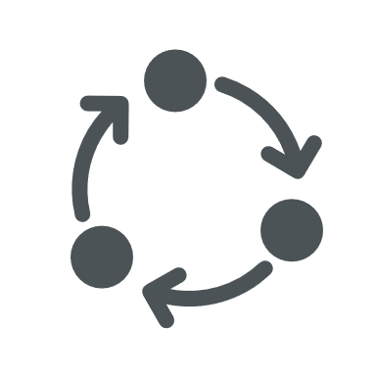
Application
(managed code)
Native
(unmanaged code)
MEJ32 Task
RTOS Task
2
RTOS Task
N
App Thread 1
App Thread N
EVENT QUEUE Thread
Call to a Java method
…
EVENT handler
…
Event Listener A
PUMP
FIFO
PUSH
…
POP
Event Listener Z
PUSH
Interrupt Handler
*

