Slide 1


Application Code
Source Project
Libraries
&
Dependencies
(including Third Party code)
(*.java)
Java Compiler (JDT)
(*.class)
(*.jar)
Bytecode Verifier
SOAR
(microejapp.o / application.fo)
Safe Runtime Execution
MEJ32 Core

Slide 2
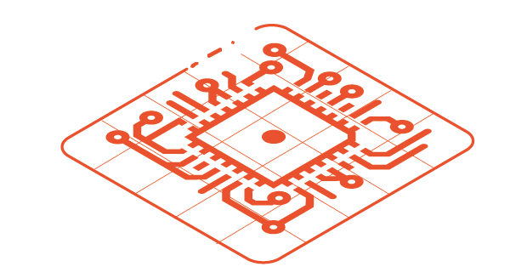

SUPPORTED LANGUAGES
bin
src
src
src
C Code
BSP drivers
+ libraries
Java Application
+ Libraries
JS Application
+ Libraries
MEJ32
C Compiler
Java Compiler
JS Compiler
Bytecode Verifier
Common Language Infrastructure (J2VM ISA)
MicroEJ SOAR : C.L.I. to MEJ32 ISA
MEJ32 ISA
ELF Linker
CPU ISA
bin
Powered by MicroEJ monolithic firmware
Application + Libraries
MicroEJ MEJ32
BSP

