Slide 1



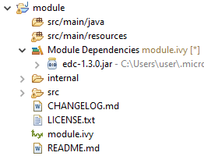

vz
Options
Settings File
Configuration
MMM
Import
Module Dependencies
vz
Module
Description
File
Build & Publish Module
Module Repository
Module Project Skeleton

Slide 2
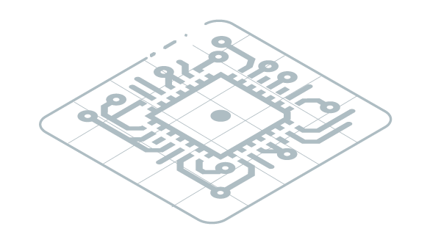

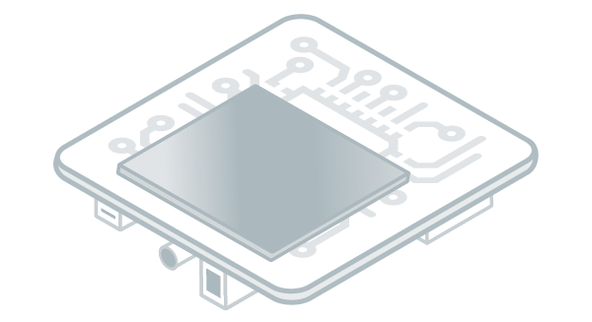

Import
Build
Virtual
Device
Build
Target
Local Deploy
MICROEJ
APPLICATION
Firmware
Build
Flash
Install
Publish

