Slide 1

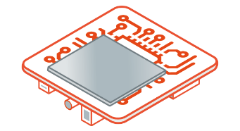



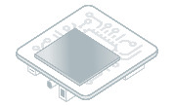


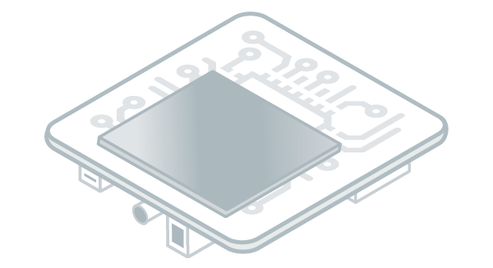

vz
vz
Software Development Tools
Platform
or Virtual Device
Install
Import
v
vz
Your Workstation
Publish
Run
Build
Download & Install
vzv
Firmware (binary)
Flash
Target
Simulator

